Slide 1
Mentoring
Cambridge Professional Development Qualifications
Presenter Name
Job title Date

Slide 2
Contents
What are the Cambridge PDQs?
How is the Cambridge PDQ structured?
What is a mentor?
What’s in it for me?
The role of the mentor in the Cambridge PDQ.
The mentor-mentee relationship.
Models of mentoring
Additional resources

Slide 3
What are the Cambridge PDQs?
Cambridge Professional Development Qualifications (Cambridge PDQs) are for practicing teachers and education leaders and are designed to enrich teaching and leadership. They are based on research evidence about the kinds of professional development that have real impact and value.
Cambridge PDQs help practising teachers and education leaders to:
engage critically with relevant educational thinking and international best practices
apply new ideas and approaches in their own practice
reflect on and share experiences and outcomes to plan further development
improve the quality of their students’ learning.

Slide 4
Cambridge International Certificate and Diploma in Teaching and Learning
Taking this programme will enable teachers to:
improve their teaching to enhance the quality of their students’ learning
integrate new ideas and approaches in their own practice and context
focus on developing effective and reflective practice to promote active learning.

Slide 5
Cambridge International Certificate and Diploma in Educational Leadership
Taking this programme will enable leaders to:
improve their leadership of the quality of learning and teaching
increase their understanding of successful leadership to develop their leadership skills
focus on developing effective and reflective leadership practice to develop their schools.

Slide 6
Cambridge International Certificate and Diploma in Teaching Bilingual Learners
Taking this programme will enable teachers to:
focus on helping bilingual learners to achieve both content and language learning objectives
develop effective and reflective practice in leading learning in curricular subjects through an additional language
contribute actively to the school’s development of bilingual education policy and practice.

Slide 7
Cambridge International Certificate and Diploma in Teaching with Digital Technologies
Taking this programme will enable teachers to:
focus on understanding the potential and use of digital technologies for best impact in teaching and learning
experiment and innovate in their own context with the opportunities offered by digital technologies
develop effective and reflective practice in leading learning using digital technologies.

Slide 8
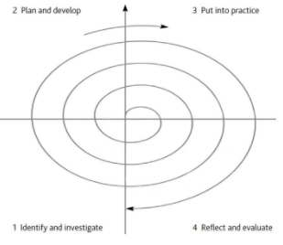
How is the Cambridge PDQ Structured?
The design of the PDQ syllabuses encourages a 'spiral of learning' by providing opportunities to plan, practice and reflect in an active and dynamic way.
We can think of the professional development spiral as having four aspects:
identifying an area of practice to be developed and researching this
planning and developing a practical application of the skills to be developed
putting this into practice with learners and/or colleagues
reflecting on and evaluating the real world practice with a mentor.
By reflecting on and evaluating on the experience further areas for development are identified – and the cycle begins again, this time incorporating new understanding and capabilities. By consciously engaging with this ‘spiral of development’ it results in higher quality teaching and leadership.

Slide 9
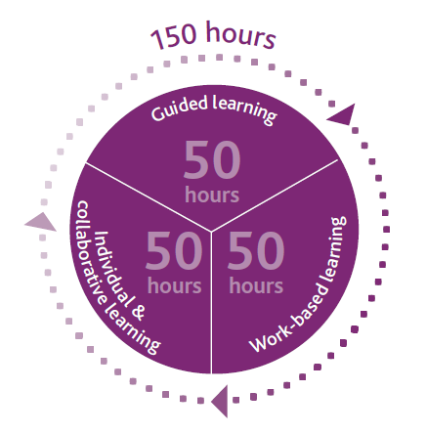
How is the Cambridge PDQ Structured?
The Cambridge PDQ is carefully structured to make the most of the spiral of learning and to ensure that candidates have the benefit of a range of different learning.
The learning for the Certificate is split equally so that candidates can be introduced to the theory in their guided learning sessions, apply the theory in their work-based learning sessions and reflect upon their experiences and extend their research and discussion in their individual and collaborative learning. This is where the mentor comes in.
Mentor’s
support
The spiral of professional learning is applied when working with the mentor and it depends on three processes:
Observation
Reflection
Learning with and from mentors
It is crucial that learners receive feedback from observations to inform their continuous reflection on their learning experiences.
Candidate is observed
Receives feedback from mentor
Candidate reflects on feedback

Slide 10
Mentors and the PDQ
“Every learner in every Cambridge PDQ programme is required to have the continuing support of an experienced and trusted colleague, who acts as their mentor. This guide will help you to prepare for mentoring and to mentor your mentees successfully to meet everyone’s needs and expectations.”
Cambridge PDQ A Guide for Mentors

Slide 11
What is a mentor?
‘A mentor is someone who takes on the role of a trusted adviser, supporter, teacher and wise counsel to another person. A mentor adopts a primarily selfless role in supporting the learning, development and ultimate success of another person … mentoring is most effective when focused clearly on the needs, goals and challenges of the person you are mentoring …’
Starr, J. (2014: 3)
Notes:
Mentoring is a powerful personal development and empowerment tool. It is an effective way of helping people to progress in their careers and is becoming increasing popular as its potential is realised. It is a partnership between two people (mentor and mentee) normally working in a similar field or sharing similar experiences. It is a helpful relationship based upon mutual trust and respect.

Slide 12
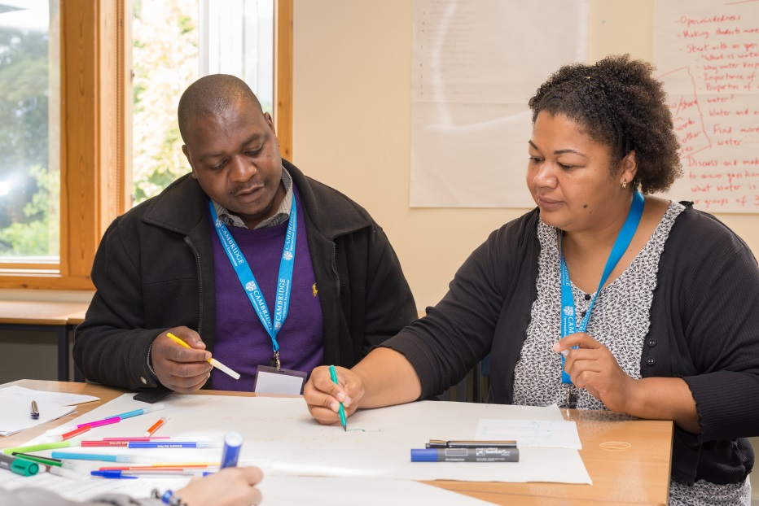
What sort of person should a mentor be?
Someone who has a genuine desire to be personally involved in the professional development of others
Someone who has the ability to communicate with others in an open and non-judgemental way
Someone who has the ability to empower others by responding to their priorities and needs rather than imposing their own.
Unsure of your mentoring skills? Try this self-assessment tool to assess your potential.

Slide 13
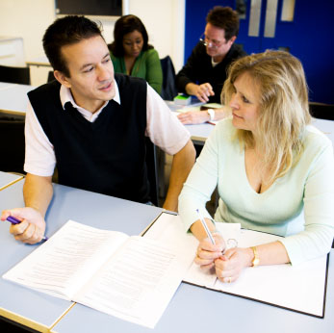
What is in it for me?
Having professional conversations with a colleague is empowering and can reignite your passions as an educator
Being nominated as a good mentor is professionally rewarding in itself and shows that you and your experience are valued
Becoming more involved in professional development can open up interesting professional pathways for you
You can demonstrate the additional responsibilities you have volunteered to take on, the skills that you have demonstrated in supporting colleagues and your enhanced understanding of professional learning on your CV.
Try this mentor self-assessment tool if you’

Slide 14
What is the mentor’s role in the PDQ?
Familiarise yourself with the PDQ syllabus
Discuss your mentees aims with them
Meet regularly with your mentee to:
Discuss and ask questions
Listen and advise
Share your experience, knowledge and enthusiasm
Keep your mentee on track
Ensure your mentee is making progress
Mentor
Attend pertinent guided learning sessions
Observe your mentee

Slide 15
What will I need to do?
Develop a relationship with your mentee. Get to know them, the PDQ and what they are hoping to achieve.
Decide upon a meeting schedule. When and where will you meet and for how long?*
Decide upon the tools you will use to structure your meetings. There are examples of these at the end of this presentation.*
Go with your mentee to observe an experienced practitioner. Spend time discussing how the lesson was effective in helping the students to learn
Observe your mentee teaching
Help your mentee to reflect on their teaching in your mentor sessions
* Your programme leader will guide you in this.

Slide 16
Spotlight on Observation
Observation is a core feature of the Cambridge PDQs. Being observed enables the mentee to develop greater awareness of their strengths and areas for development, and provides a stimulus for professional dialogue.
As a mentor you will want to create a learning environment that:
offers challenge
supports risk taking
permits failure as a learning experience
encourages experimentation and trying out new things
involves reflection before, in and on practice.

Slide 17

The Structure of the Observation
When Cambridge examines the portfolio, we do look for evidence of the effectiveness of the observation and feedback for the further development of the candidate.
Pre-observation discussion
        When you meet your mentee before the observation clarify with them the intended outcomes for observation (not the lesson). Agree a focus for the observation: This focus will partly be guided by the assessment requirements. Ask them for their lesson plan and any other relevant resources

Slide 18
The Structure of the Observation
The Observation
In the observation you should focus more on what the learners are doing and their learning rather than on the ‘teaching’. For example if the timekeeping or voice projection is an issue you should state this, but these issues of delivery should not be the focus of the observation.
Remember to focus on the learning more than the teaching activities. Consider:
what the learners are doing – are they engaged, attentive, thinking?
how the teacher interacts with the learners – are they contributing, relaxed?
what is going on and why – you can note ‘this happened… because…’.
are the learners contributing and actively engaged with their learning?
are all learners included, are they challenged and supported?
were the resources appropriate?
how did the teacher check understanding throughout the lesson (formative assessment)?
did the teacher ask for learner feedback? If so, how and how are they using the feedback?
NB – to repeat: Observation for the PDQs is formative, for the benefit of your mentee’s professional learning and development. You should not assess your mentee summatively, nor share the observation report for the purpose of a performance appraisal.

Slide 19
The Structure of the Observation
Post-observation Discussion.
Schedule your post-observation discussion soon after the observation. Give your comments in a way that assists your mentee to discuss and reflect on the lesson. Ask questions and be curious about how and why they approached aspects of the lesson. Encourage your mentee to be articulate and clear about their thinking. Approach the post-observation discussion as a chance for self-reflection and sharing of experience.
Your mentee will want your feedback on the lesson and you should aim to provide this in a way that will benefit and encourage their practice. Always start with the positives! Be specific and be prepared to enter into a conversation. Check that your mentee understands your comments– and whether they agree.

Slide 20
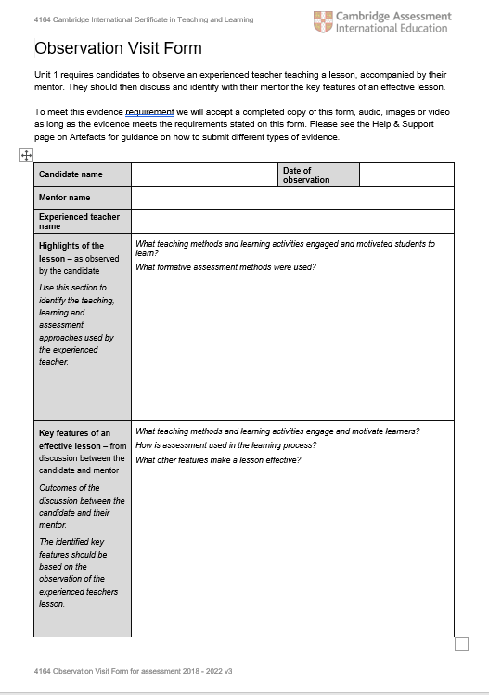
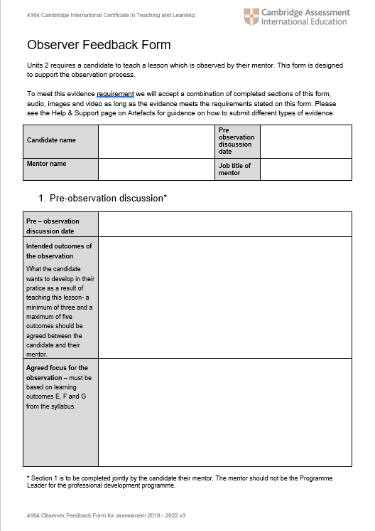
Observation Tools
The programme leader will introduce you to the Cambridge templates for the observations. These consist of:
A pre-observation record form which is completed by the mentee
An observation form to help you to focus on the important elements of the lesson. This is completed by the mentor
A post-observation record form which is completed by the mentee

Slide 21
The Mentor-Mentee Relationship
In the Guide for Mentors, Cambridge suggest the mentoring relationship might look a little like this:
Discuss mutual goals
Build trust and confidence
Model and assist
Acknowledge and appraise
Explain and share strategies
Stage One – The mentee is more dependent
Observe
Give and receive feedback
Challenge and question
Offer options
Promote reflection
Stage Two – The mentee grows increasingly independent
Two way dialogue
Plan collaboratively
Decision making and problem solving
Reflective practice
Stage Three – The mentee and mentor are interdependent
Notes:
Every mentor-mentee relationship will look slightly different, but this is the model to which each partnership should aspire. As with acquiring any new skill the initial stage is the most challenging and requires the most support – riding a bike analogy – but as the mentee’s knowledge and experience grows they gain some independence and can reflect on the positive and negative experiences they have had. Finally, the mentee feels confident enough in their knowledge and experience to benefit from a more collaborative relationship with their mentor.

Slide 22
Models of Mentoring
During your mentor meetings the GROW model might help to guide your discussions by providing a structure for your questions:
      G – Goal – what do you want to achieve?
      R – Reality – where are you now, what will you need to do?
      O – Options – how can you approach this challenge?
      W – Will – how committed are you to the challenge?
Notes:
This model offers some practical advice for how to structure mentoring sessions and the GROW questions can be applied to a range of teaching experiences, e.g.
What do you want to achieve in writing a new scheme of work?
What will you need to do to complete this activity in terms of materials, resources and time?
What options do you have to complete the scheme of work? Working with colleagues, using text books, using on-line resources?
What is driving you to complete this work? What will your learners gain? What will you gain?

Slide 23

Resources
In addition to the Guide for Mentors, Cambridge have produced Getting Started With Mentoring:
The Getting Started with guide covers the following:
What is mentoring?
The benefits of mentoring.
The research behind mentoring
Misconceptions around mentoring
Mentoring in practice
Mentoring tools and strategies
Mentoring checklist and next steps

Slide 24
Bibliography
Bartell C (2014: 135) in Murray J (2014) Designing and Implementing Effective Professional Learning. London: Corwin Press ISBN: 978-1452257792
Starr, J. (2014) The mentoring manual: your step by step guide to becoming a better mentor. Harlow: Pearson Education. ISBN: 978-1292017891
Clutterbuck D (2004) Everyone Needs a Mentor: fostering talent in your organisation, 4th ed. London: Chartered Institute of Personnel and Development
Cambridge Professional Development Qualifications: A Guide for Mentors (2015) Cambridge International Examinations. Available at: http://www.cie.org.uk/images/304230-a-guide-for-mentors.pdf

Slide 25
Thank you

