Slide 1

Lesson Objectives:
Describe the structure of personality
Describe the parts of the mind
Explain the psychodynamic theory of forgetting

Slide 2

Talking point: ‘Sometimes, we forget things on purpose’ Discuss.

Slide 3
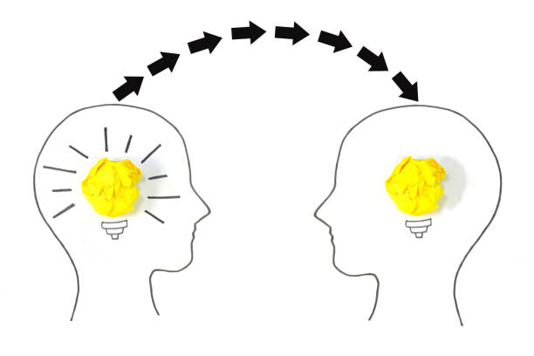

Actively listening to each other
Justifying contributions / engaging with others’ views
Respectfully challenging others’ views
Sharing ideas

Slide 4

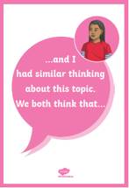


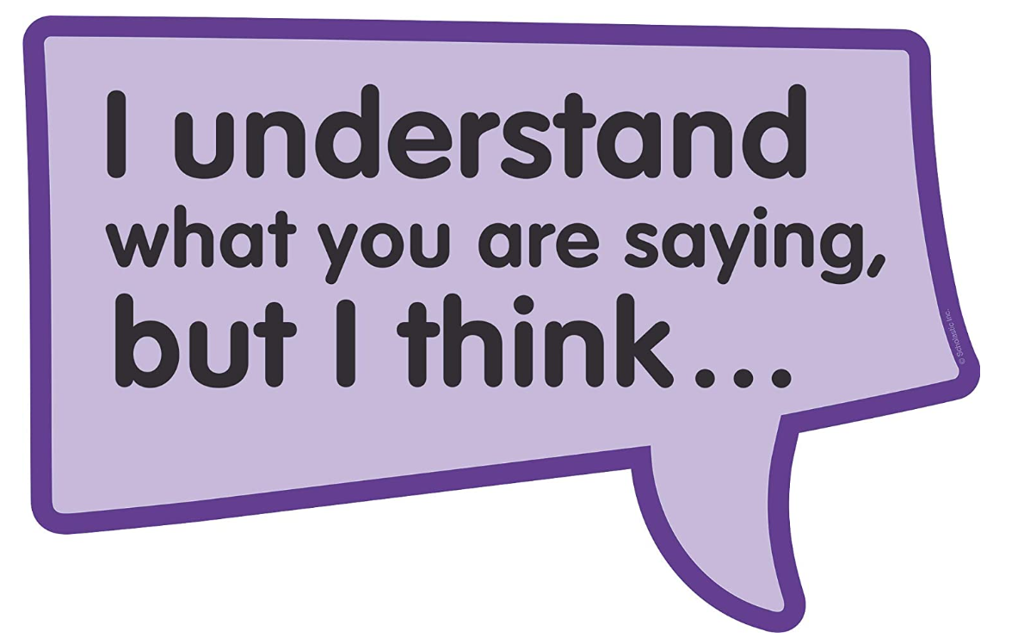
Sentence stems

Slide 5

Class discussion
Did you agree or disagree with the statement, and can you explain why?
Why might we want to forget some things and not others?
Are we aware of all our motivation / reason for doing things?

Slide 6
Psychodynamic theory
Sigmund Freud is considered the original psychodynamic theorist.
Behaviour as a result of unconscious motivation and conflicts in the mind.
We will look at the role of the parts of the mind and structure of personality in explaining motivated forgetting.

Slide 7
Look at this diagram about the structure of personality - what do you notice? What questions do you have?

Slide 8

Key term
The ‘id’ is:
‘the innate part of the mind led by desire’
The ‘ego’ is:
‘the part of the mind that balances the id and super-ego’
The ‘super ego’ is:
‘the part of the mind led by moral and societal standards’

Slide 9
Alex is a university student who has an important exam tomorrow. He knows he should be revising, but his friends invite him to watch a sports game instead.
Explain the role of the id, ego and super-ego in Alex’s experience.

Slide 10
Research task
In pairs or groups of three, research the parts of the mind in psychodynamic theory:
Conscious
Preconscious
Unconscious
Write a short definition for each.

Slide 11
Key term
The ‘conscious’ is:
‘thoughts and feelings currently in a person’s awareness’
The ‘pre-conscious’ is:
‘thoughts and feelings a person is not currently aware of, but can easily bring to their awareness’
The ‘unconscious’ is:
‘thoughts and feelings a person cannot bring to their awareness’

Slide 12
Check your understanding - match the definitions
Key term | Definition
conscious | a. part of the mind led by moral and societal standards
ego | b. thoughts and feelings a person is not currently aware of, but can easily bring to their awareness
unconscious | c. thoughts and feelings a person cannot bring to their awareness
super-ego | d. part of the mind that balances the id and super-ego
id | e. thoughts and feelings currently in a person’s awareness
pre-conscious | f. innate part of the mind led by desire

Slide 13
Check your understanding - answers
Key term | Definition
conscious | e. thoughts and feelings currently in a person’s awareness
ego | d. part of the mind that balances the id and super-ego
unconscious | c. thoughts and feelings a person cannot bring to their awareness
super-ego | a. part of the mind led by moral and societal standards
id | f. innate part of the mind led by desire
pre-conscious | b. thoughts and feelings a person is not currently aware of, but can easily bring to their awareness

