Slide 1

Lesson Objectives:
Describe the role of different parts of the brain in memory and forgetting
Explain the effect of damage to the limbic system
Apply knowledge of the role of parts of the brain to explain memory and forgetting

Slide 2

Starter activity: Read through or review your project ready for presentation.

Slide 3
Each group will have five minutes to present their project. Make notes on the role of each part of the brain, its location, function, role in memory and forgetting.

Slide 4
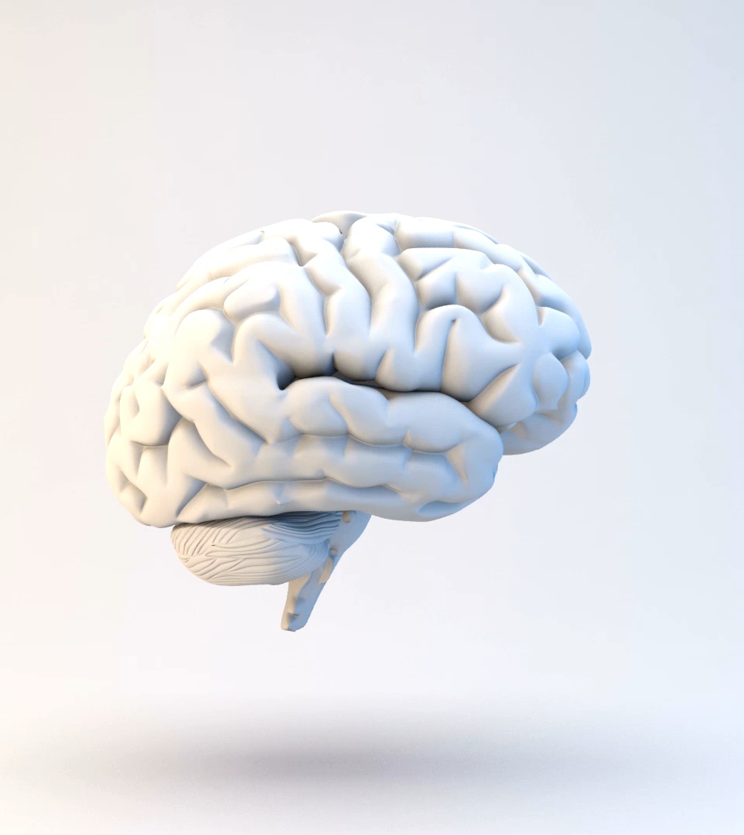
Reflections on presentations
Questions to reflect on:
Which brain parts did the group focus on?
How does damage to this area affect memory formation or memory loss?
Can the brain compensate if this area is damaged?

Slide 5

The limbic system
The amygdala and hippocampus are both parts of the limbic system in the brain.
This is important background information for the named study about HM amnesia (Milner et al).
Watch this video which explains the role of the limbic system.

Slide 6
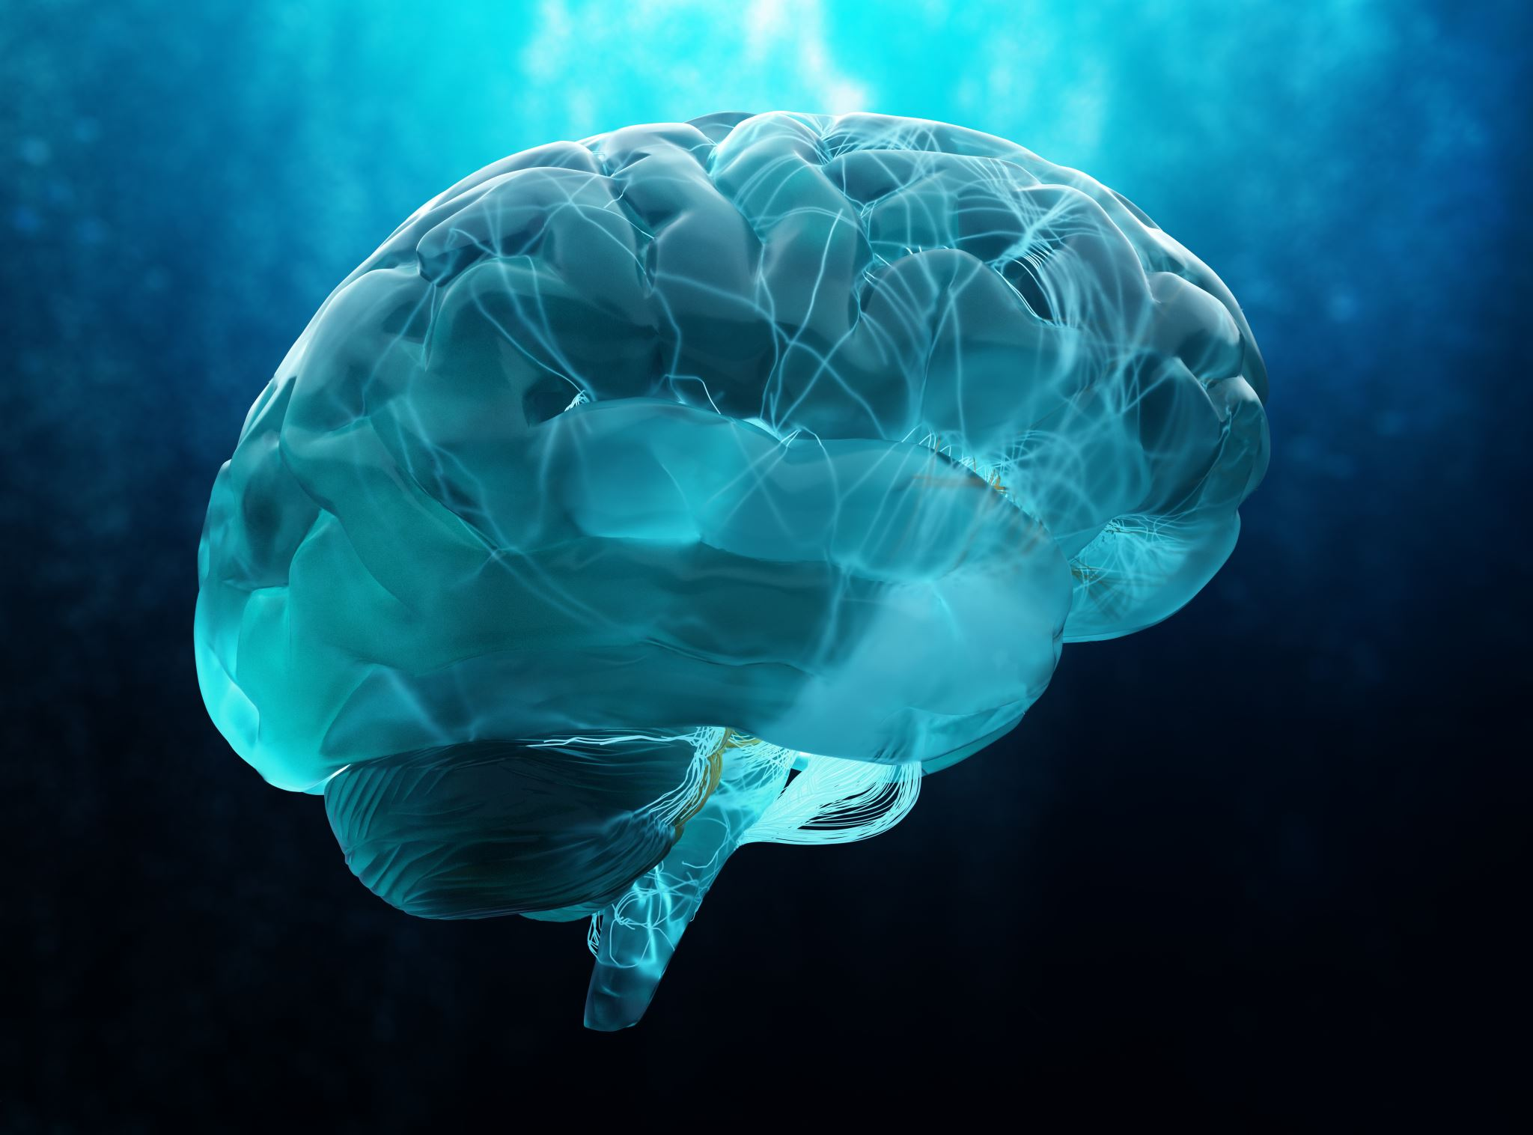
Nadia has experienced brain damage from an illness. She has difficulty learning her way to a new school.
Which part of the brain do you think Nadia has damaged?
Explain your answer to question 1.

Slide 7

Check your understanding
Think-Pair-Share:
Think of one new thing you learned from another group’s project.
Share it with a partner.
Be ready to tell the class one interesting takeaway.

