Slide 1

Lesson Objectives:
Explain localisation of function
Describe the role of the amygdala in memory
Describe the role of the hippocampus in memory
Describe the role of the cerebellum in memory

Slide 2

Talking point: Different parts of the brain have completely different jobs. Discuss with a partner.

Slide 3

Key term
‘localisation of function ’ means that:
‘specific parts of the brain are responsible for specific functions’

Slide 4
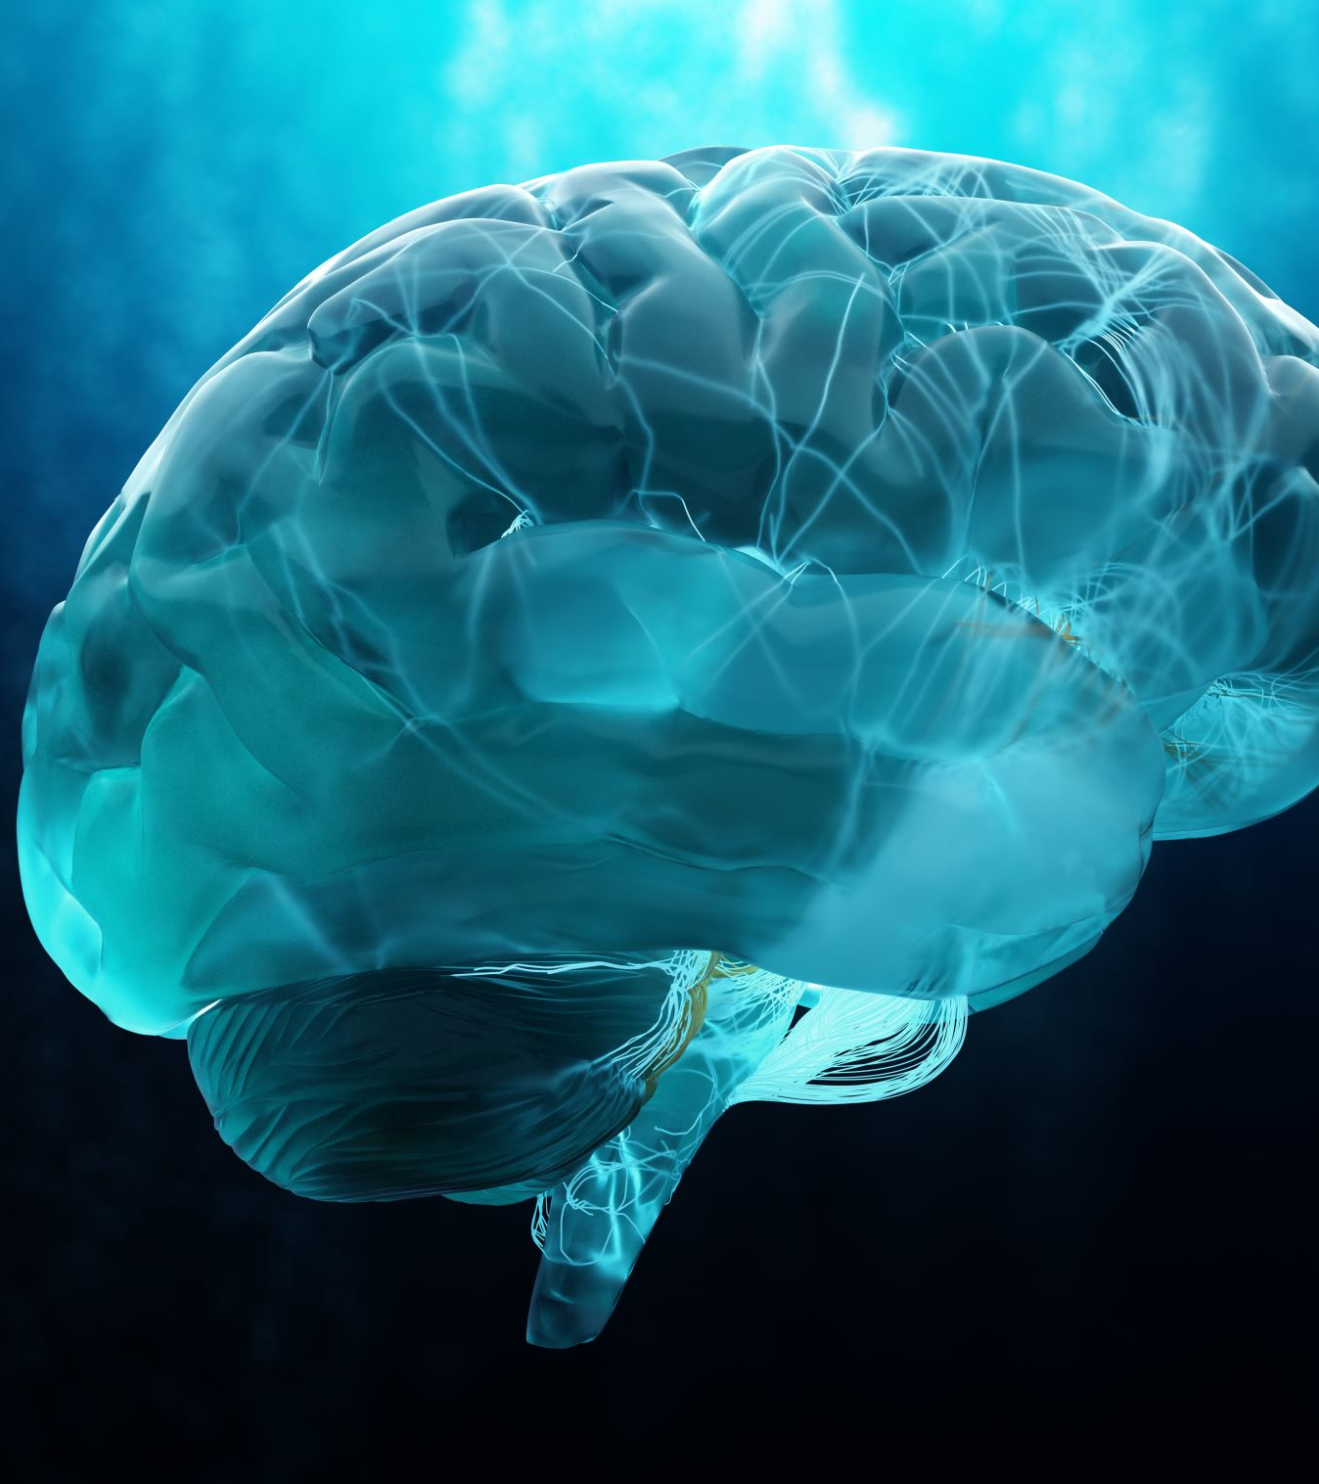
Project work
Your group has this lesson to create a model, presentation or poster to share with the class next lesson on one of the following part of the brain:
the amygdala
the hippocampus
the cerebellum.
Your project must contain the following information about this part of the brain:
the location
the general function
role in memory formation, processing and storage
effects of damage.

Slide 5

Plenary
In your groups, make a checklist of any work left to be completed on the project.
Assign roles on how you will take turns presenting your work to the class.

