Slide 1



Teaching Pack – Analysis and Design
Lesson 3 – Design – algorithm & flowcharts
Cambridge IGCSE™
Computer Science 0478
Version 1.0
Copyright © UCLES May 2025

Slide 2
In this lesson we will cover:
recap how to break down systems into smaller parts
explore three different ways to express your ideas
develop an understanding of algorithms
learn how to read and create flowcharts
practice solving simple problems using algorithms and flowcharts
By the end of this lesson, you should feel confident in using algorithms and flowcharts to design solutions for given problems.

Slide 3
Recap Activity: What’s My Sub-System?
Clue | Answer
This part of an airline system handles assigning seats to passengers during booking. | System → Airline Reservation System Sub-system → Booking Module → Seat Allocation
This part of a school system handles student fee payments. | System → Sub-system → Module →
In a smartphone, this handles sending messages and emails. | System → Sub-system →
This part of a car’s onboard computer alerts the driver when tire pressure is low. | System → Sub-system → Module →
This part of a digital library system lets users search for books by title or author. | System → Sub-system → Module →
School
Administration
Finance
Smartphone
Communication
Car System
Safety Monitoring
Tire Pressure Sensor
Digital Library
Search Engine
Book Search
Notes:
This slide or worksheet serves as a recap activity.
It reinforces the concept of decomposition by allowing learners to practice identifying systems, sub-systems, and tasks.
The first example is solved to guide them.
In this task, learners are expected to:
Identify the main system mentioned in the clue
Suggest a possible sub-system related to it
(Optional) Name the specific task or module referred to in the clue

Slide 4
How to express thoughts
There are 3 ways of expressing your computational & logical thoughts while solving any given problem:
Algorithms - well-defined, step-by-step procedure for solving a problem using simple English.
Flowcharts - visual representation of an algorithm using standardized symbols.
Pseudocode - high-level description of an algorithm using English keywords
Notes:
Using this slide, explain the learners about the 3 ways in which they can express their logical and computational thoughts while solving any given problem.
Explain them that the Algorithms and Flowcharts will be covered in this lesson and Pseudocode will be covered in the next lesson.

Slide 5
What is an algorithm ?
An algorithm is a well defined, step-by-step set of instructions (in simple English language) that tells the computer (or a person) how to solve a problem or do a task.
Think of an algorithm like a cooking recipe.
It gives clear steps to follow, in the right order, to make a dish.
Just like:
  Boil water
  Add pasta
  Stir and cook for 10 minutes
  Drain water
  Add sauce
If you follow the steps, you get the correct result.
Notes:
Use this slide to introduce the concept of an algorithm in a simple, student-friendly manner.
The real-world example provided will make it easier for learners to relate to and understand the idea.

Slide 6
Why are algorithms important ?
Computers don’t think on their own like humans do, they need exact steps.
Algorithms help:
  solve problems
  create programs
  make tasks automatic and efficient
Everyday Examples of Algorithms:
  Making a cup of tea
  Following a map to a destination
  Doing long division
  Logging into a website
Any task you perform can be broken down into smaller steps (i.e. decomposition).
When you write down these steps to complete the task, it’s called an algorithm.
Notes:
This slide will help learners understand the importance of algorithms.

Slide 7
Everyday example
You are seated on a couch in a room and need to turn on the light. What steps or algorithm would you follow to do this?
  START
  Stand up from the couch
  Walk towards the light switch
  Reach your hand towards the switch
  Flip the switch up
  Check if the light is on
  If the light is on, return to the couch
  Sit back down
  STOP
Key takeaways:
Algorithms are not just for computers — they exist in real life too
Every step must be clear, in the correct order and complete
This is similar to how you’d give a computer instructions
Notes:
Use this slide to explain them how to think and write the algorithm.
Ask the questions to the learners and wait for their responses.
After their responses, show them the algorithm and the key takeaways on the slide.
Since algorithms use simple English statements, the real-world scenario shown on this slide will help each learner understand the concept more clearly.
Also, explain that including START' and STOP’, as shown in the example above, is considered a good practice.

Slide 8
Try this
Can you think of a daily task you perform that involves following a sequence of steps?
Notes:
Ask learners if they can think of any everyday task they perform that involves following a series of steps.
If needed, you can prompt them with examples such as:
Brushing their teeth
Making toast
Logging into a computer

Slide 9
Simple Algorithm to add 2 numbers
START
Ask the user to enter two numbers
Add the 2 numbers
Display the total
STOP
Key takeaways:
Algorithms are not code (yet), but the plan behind the code
Algorithms are like instructions for solving a problem
You must be precise, clear and follow the correct sequence
Notes:
Work through this slide with the class to help them understand that computer-based algorithms can be written in a similar step-by-step manner, just like the daily tasks discussed on the previous slide.
Highlight the last bullet point in the key takeaway section — it’s important that instructions are precise, clear and follow the correct sequence.

Slide 10
Activity – find the larger of the 2 numbers
Write a step-by-step algorithm to accept 2 numbers and display the largest of the two.
1: START
2: Input two numbers
3: If first number is larger then display it
4: If second number is larger then display it
5: STOP
1: START
2: Input two numbers
3: If first number is larger then display it
4: Otherwise, display the second number
5: STOP
1: START
2: Input two numbers, a and b
3: If a is greater than b, then set max to a
4: Otherwise, set max to b
5: Output max
6: STOP
Notes:
Use this slide or the worksheet to complete this activity, individually.
Ask the learners to write a pseudocode to accept 2 numbers and display the largest of the two.
Their responses may vary from one another and may also differ from the three possible solutions shown on the slide.
After the activity is complete, show the three possible solutions and explain that while they use different phrasing in English, they all represent the same underlying steps or logic.

Slide 11
What is a flowchart ?
Flowchart is a visual representation of an algorithm.
Each step is shown as a shape, which has a specific meaning.
Arrows connect the shapes to show the order of steps.
These are standardized symbols.
Flowcharts are used before writing actual code.
They help plan and explain the logic of a program.
Notes:
Use this slide to introduce the idea of a flowchart.

Slide 12
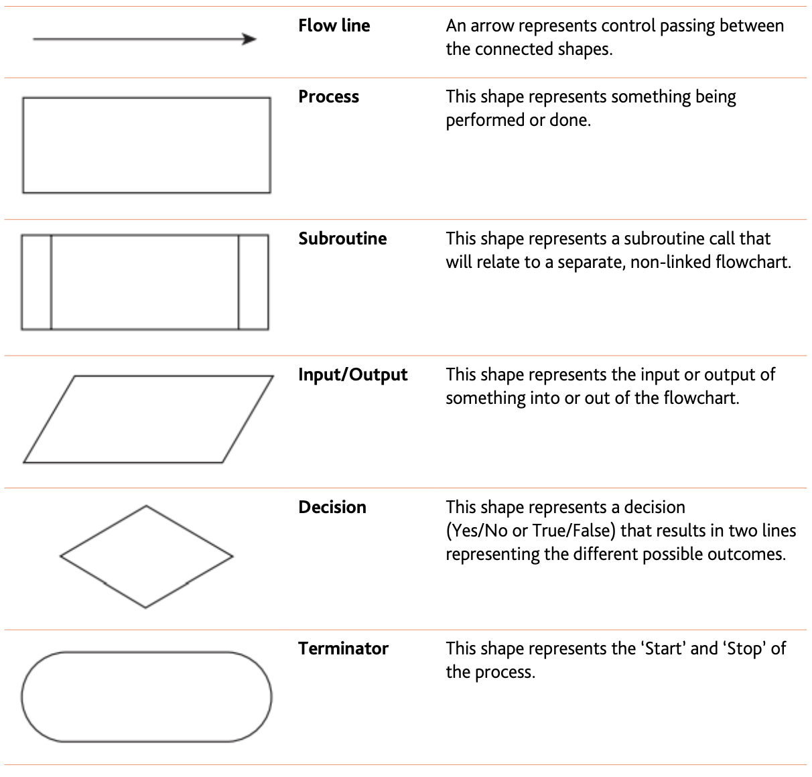
Flowchart symbols
The branches must be clearly labeled as Yes / No
Notes:
Use this slide explain the main symbols used in flowcharts.
Note:
These symbols are also included in the subject syllabus.

Slide 13
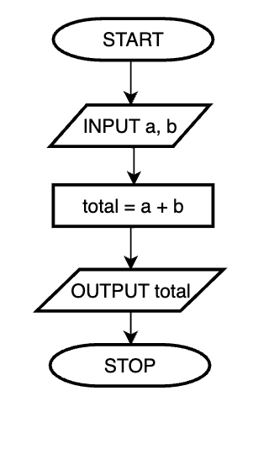
Simple flowchart – add 2 numbers
Notes:
Work through this slide with the class to help them understand how to draw a flowchart for a given example.

Slide 14
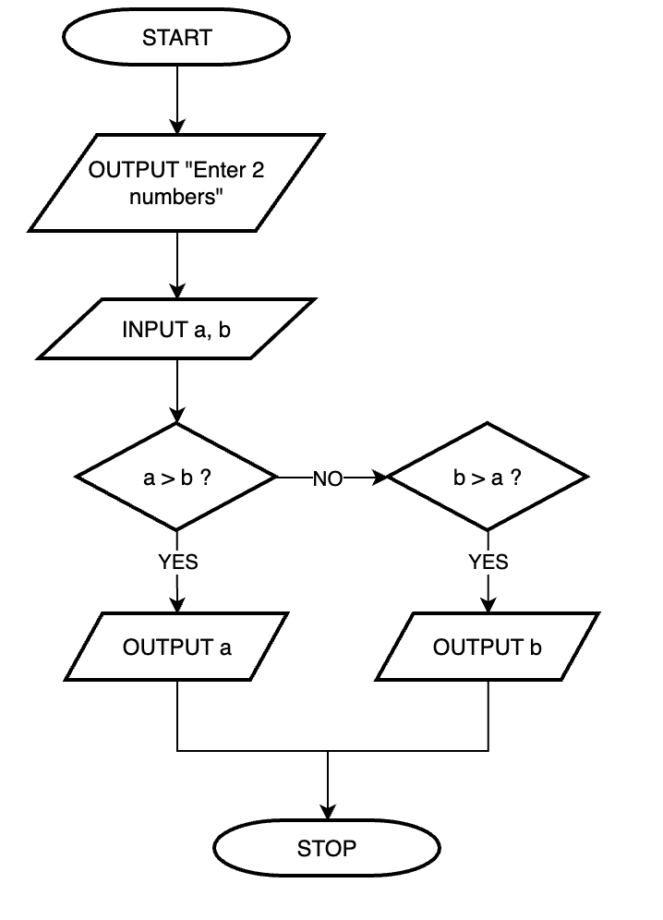
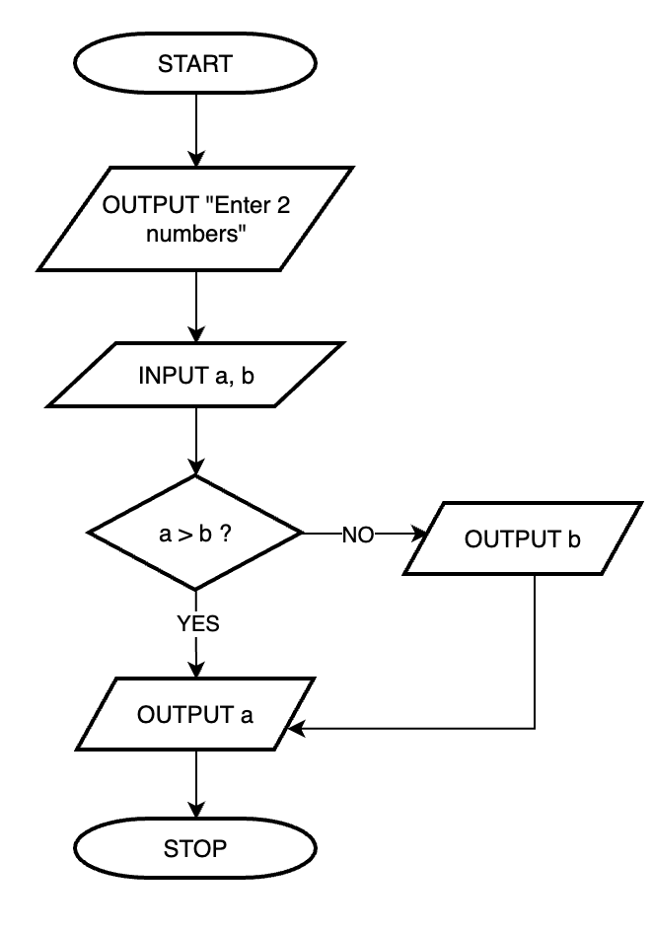
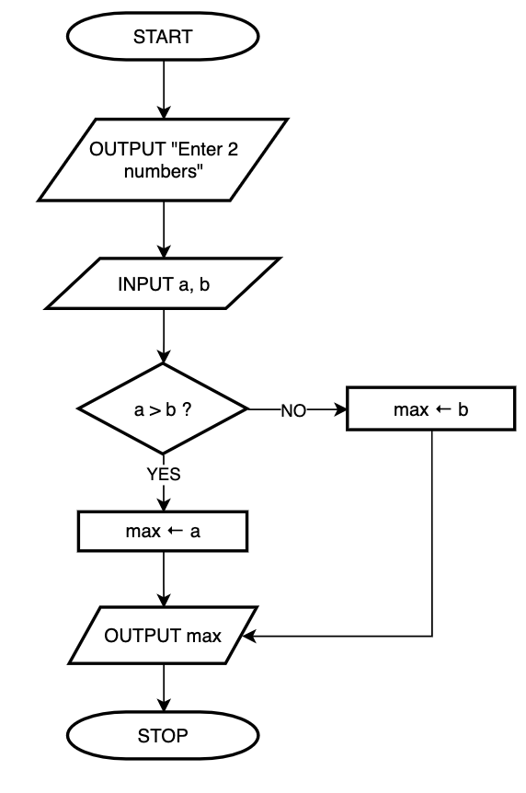
Activity – find the larger of the 2 numbers
Draw the flowchart to accept 2 numbers and display the largest of the two.
Notes:
Use this slide or continue with the previous worksheet to complete the activity individually.
Learners are required to convert their algorithm into a flowchart.
The slide provides flowcharts for the three sample solutions shown earlier.
However, explain to learners that their versions can also be correct as long as they use the appropriate symbols, apply correct logic, and maintain the right sequence.
The teacher will support learners in identifying and understanding any errors in their flowcharts.

Slide 15
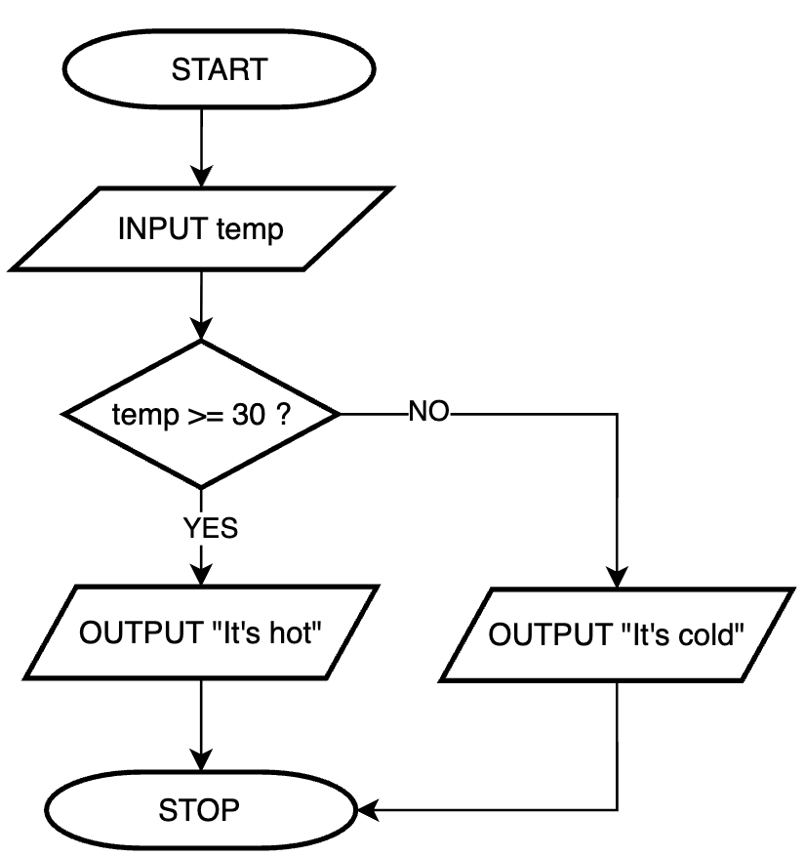
Activity - Temperature Check – Hot or Cold
Write an algorithm and draw a flowchart :
Ask the user to enter the current temperature. If the temperature is greater than or equal to 30°C, display “It’s hot”. Otherwise, display “It’s cold”.
Algorithm
Flowchart
1: START
2: Input temp
3: If temp >= 30 then print "It’s hot”
4: Otherwise, print ”It’s cold"
5: STOP
Notes:
Use this slide or the worksheet.
This is a simple program where it will reinforce:
Basic input & output
Simple comparison using IF–ELSE
Correct use of symbols in flowchart

Slide 16
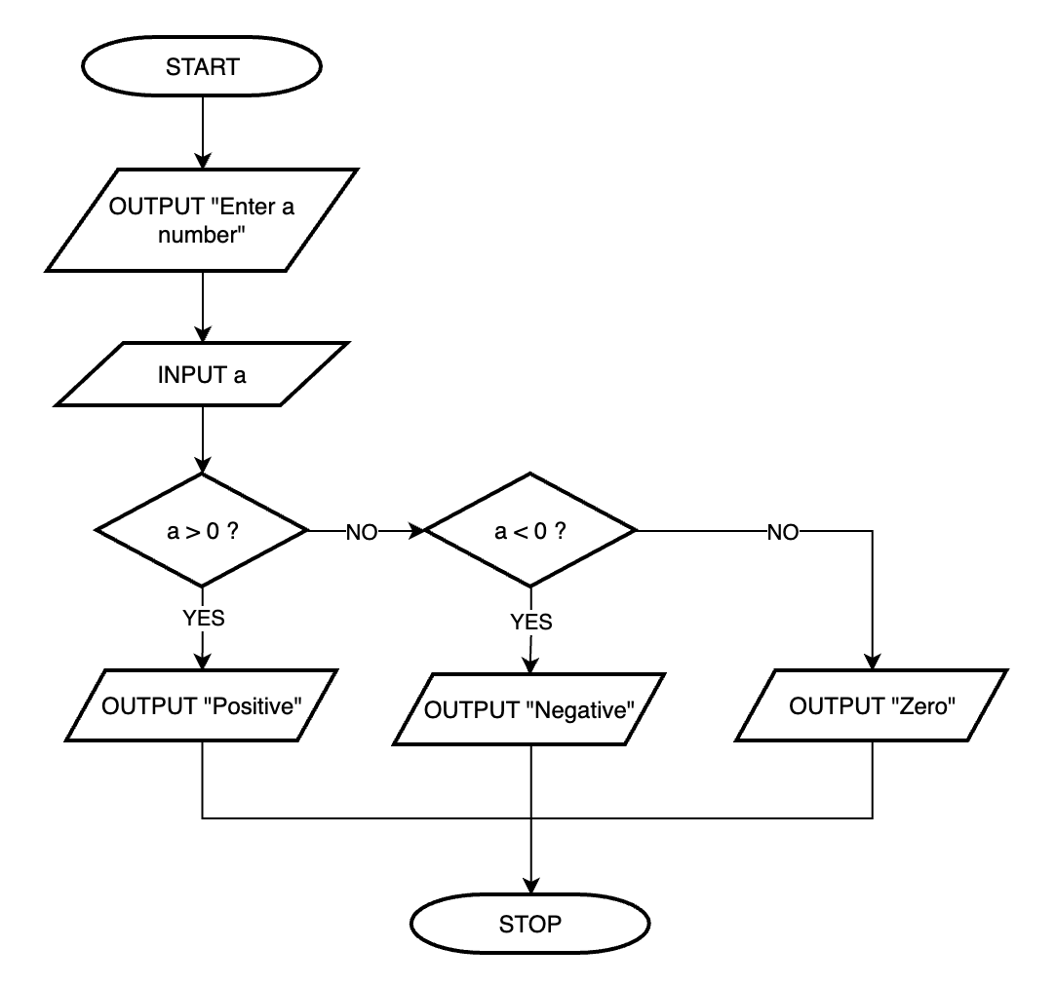
Activity - Find if a number is positive, negative, or zero
Write an algorithm and draw a flowchart :
Ask user to enter a number. Display an appropriate message stating if it is a positive number, negative number or a Zero.
Flowchart
Algorithm
1: START
2: Input a
3: If a is greater than 0, print "Positive"
4: If a is less than 0, print ”Negative"
5: Otherwise, print ”Zero"
6: STOP
Notes:
Use this slide or the worksheet.
This is a simple program where it will reinforce:
Basic input
Simple comparison using IF–ELSE IF–ELSE (nesting of IFs)
Correct use of decision boxes in flowchart

Slide 17
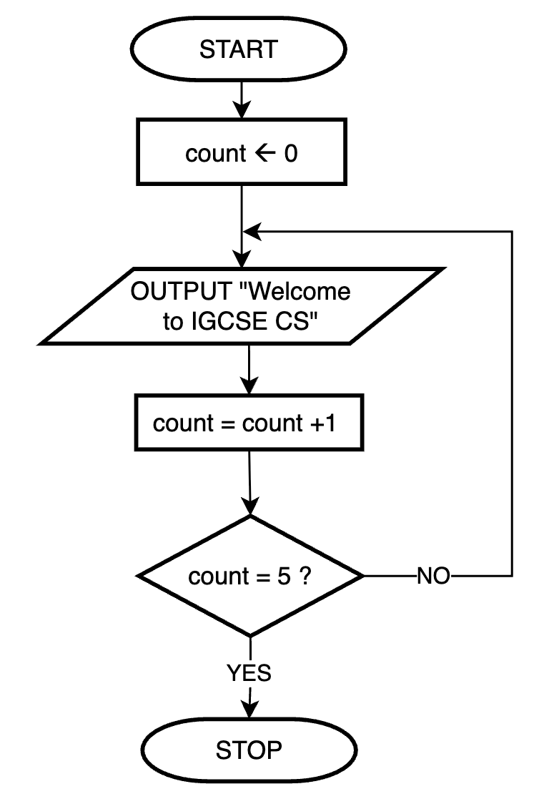
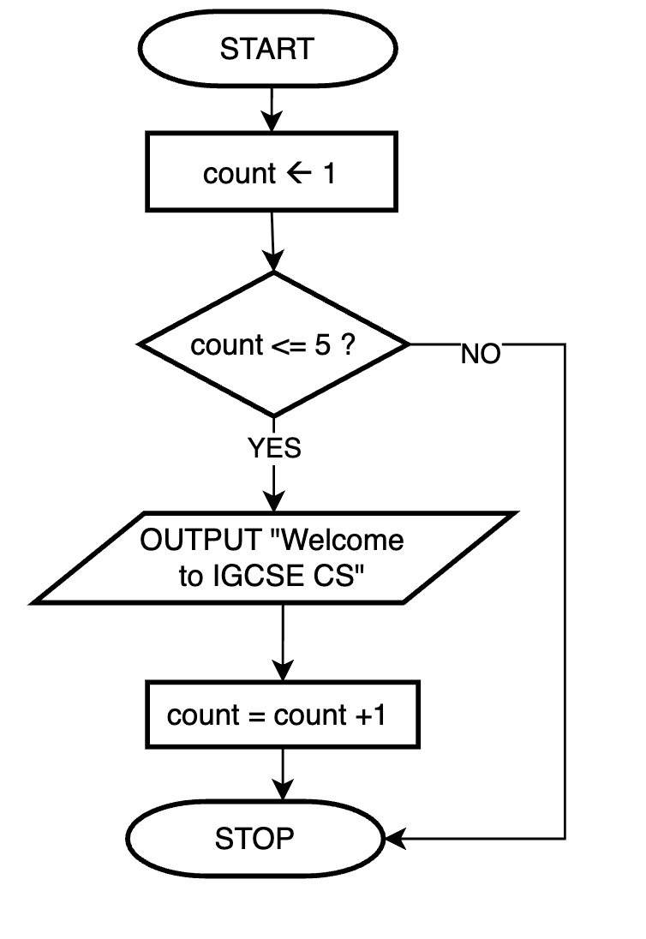
Activity - Display a Message 5 Times
Write an algorithm and draw a flowchart :
Displays the message “Welcome to IGCSE CS” 5 times.
while
Repeat until
1: START
2: set count to 1
3: repeat while count < = 5
  a: Output “Welcome to IGCSE CS”
  b: increase count by 1
4: STOP
1: START
2: set count to 0
3: repeat
  a: Output “Welcome to IGCSE CS”
  b: increase count by 1
until count = 5
4: STOP
Notes:
Use this slide or the worksheet.
This is an optional slide.
Here, explain to learners that the difference lies in the wording — "repeat while" vs. "repeat until”.
Although they sound similar, each requires important changes in how the condition is written and how the total variable is initialized.
Explain to them that "repeat while" uses a condition that determines when the loop should continue running, whereas "repeat until" uses a condition that specifies when the loop should stop.

Slide 18
Summary
 | Algorithm | Flowchart
Difference | Step-by-step set of instructions | Visual representation of the algorithm
 | Written in simple English (structured format) | Uses standardized symbols
Similarity | Help in planning and explaining the logic before writing code.
 | Must be clear, correct, and in a logical order.
Notes:
Use this slide to as a plenary to summarise the similarities and differences between an algorithm and a flowchart.
Take this opportunity to address any questions or clarify any doubts learners may have.

