Slide 1



Teaching Pack – Boolean Logic
Lesson 5 – Problem statements
Cambridge IGCSE™
Computer Science 0478
Version 1.0
Copyright © UCLES May 2025

Slide 2
In this lesson we will cover:
recap circuits
solving the problem statements
By the end of the lesson, you should be able to solve the problem statements related to logical circuits.

Slide 3
Activity – Circuit masters
Statement 1
Statement 2
Create the truth table for each of the following statements:
Statement 1: (p AND q) OR r
Statement 2: (p OR r) AND (q OR r)
Do you observe anything?
p | q | r | A (p . q) | A + r
0 | 0 | 0 | 0 | 0
0 | 0 | 1 | 0 | 1
0 | 1 | 0 | 0 | 0
0 | 1 | 1 | 0 | 1
1 | 0 | 0 | 0 | 0
1 | 0 | 1 | 0 | 1
1 | 1 | 0 | 1 | 1
1 | 1 | 1 | 1 | 1
p | q | r | A (p + r) | B (q + r) | A . B
0 | 0 | 0 | 0 | 0 | 0
0 | 0 | 1 | 1 | 1 | 1
0 | 1 | 0 | 0 | 1 | 0
0 | 1 | 1 | 1 | 1 | 1
1 | 0 | 0 | 1 | 0 | 0
1 | 0 | 1 | 1 | 1 | 1
1 | 1 | 0 | 1 | 1 | 1
1 | 1 | 1 | 1 | 1 | 1
Conclusion: they are logically equivalent (i.e., they match) because they have the same truth values for every input combination.
Notes:
Use this slide to review truth tables and circuits, and to help learners understand that two circuits, despite looking completely different, can produce the same output—demonstrating that they are logically equivalent.

Slide 4
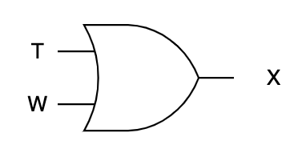
Basic gates - word problem
An alert light turns ON (X = 1) if either the input T is ON or W is ON.
Give the Boolean expression. Draw the logic circuit and truth table.
Recollect:
0 is OFF / NOT 1
1 is ON / NOT 0
To indicate that a variable is ON, simply write the variable by itself.
To show that a variable is OFF, place NOT (or use ~) before the variable.
  Example:
  A represents A = 1 (ON)
  NOT B or ~B represents B = 0 (OFF)
X = T + W
T | W | X = T + W
0 | 0 | 0
0 | 1 | 1
1 | 0 | 1
1 | 1 | 1
Notes:
Use this slide to explain the learners how to work on basic word problems based on gates.

Slide 5
Understanding Gate word problems
Write the Boolean expression for the following:
An alert light turns on (X = 1) if:
  the bearing temperature is below 80°C and
  the wind velocity is over 120 kph.
An alarm (Y = 1) sounds if:
  either the wind velocity is not greater than 120 kph or
  the bearing temperature is greater than 80°C
Description | Value | Condition
bearing temperature (T) | 0 | bearing temperature <= 80°C
 | 1 | bearing temperature is over 80°C
wind velocity (W) | 0 | wind velocity <= 120 kph
 | 1 | wind velocity is over 120 kph
X = ~T . W
Y = ~W + T
Notes:
Now, use this slide to explain the word problems, which have now increased in complexity.

Slide 6
Practice - Gate word problems
Write the Boolean expression using inputs S, T and W
A cooling system activates (output X = 1) only when both the turbine speed is greater than 1000 rpm and the bearing temperature is greater than 80°C.
A red indicator turns on (X = 1) if:
  Neither turbine speed nor bearing temperature is high
  AND
  Wind velocity is high (W = 1)
Description | Value | Condition
bearing temperature (T) | 0 | bearing temperature <= 80°C
 | 1 | bearing temperature > 80°C
turbine speed (S) | 0 | turbine speed <= 1000 rpm
 | 1 | turbine speed > 1000 rpm
wind velocity (W) | 0 | wind velocity <= 120 kph
 | 1 | wind velocity > 120 kph
X = S . T
X = ~(S + T) . W
Notes:
Use this slide or the worksheet to support learners in developing their skills in solving word problems.
Use this opportunity to clarify any misconceptions

Slide 7
Practice - Smart Greenhouse Safety System
A smart greenhouse uses sensors to monitor environmental conditions and activates an emergency venting system (X = 1) if any of the following combinations of conditions occur:
Humidity is > 70% and Temperature is ≤ 30°C
Light is ≤ 800 lux and Temperature is > 30°C
Humidity is ≤ 70% and Light is > 800 lux
Task:
Write the logical statement using inputs
H, T & L
Draw the circuit diagram
Create the truth table
Description | Value | Condition
Humidity (H) | 0 | Humidity <= 70%
 | 1 | Humidity > 70%
Temperature (T) | 0 | Temperature <= 30°C
 | 1 | Temperature > 30°C
Light Level (L) | 0 | Light intensity <= 800 lux
 | 1 | Light intensity > 800 lux
Notes:
Use this slide or the worksheet to give learners the flavour of complex word problems.
You may need to scaffold some learners if you find them struggling. The solution is on the next slide.
This will prepare them for the plenary.

Slide 8
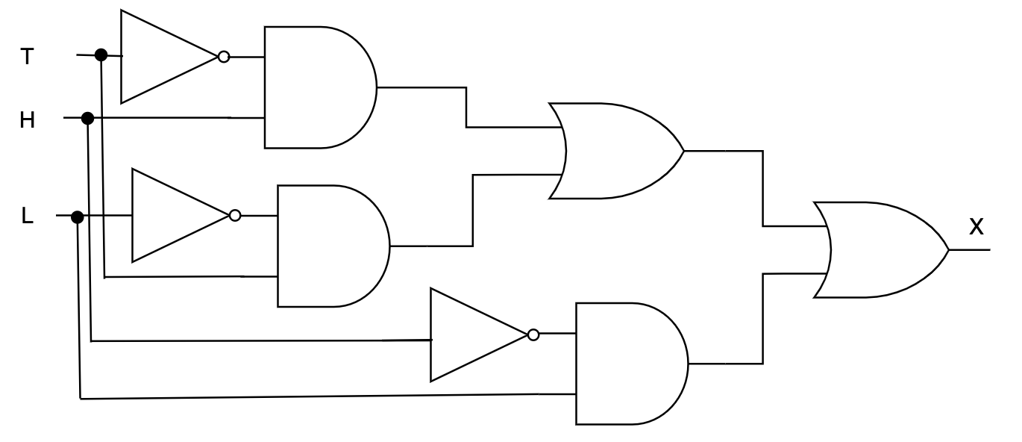
Solution
X = (H AND NOT T) OR (NOT L AND T) OR (NOT H AND L)
Part 1
Part 2
Part 3
H | T | L | ~T | H . ~T | ~L | ~L . T | ~H | ~H . L | X
0 | 0 | 0 | 1 | 0 | 1 | 0 | 1 | 0 | 0
0 | 0 | 1 | 1 | 0 | 0 | 0 | 1 | 1 | 1
0 | 1 | 0 | 0 | 0 | 1 | 1 | 1 | 0 | 1
0 | 1 | 1 | 0 | 0 | 0 | 0 | 1 | 1 | 1
1 | 0 | 0 | 1 | 1 | 1 | 0 | 0 | 0 | 1
1 | 0 | 1 | 1 | 1 | 0 | 0 | 0 | 0 | 1
1 | 1 | 0 | 0 | 0 | 1 | 1 | 0 | 0 | 1
1 | 1 | 1 | 0 | 0 | 0 | 0 | 0 | 0 | 0
Notes:
This slide provides the solution for the previous slide.
This is an optional slide.

Slide 9
Activity – Escape corner
Game Rules:
There are 3 corners to escape, each containing 1 puzzle. All groups will receive the same puzzle for each corner.
Each group will get a worksheet with the puzzle and space to write their answers. Answers must not be spoken aloud.
Once a group has their final answer, they should raise their hand for the teacher to check.
A group can only proceed to the next corner if their answer is correct.
The puzzles will become progressively more challenging with each corner.
Each group is allowed to use only one hint token during the entire game.
The group that escapes all 3 corners first will be declared the winner.
The activity will continue until every group has successfully escaped all 3 corners.
Notes:
This activity is to be used for the plenary. It is meant for the learners to extend their thinking capabilities & work in groups.
Make groups and explain them the rules of this game.
For easy reference – the prerequisites and hints are mentioned here too.
Prerequisites:
Each set includes three puzzles. Print one complete set per group.
Ask each group to bring a pen and let them use the worksheet for any rough work.
Use this slide to clearly explain all the rules. You may also choose to keep this instruction slide projected throughout the activity for easy reference.
The first group to complete all puzzles will be declared the winner but encourage all groups to finish the challenge.
Let them know the activity continues until every group has escaped all three corners.
Each group is allowed to use only one hint token during the game.
Hints:
For 1st corner – It’s a combination gate, means use 2 gates to form this gate. (This should lead learners to consider gates like NAND or NOR, and apply their understanding to identify the correct one.)
For 2nd corner – the answer includes the gate from the 1st corner.
For 3rd corner – To convert binary to decimal, remind them to use the 2 to the power of place value method (e.g., 2⁰, 2¹, 2², etc.).

