Slide 1



Teaching Pack – Boolean Logic
Lesson 4 – Circuits
Cambridge IGCSE™
Computer Science 0478
Version 1.0
Copyright © UCLES May 2025

Slide 2
In this lesson we will cover:
recap of all 6 gates
working with circuits
By the end of the lesson, you should be able to work with circuits diagrams, construct their truth tables & write their Boolean expressions.

Slide 3
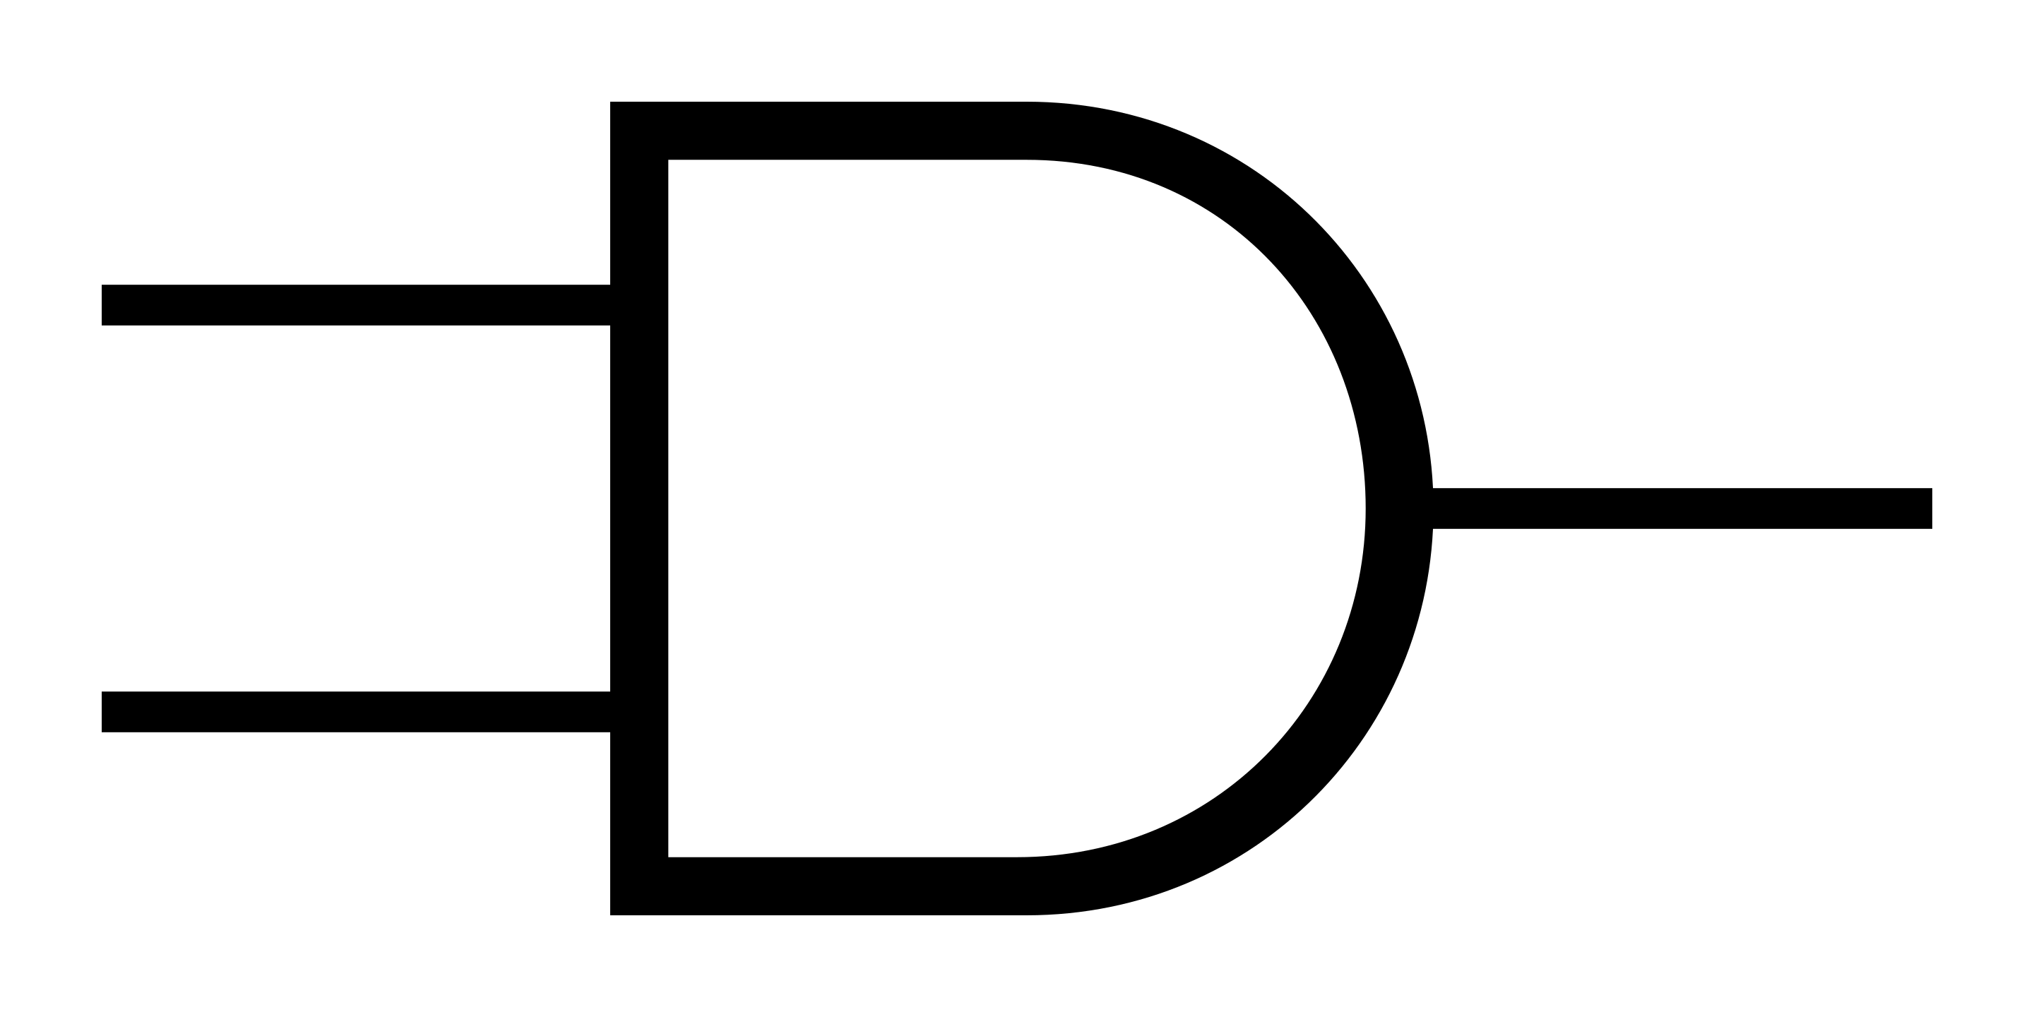
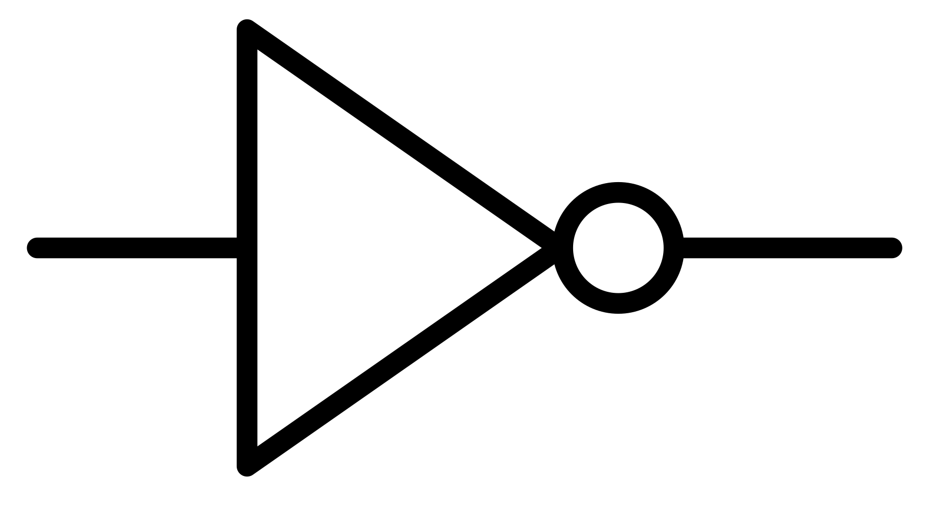

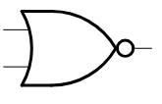
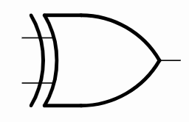
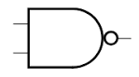
Match the gates
Draw lines to connect the correct Gate names with their Symbols and their Boolean expressions.
Gates |  | Symbol |  | Boolean Expression
NOT |  |  |  | A + B
AND |  |  |  | ~ (A + B)
NOR |  |  |  | A ⊕ B
XOR |  |  |  | A . B
NAND |  |  |  | ~A
OR |  |  |  | ~ (A . B)
Notes:
Use this slide or worksheet to quickly assess the class’s basic level of understanding of all the 6 gates.

Slide 4
Recap of AND, OR, NOT gates
Keywords | Symbol | Boolean Expression | Truth Table
For Logical statements | For logical circuit | For Boolean Algebra | For testing the circuits
AND |  | A . B | This means both A and B must be 1 (ON) to get the output 1 (ON). (Takes 2 inputs)
OR |  | A + B | This means the output will be 0 (OFF) only when both A and B are 0 (OFF). (Takes 2 inputs)
NOT |  | ~A / Ā | This means the output will be the reverse of what is input. If input is 1 (ON) then output will be 0(OFF). (Takes 1 input)
Notes:
Use this slide to recap the learning of the 3 gates (AND, OR, NOT) in all the 4 ways of expressing it.
Use this opportunity to clarify the doubts, if any.

Slide 5
Recap of NAND, NOR & XOR gates
Keywords | Symbol | Boolean Expression | Truth Table
For Logical statements | For logical circuit | For Boolean Algebra | For testing the circuits
NAND |  | ~ ( A . B ) ______ ( A . B ) | Reverse of AND. This means if both A and B are 1 (ON) then output will be 0 (OFF).
NOR |  | ~ ( A + B ) ______ ( A + B ) | Reverse of OR. This means if both A and B are 0 (OFF) then output will be 1 (ON).
XOR |  | A ⊕ B | Exclusive OR. This means when exclusively only one of the input is in the 1 (ON) state then the output will be 1 (ON).
Notes:
Use this slide to recap the learning of the 3 gates (NAND, NOR, XOR) in all the 4 ways of expressing it.
Use this opportunity to clarify the doubts, if any.

Slide 6
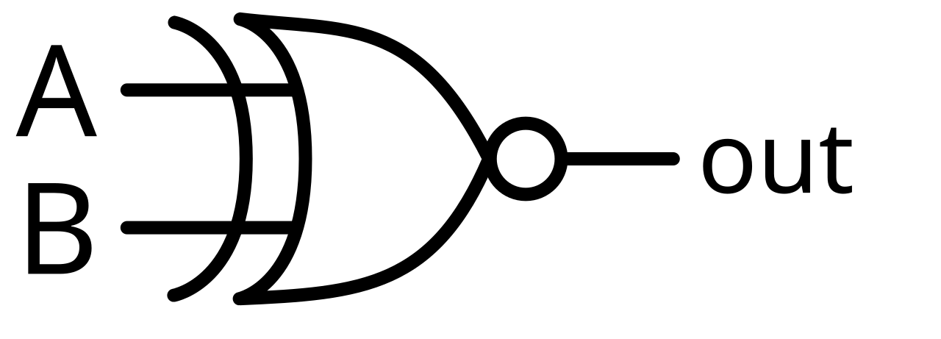
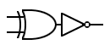
Extension
Look at the gate symbol shown below and use what you've learned so far to try and identify the name of this gate.
XNOR gate
In your opinion, how might this gate be constructed?
And what do you think this gate's function might be?
The XNOR gate (Exclusive NOR) is the inverse of the XOR gate.
XNOR gate produces a 1 (ON) output only when both the inputs are same.
Credit: https://www.electrical-symbols.com/electric-electronic-symbols/logic-gates-symbols.htm#google_vignette
Notes:
This is an optional slide, intended as an extension of the gates covered so far. It introduces the final gate that also takes two inputs.
Encourage learners to apply what they've learned and try to predict the name of the gate and how it might function.

Slide 7
Circuits
Circuits are formed by connecting 1 or more gates together to do a specific task.
Simply put, a logical circuit is like a mini decision-maker that follows clear rules to give a result based on the inputs it gets.
Examples using Boolean expression form :
Z AND (P OR Q) ?
NOT ((A AND B) OR P)
(A NAND B) NAND C
NOT (A XOR B)
Examples using symbols :
P OR (Q AND R) ?
(A AND B) OR C ?
Z . ( P + Q )
Q
~ (( A . B ) + P )
R
P
~ ( ~( A . B ) . C)
B
~ ( A ⊕ B )
A
C
Notes:
Use this slide to explain to the learners the concept of circuits.
The examples shown here must be used for explanation so that the learners grasp it more effectively.
Using examples of Boolean expressions, explain the learners that like in mathematics, here too, they must first work on the innermost brackets and then keep coming outwards.
Also, using the examples of symbols, explain how the circuit within the brackets are created first and then its output is used further to complete the remaining circuit.
Also explain them that they can use the decomposition technique to divide a complex circuit into smaller ones, by giving labels to each output.
Also, inform the learners that the circuits can take more than 3 inputs too, but the scope of our syllabus limits to 3 input circuits

Slide 8
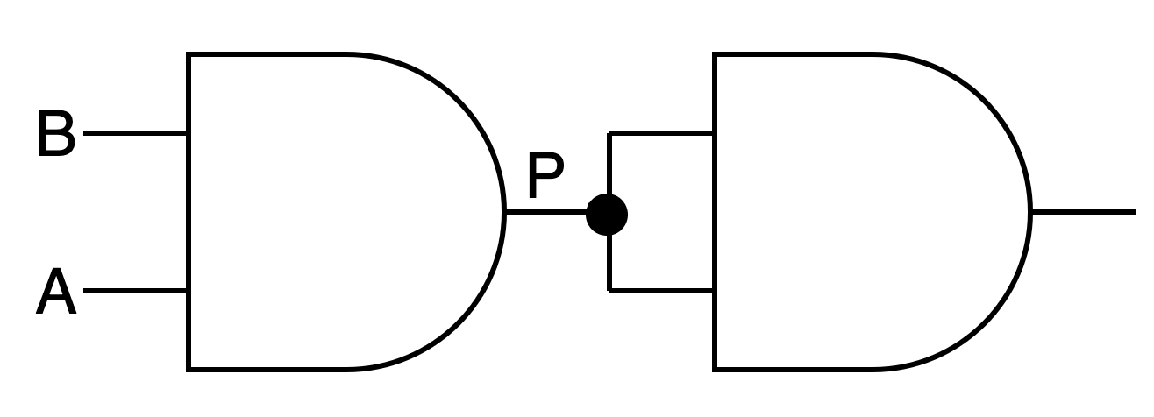
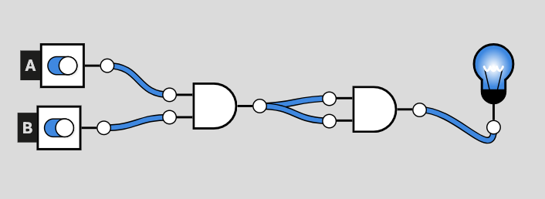
Circuit activity - truth table & simulation
Use the input pattern explained in previous lesson
A . B
P . P
Create a truth table for the given diagram:
A | B | P | Output
Use decomposition
0
0
0
0
0
1
0
0
1
0
0
0
P
1
1
1
1
This is how the circuit will look like on the website https://logic.ly/demo/
Notes:
Use this slide or the worksheet to give learners the practice of creating the truth table for the given circuit.
Also, bring their attention towards the circuit and explain them that when the same input is split and used as both the input for the gate, it is denoted with a joint (as shown).
Incase a few learners are struggling with the truth table, explain them step by step with the help of the solution provided on this slide:
emphasizing on the input pattern trick learnt in the last lesson
Decomposition technique
Take this opportunity, to also give the learners a hands-on experience on the working of the given circuit using the online simulator - https://logic.ly/demo/.
Ask them to create this circuit and cross check if the truth table works exactly as intended.
To aid this, shown at the bottom is the image of how the circuit would look like in the simulator.

Slide 9
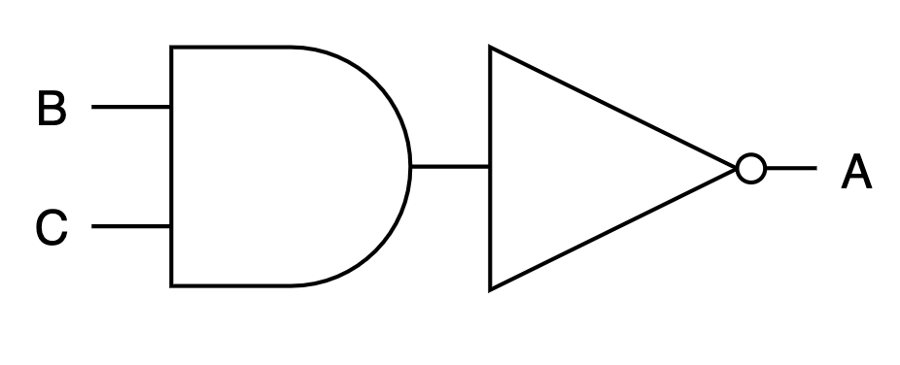
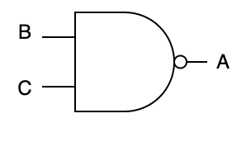
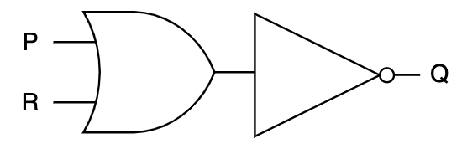
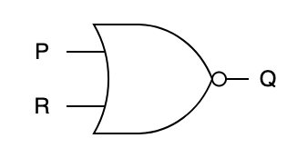
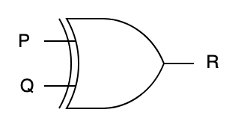
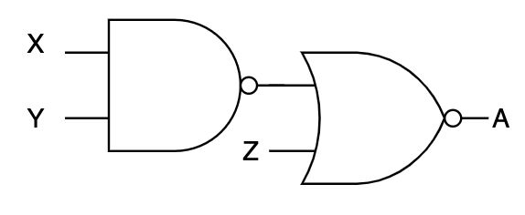
Practice simple circuits
Write the Boolean expression for the following:
X NAND Y ?
R = P NOR Q ?
A XOR B ?
D = (A NOR B) XOR C?
NOT (Y NAND Z) ?
Draw the logic circuit for the following using the 3 basic gates (AND, OR, NOT) and then also with the NAND & NOR gates:
A = B NAND C
Q = P NOR R
Draw the logic circuit for the following using the NAND, NOR & XOR gates:
R = P XOR Q
A = (X NAND Y) NOR Z
~ (X . Y)
R = ~ (P + Q)
A ⊕ B
D = ( ~ (A + B) ) ⊕ C
~ (~ ( Y . Z ) )
Notes:
This slide or the worksheet is created to give appropriate practice to the learners. Use this opportunity to clarify any misconceptions

Slide 10
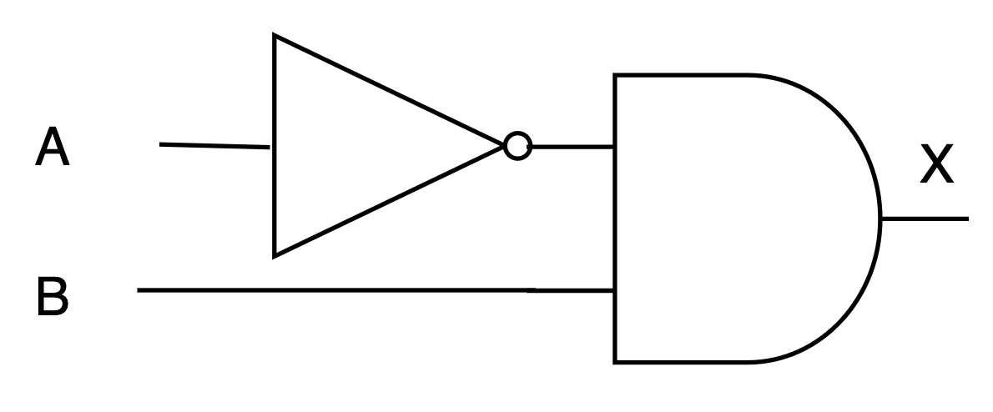
Practice Boolean expression & Logic circuit
For the below truth table, write Boolean expression & draw its logic circuit:
Input 1 | Input 2 | Output
0 | 0 | 0
0 | 1 | 1
1 | 0 | 0
1 | 1 | 0
Boolean Expression:
X = ~A . B
Notes:
Use this slide or the worksheet to give practice to the learners related to writing Boolean expression and creating its circuit from the given truth table.
Explain the learners to produce the the logic expression, they should look at the truth table row where the output value is 1. like here, A = 0 and B = 1 which gives the logical expression: NOT A AND B
Recollect:
0 is OFF / NOT 1
1 is ON / NOT 0
To indicate that a variable is ON, simply write the variable by itself.
To show that a variable is OFF, place NOT (or use ~) before the variable.
Example:
A represents A = 1 (ON)
NOT B or ~B represents B = 0 (OFF)

Slide 11
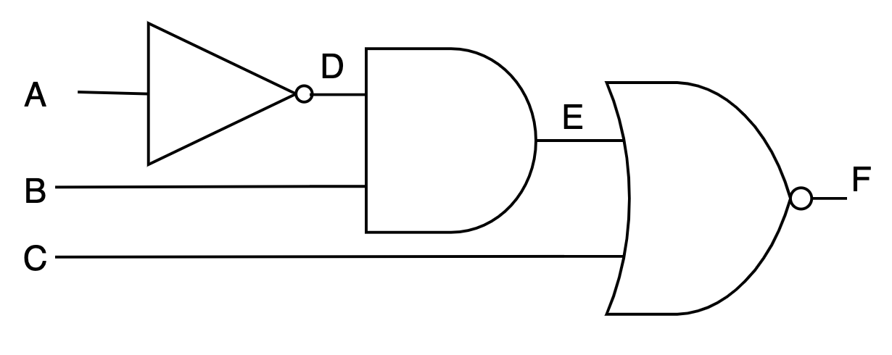
Practice Boolean expression & Truth table
For the below logic circuit, write logic statements, Boolean expression & produce its truth table:
A | B | C | D (~A) | E (D . B) | E + C | F ~(E + C)
0 | 0 | 0 | 1 | 0 | 0 | 1
0 | 0 | 1 | 1 | 0 | 1 | 0
0 | 1 | 0 | 1 | 1 | 1 | 0
0 | 1 | 1 | 1 | 1 | 1 | 0
1 | 0 | 0 | 0 | 0 | 0 | 1
1 | 0 | 1 | 0 | 0 | 1 | 0
1 | 1 | 0 | 0 | 0 | 0 | 1
1 | 1 | 1 | 0 | 0 | 1 | 0
Logical statement:
F = NOT ((NOT A AND B) OR C)
Boolean Expression:
F = ~((~ A . B) + C)
Notes:
Use this slide or the worksheet to give practice to the learners.
Make sure that you re-emphasize on the technique of decomposition and labeling the intermediate output.

Slide 12
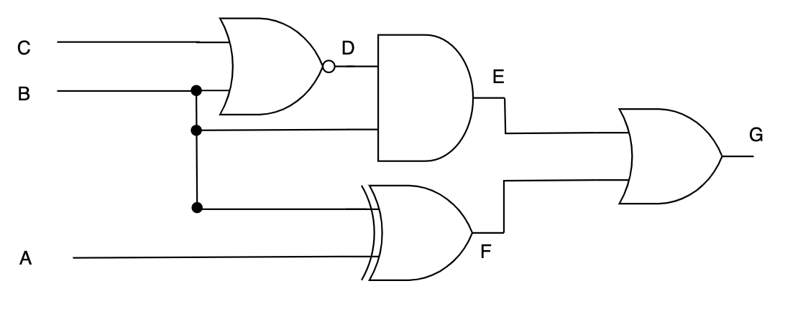
Practice Circuit diagrams & truth tables
For the below logic statement, draw the circuit diagram & produce its truth table:
(A XOR B) OR ((B NOR C) AND B)
A | B | C | B + C | D ~(B + C) | E (D . B) | F (A ⊕ B) | G (F + E)
0 | 0 | 0 | 0 | 1 | 0 | 0 | 0
0 | 0 | 1 | 1 | 0 | 0 | 0 | 0
0 | 1 | 0 | 1 | 0 | 0 | 1 | 1
0 | 1 | 1 | 1 | 0 | 0 | 1 | 1
1 | 0 | 0 | 0 | 1 | 0 | 1 | 1
1 | 0 | 1 | 1 | 0 | 0 | 1 | 1
1 | 1 | 0 | 1 | 0 | 0 | 0 | 0
1 | 1 | 1 | 1 | 0 | 0 | 0 | 0
Notes:
Use this slide or the worksheet to give practice to the learners.
Make sure that you re-emphasize on the technique of decomposition and labeling the intermediate output.

Slide 13
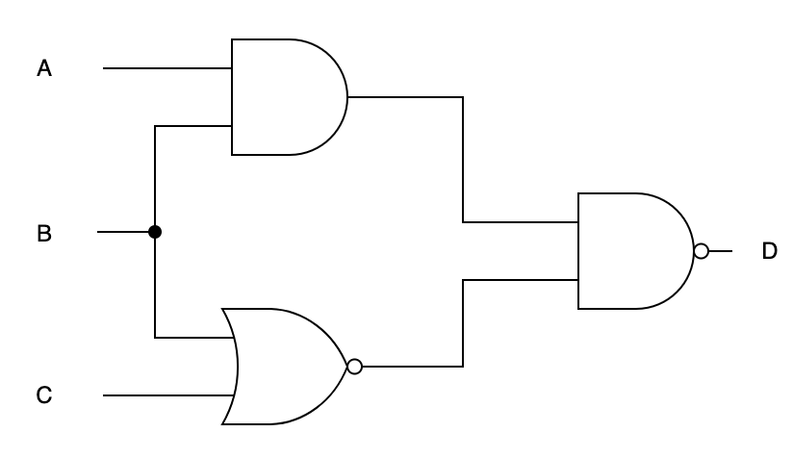
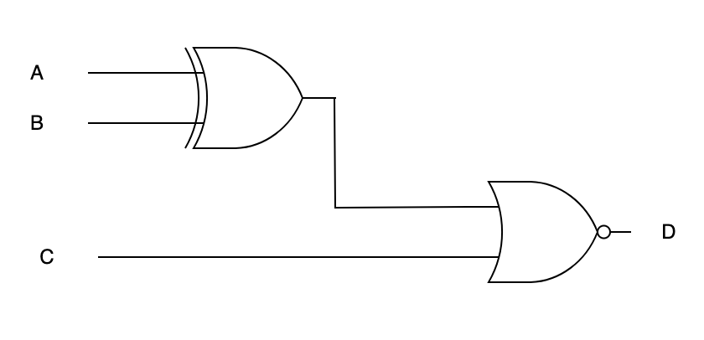
Plenary - Circuits
Write Boolean expressions & produce truth tables for the following logic circuits:
E
D = ~((A . B) . (~(B + C)))
E
D = ~((A ⊕ B) + C)
F
A | B | C | E A . B | F ~(B + C) | D ~(E . F)
0 | 0 | 0 | 0 | 1 | 1
0 | 0 | 1 | 0 | 0 | 1
0 | 1 | 0 | 0 | 0 | 1
0 | 1 | 1 | 0 | 0 | 1
1 | 0 | 0 | 0 | 1 | 1
1 | 0 | 1 | 0 | 0 | 1
1 | 1 | 0 | 1 | 0 | 1
1 | 1 | 1 | 1 | 0 | 1
A | B | C | E A ⊕ B | D ~(E + C)
0 | 0 | 0 | 0 | 1
0 | 0 | 1 | 0 | 0
0 | 1 | 0 | 1 | 0
0 | 1 | 1 | 1 | 0
1 | 0 | 0 | 1 | 0
1 | 0 | 1 | 1 | 0
1 | 1 | 0 | 0 | 1
1 | 1 | 1 | 0 | 0
Notes:
Use this slide or the worksheet as plenary
Make sure that you re-emphasize on the technique of decomposition and labeling the intermediate output.

