Slide 1



Teaching Pack – Boolean Logic
Lesson 3 – More Logical Gates (NAND, NOR, XOR)
Cambridge IGCSE™
Computer Science 0478
Version 1.0
Copyright © UCLES May 2025

Slide 2
In this lesson we will cover:
recap of AND OR NOT
understanding function of NAND, NOR & XOR gates
for these 3 gates:
  identifying and using their symbols
  creating their truth tables
  writing their Boolean expressions
working with circuits
By the end of the lesson, you should be able to identify and use the 6 gates, construct their truth tables, write their Boolean expressions and work with circuits.

Slide 3

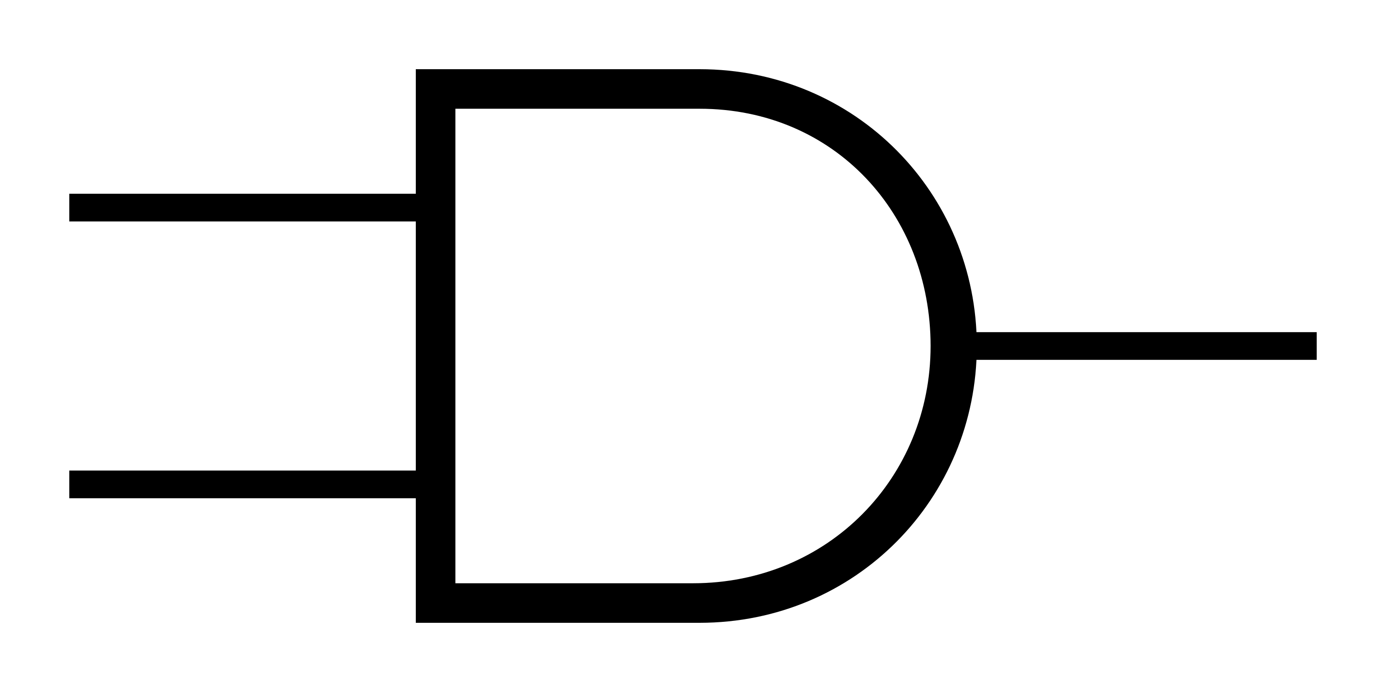
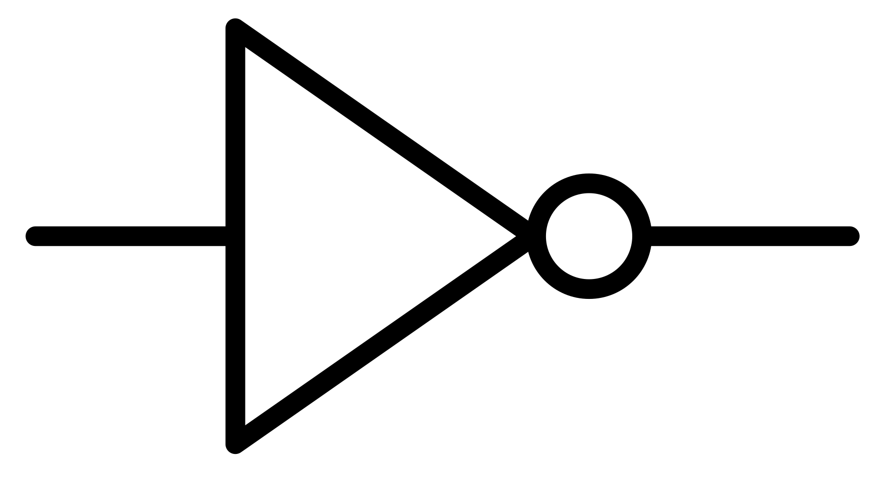
Recap of AND, OR, NOT
Write the below in statements in Boolean expression form :
C = A OR B ?
P AND Q ?
Y = NOT Z ?
Mention True or False for each of the following statements:
If at least 1 of the inputs are 1 (ON) AND gate gives an output of 1 (ON) ?
NOT gate takes only 1 input ?
Use Symbols to draw the diagrams for the following:
A = X OR Y ?
X = A AND B ?
NOT (R) ?
X
A
C = A + B
Y
P . Q
A
Y = ~ Z
X
B
R
False
True
Notes:
Use this slide to recap the 3 Boolean gates symbols as well as Boolean expressions (for AND, OR, NOT).

Slide 4
Practice with Boolean logical statements
NOT ( (5 > 3) AND (7 = 7) ) ?
NOT ( (3 is prime) OR (4 is even) ) ?
Exclusively either (4 is prime)
OR (5 is odd) ?
NOT ((Circle is a shape) OR (triangle is a shape) ) ?
NOT ( (Water boils at 50°C) OR (Sun rises in the west) ) ?
Exclusively either (Earth is round) OR (Water is wet) ?
A switch is either ON OR OFF ?
FALSE
TRUE
FALSE
FALSE
TRUE
TRUE
FALSE
Notes:
This slide or worksheet is designed to introduce learners to the next level of Boolean operators (NAND, NOR, XOR) using clear and simple language.
Use this opportunity to address and clarify any misconceptions.
Note: “Exclusive” or “either/or” statements mean that only one condition should be true—if both are true, the result is false.

Slide 5
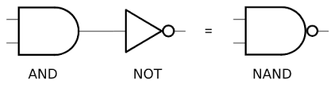
NAND Gate
NAND
A | B | A . B | ~ (A . B)
0 | 0 | 0 | 1
1 | 0 | 0 | 1
0 | 1 | 0 | 1
1 | 1 | 1 | 0
~ ( A . B )
______
( A . B )
NAND gate produces a 0 (OFF) output only when both inputs are 1 (ON).
Credit: https://spinningnumbers.org/
Notes:
Use this slide to introduce NAND gate as a combination of AND + NOT.
Introduce its symbol and explain its Boolean expression.
Ask the learners to solve the truth table step by step to reach the output.
Also, draw their attention towards the fact that NAND gives a complete reversed output of AND gate.
So, when both the inputs are ON, the NAND gate will be OFF.

Slide 6
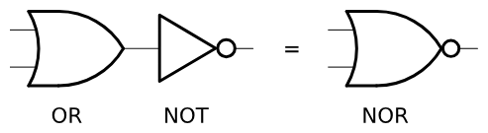
NOR Gate
NOR
A | B | A + B | ~ (A + B)
0 | 0 | 0 | 1
1 | 0 | 1 | 0
0 | 1 | 1 | 0
1 | 1 | 1 | 0
~ ( A + B )
______
( A + B )
NOR gate produces a 1 (ON) output only when both inputs are 0 (OFF).
Credit: https://spinningnumbers.org/
Notes:
Use this slide to introduce NOR gate as a combination of OR + NOT.
Introduce its symbol and explain its Boolean expression.
Ask the learners to solve the truth table step by step to reach the output.
Also, draw their attention towards the fact that NOR gives a complete reversed output of OR gate.
So, when both the inputs are OFF, the NOR gate will produce a ON state.

Slide 7
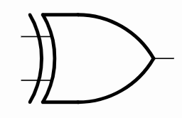
XOR Gate
XOR
A | B | A ⊕ B
0 | 0 | 0
1 | 0 | 1
0 | 1 | 1
1 | 1 | 0
A ⊕ B
XOR gate produces a 1 (ON) output only when exclusively only 1 input is 1 (ON).
i.e. when the 2 inputs are different.
Credit: https://spinningnumbers.org/
Notes:
Use this slide to introduce XOR gate as a modified version of OR.
Introduce its symbol and explain its Boolean expression.
Explain the learners that XOR means Exclusive OR – that means when exclusively only 1 of the input is in the ON state will the output be as ON.

Slide 8
Summary of NAND, NOR & XOR gates
Keywords | Symbol | Boolean Expression | Truth Table
For Logical statements | For logical circuit | For Boolean Algebra | For testing the circuits
NAND |  | ~ ( A . B ) ______ ( A . B ) | Reverse of AND. This means if both A and B are 1 (ON) then output will be 0 (OFF).
NOR |  | ~ ( A + B ) ______ ( A + B ) | Reverse of OR. This means if both A and B are 0 (OFF) then output will be 1 (ON).
XOR |  | A ⊕ B | Exclusive OR. This means when exclusively only one of the input is in the 1 (ON) state then the output will be 1 (ON).
Notes:
Use this slide to summarize the learning of the 3 gates (NAND, NOR, XOR) in all the 4 ways of expressing it.
Use this opportunity to clarify the doubts, if any.

Slide 9
Understanding visually
Short video for:
NAND Gate: https://wwwˌyoutubeˌcom/shorts/HCxcksrm-zU
NOR Gate: https://wwwˌyoutubeˌcom/shorts/OnDSgUAzwGM
XOR Gate: https://wwwˌyoutubeˌcom/shorts/-2GVoKkdCi4
Notes:
Use this slide to demonstrate to learners how these three gates are implemented and how they function.

Slide 10
Practice NAND, NOR & XOR gate
Give the correct output for each of the following:
Sun sets in the west
Blood is red in color
0
0
Sun rises in the east
Sun is a star
The door is open now
You are standing now
1
0
That door is also closed at the same time
You are not sitting at the same time
Notes:
Use this slide of the worksheet to let the learners practice NAND, NOR & XOR Gates.

Slide 11
Practice truth table
Complete the following truth tables:
XOR Gate
NAND Gate
NOR Gate
A | B | A ⊕ B
0 |  | 1
0 | 0 | 0
 | 0 | 1
1 | 1
A | B | working | ~ (A . B)
0 |  |  | 1
0 | 0
 | 0 |  | 1
1 | 1
A | B | working | ~ (A + B)
1 | 1 |  | 0
0 | 0 |  | 1
 | 1 |  | 0
1
1
1
0
1
0
1
0
1
1
0
0
1
0
1
0
0
1
0
Notes:
This slide or the worksheet is created to give appropriate practice to the learners. Use this opportunity to clarify any misconceptions
NOTE: The inputs are not in the order (as discussed on Slide 11) on purpose so that the learners actually apply the rule to get the result.
Encourage learners to use the working column as it is beneficial in exams to show the working

Slide 12
Real life examples
Gate | Example | Explanation
AND | A microwave only starts if the door is closed AND the start button is pressed. | Both conditions must be true for it to work.
OR | You decide to carry an umbrella if it’s raining OR if the weather forecast predicts rain. | Any 1 or both condition must be true for it to be true.
NOT | A smart tap stops water flow when motion is NOT detected. | It inverts the input.
NAND | A safety alarm system is active unless both safety checks are passed. | If both conditions are true (i.e., checks passed), the output is false (no alarm); otherwise, the alarm sounds.
NOR | Water can be fully contained only if the container is not porous and not flat. | Both conditions must be false for the water to be contained, else it will get absorbed or drained.
XOR | A lamp controlled by two-way switches turns ON only when one switch is flipped. | Flipping either switch changes the lamp's state, but flipping both cancels out, leaving it OFF — classic XOR behaviour.
Notes:
Use this slide to wrap up the lesson by providing real-world examples.
This will prepare them for the plenary.

Slide 13
Plenary - Guess the gate
For each of the following input-output scenarios, determine which logic gate (AND, OR, NOT, XOR, NAND, or NOR) produced the result. Show your reasoning.
Example:
Input A = 1, Input B = 1, Output = 0
Answer: NAND
Reasoning: A NAND gate gives 0 only when both inputs are 1.
Input A = 0, Input B = 0, Output = 0
Answer: ____________
Reasoning: __________________________________________
Input A = 1, Input B = 1, Output = 1
Answer: ____________
Reasoning: __________________________________________
Input A = 1, Input B = 0, Output = 1
Answer: ____________
Reasoning: __________________________________________
Notes:
This activity is to be used for the plenary. It is meant for the learners to extend their thinking capabilities & go beyond the simple examples solved till now.
The aim for this slide is to help learners identify the circuit / gate using the truth table.
Use this slide or the worksheet.
Note: more than 1 gate may be valid.
Encourage learners to use truth tables to back up their answers.
Solution: (Accept any of the correct answers with correct reasoning)
AND / OR / XOR
AND / OR
OR / XOR / NAND

Slide 14
Plenary - Guess the gate
Input A = 1, Input B = 0, Output = 0
Answer: ____________
Reasoning: __________________________________________
Input A = 0, Input B = 0, Output = 1
Answer: ____________
Reasoning: __________________________________________
Input A = 0, Output = 1
(Note: This is a single-input gate)
Answer: ____________
Reasoning: __________________________________________
Input A = 1, Input B = 1, Output = 0
Answer: ____________
Reasoning: __________________________________________
Notes:
This activity is to be used for the plenary. It is meant for the learners to extend their thinking capabilities & go beyond the simple examples solved till now.
Solution: (Accept any of the correct answers with correct reasoning)
4.AND / NOR
5.NOR / NAND
6.NOT
7.NAND / NOR

