Slide 1



Teaching Pack – Boolean Logic
Lesson 1 – Logical Gate (AND)
Cambridge IGCSE™
Computer Science 0478
Version 1.0
Copyright © UCLES May 2025

Slide 2
In this lesson we will cover:
recap of simple Boolean logical operators
introduction to the concept of gates
understanding the function of AND gate
for the AND gate:
  identify and use its symbol
  create its truth table
  write its Logical / Boolean expression
By the end of this lesson, you should have a clear understanding of logic gates. For the AND gate you should be able to recognize its symbol, explain its function, construct its truth table, and write its corresponding logical expression.

Slide 3
Recap of Boolean logical operator - AND
AND
Both conditions must be true for the result to be true.
      Examples:
      1) The grass is Green
      AND
      The sun is Hot
      (TRUE AND TRUE = TRUE)
      2) The grass is Green
      AND
      The sun is Cold
      (TRUE AND FALSE = FALSE)
      3) The grass is Pink
      AND
      The sun is Cold
      (FALSE AND FALSE = FALSE)
Notes:
Use this slide to recap the the Boolean Logical Operator – AND
The examples provided here, are based on real-life scenario, which would be easy to understand.

Slide 4
Practice with Boolean logical statements
(2 > 5) AND (2 < 4)?
(99 ≥ 98) AND (2 ≤ 1) ?
6 is even AND divisible by 3 ?
A circuit conducts current if it is closed AND contains a power source.
11 is a prime number AND is even ?
Triangle has no angle = 90° AND it satisfies Pythagoras’ theorem ?
Earth is round AND the sun sets in the west ?
A light bulb turns on if the switch is ON AND power is supplied.
(1 != 1) AND sugar tastes sweet ?
Dogs meow AND Cats bark ?
FALSE
TRUE
FALSE
TRUE
TRUE
FALSE
TRUE
FALSE
FALSE
FALSE
Notes:
This slide or worksheet is designed to provide targeted practice to learners on Boolean operator (AND).
Use this opportunity to address and clarify any misconceptions.

Slide 5
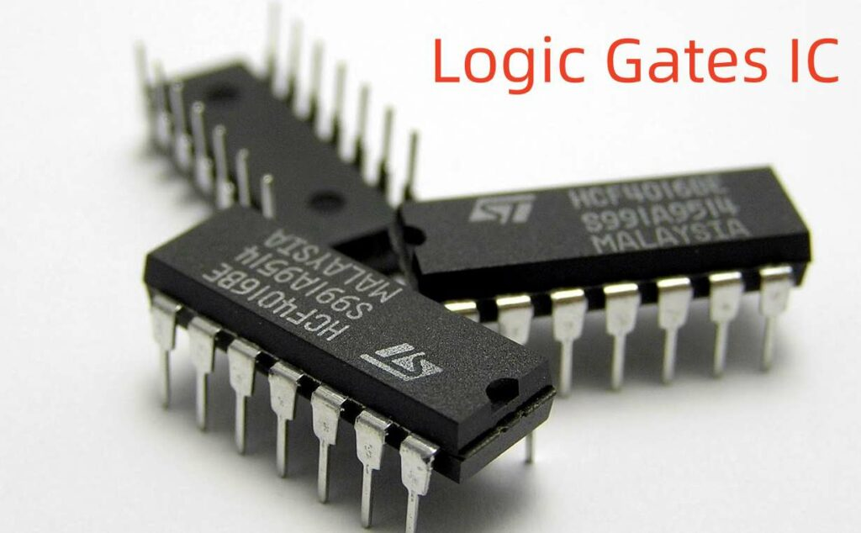
How does Boolean logic actually work in a computer?
You just saw how Boolean logic statements works on the previous slide.
But have you ever wondered how a computer checks something like:
“6 is even AND divisible by 3”?
This is where logic gates help us!
Logic gates are tiny electronic parts inside a computer.
They carry out Boolean logic operations — like AND, OR, NOT.
They are the real tools that help a computer make decisions in the physical world.
Image credit: https://ebics.net/logic-gates-ic/
Notes:
Use this slide to introduce the concept of gates.
The operators of AND that was mentioned previously are used to make a logical statement.
Now, Boolean Logical gates means the same thing, but in electronics.
Gates are used in circuits and computers to physically execute the logical statements.

Slide 6
Example - understanding Gates
There are 2 rules to enter the club.
You should be:
  the club member
  AND
  over 21 years of age
The Boolean operator AND, is a simple English word which helps you create the above rule in your mind and then express it to the world via algorithm, pseudocode or programming.
The Boolean logical gate AND, is like the security guard at the door who is physically checking the membership card and ID and then decides whether to let the person in or not (i.e., implementing that rule in the real world).
Notes:
Use this slide to give a clearer explanation of logic gates through the real-world example provided.

Slide 7
Difference between Boolean operators and Boolean gates
 | Boolean Operators | Boolean Gates
Usage | Used in thinking or programming | Used to create circuits or electronics
World | Programming world (concept) | Real Physical world (physical implementation of that concept)
Meaning | Used to create logical instructions | These are physical devices (inside the computing device) that execute the instructions written using the Boolean operators
Works with | True / False | 1 (ON) / 0 (OFF)
Expressed as | Logical statements (English keywords – AND, OR & NOT) | Symbol Truth Table Boolean expression / Boolean algebra
Notes:
Use this slide to highlight the key differences and summarize the concepts of Boolean operators and Boolean gates.
Highlight that the Gates work with 0s and 1s.
0 indicates OFF / LOW / FALSE
1 indicates ON / HIGH / TRUE

Slide 8
Class activity - Inputs & Outputs
2 + 2 = 4
How many inputs are there for this + operator ?
2
How many outputs does this + operator produce?
1
Earth is round AND the sun sets in the west → TRUE
NOT true that 4 is less than 8? → FALSE
How many inputs are there for this AND operator ?
How many inputs are there for this NOT operator ?
2
1
How many outputs does this AND operator produce?
How many outputs does this NOT operator produce?
1
1
Notes:
Use this slide to help learners explore the number of inputs and outputs for the AND and NOT gates.
Hint:
If there is data on only one side of the operator, it means there's 1 input.
If there's data on both sides, then there are 2 inputs.
The result, or output, is always on the right side of the equals sign.
Conclusion :
All three gates produce 1 output,
AND and OR gates require 2 inputs,
NOT gate works with 1 input.

Slide 9
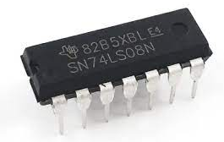
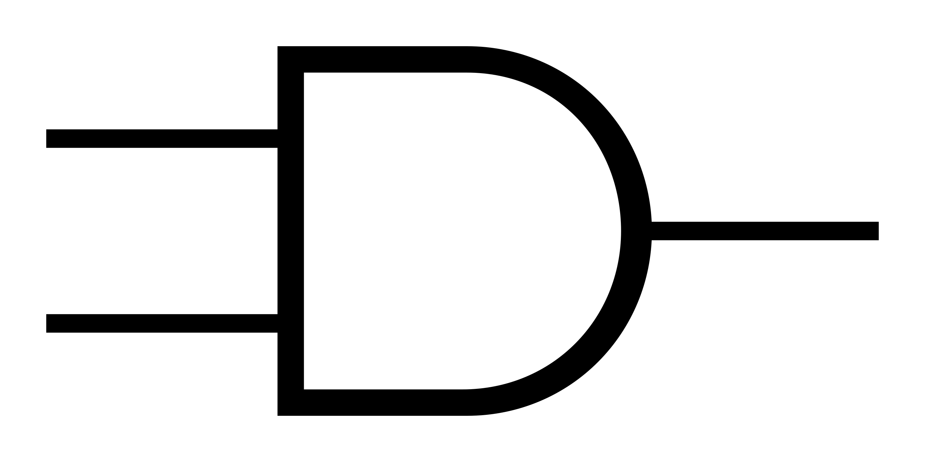
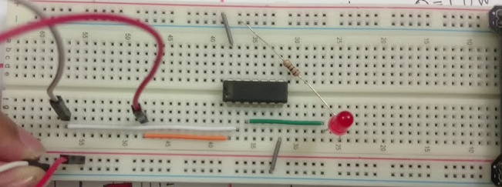
Symbol for AND
AND Symbol
A
OUTPUT
2 INPUTS
B
X
Used on circuit diagrams
Use in Real-World Electronics
Inside devices like phones, calculators, or even air conditioner, the physical gates are inside microchips.
And Engineers use the symbol to design and explain how those chips behave (logical circuit diagram).
Image credit: https://www.youtube.com/watch?v=eX84sXsPGmk
Notes:
Use this slide to introduce the symbol for AND gate.
Explain them that symbols provide a simplified, diagrammatic way to represent logic gates.
Engineers & students rely on these symbols to draw circuit diagrams.
Just like electrical diagrams have battery and resistor symbols, logic circuits have gate symbols.
Explain them that there are 2 inputs represented by the lines on the left side and 1 output represented by the line on the right side. They are usually labelled for ease of addressing them.
Make sure learners understand the distinction between a physical AND gate and its symbolic representation (the images are used to show the AND gate IC and its connection on the breadboard with inputs and outputs).

Slide 10
Understanding inputs & outputs with AND symbol
2 INPUTS
OUTPUT
A
Earth is round
True
X
Sun sets in west
True
B
TRUE
2 INPUTS
OUTPUT
99 ≥ 98
True
A
X
B
2 ≤ 1
False
FALSE
Notes:
This slide can be used to illustrate inputs and outputs to the AND gate through real-world examples.
Present the two inputs shown in the first diagram and ask learners to determine the output.
Then, do the same with the second diagram, encouraging learners to predict the output based on the given inputs.

Slide 11
Truth Table for AND
Example
Truth Table
Dogs meow AND Cats bark ?
Dogs meow AND Cats meow ?
Dogs bark AND Cats bark ?
Dogs bark AND Cats meow ?
Input 1 | Input 2 | Output
False | False | False
False | True | False
True | False | False
True | True | True
FALSE
FALSE FALSE
FALSE TRUE
TRUE FALSE
TRUE TRUE
FALSE
FALSE
TRUE
AND will produce a TRUE output only when both the inputs are TRUE.
Truth table is a simple tabular way to show all the possible outcomes of a logical statement based on different combinations of inputs.
It helps us see exactly what the gate does, so understanding the gate's function is key to constructing its truth table.
Notes:
Use this slide to introduce the concept of a truth table through a real-life scenario, making it easier for learners to grasp.
Ask learners to answer the four example questions and explain their reasoning. Highlight that for the AND operator, both inputs must be TRUE to get a TRUE output—this is why only the last example gives a TRUE result.
Help them recognize that Boolean operators work with values that are either TRUE or FALSE and produce an output in the same format—hence the term Boolean.
Finally, explain how the example on the left is represented in the tabular form on the right, which is called the truth table.
To construct a truth table, learners should label all input variables as column headings, list every possible combination of inputs as rows, and then work through the logic step by step to determine the final output for each row.
Truth table is used by Engineers and students to build, test, or check logic circuits.

Slide 12
Boolean expression of AND Gate
Gate | Boolean Expression | Meaning
A AND B | A . B | This means both A and B must be ON to get the output ON.
Notes:
Using this slide introduce how to write AND gate in the Logical or Boolean expression form (also known as Boolean Algebra).
It’s just a short way to write what a logic gate does, using letters and symbols.

Slide 13
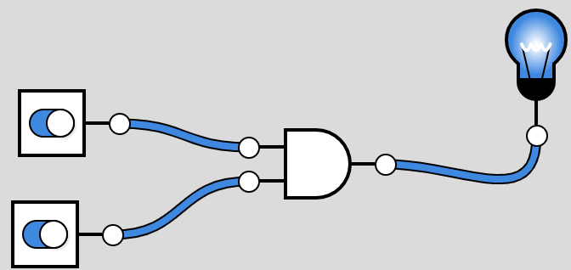
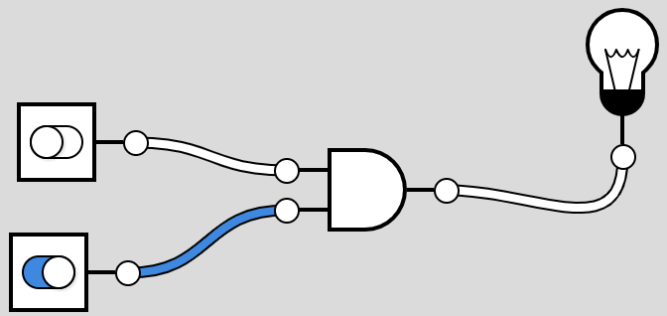
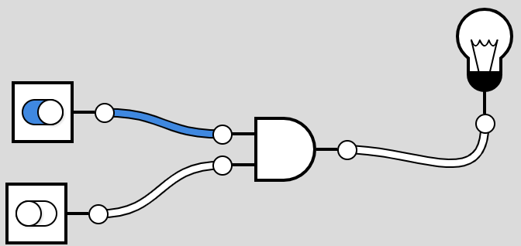
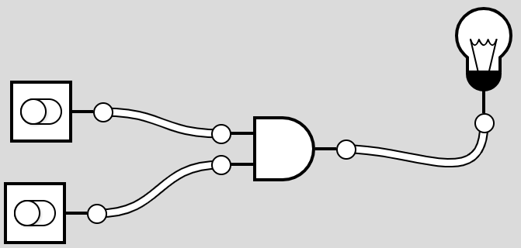
Simulation
Website: https://logicˌly/demo/
Both switches are ON → Light Bulb is ON
One of the switch is OFF → Light Bulb is OFF
Both switches are OFF → Light Bulb is OFF
Notes:
This slide is optional.
Simulation creation instruction for teacher: Visit website: https://logic.ly/demo/ to create your own simple circuit with 1 AND gate and 2 Toggle switches for input along with a light bulb for output. Connect them all as shown in the diagram above.
Use this to give the demo to the learners.
Use this slide in case the simulation website is unavailable.
Alternatively, you may also wish to work with the downloadable logic gate simulator: www.softpedia.com/get/Others/Home-Education/Logic-Gate-Simulator.shtml or www.logiccircuit.org/
Also, inform the learners that the gates can take more than 2 inputs too, but the scope of our syllabus limits to 2 input gates
Note: This website and alternatives are mentioned in the SOW too.

Slide 14
Practice
List all possible combination of Boolean values for both the scenarios.
Give the correct output:
With 1 input
10 x 10 = 100
With 2 inputs
0
Input 1
Input 1 | Input 2
10 + 10 = 100
0
0
0
Give the correct input:
E or any alphabet after E. (Aim – get true here)
1
0
1
D comes before ___
1
0
1
1
1
The next number in the sequence:
2, 4, 8, 16, ___? IS 32
Notes:
Use this slide or the worksheet to give additional practice to the learners.
Explain the learners that since we were understanding the concept of Truth tables (in slide 11), we used True/False. However, now they must start using 0s & 1s (0 indicates OFF / LOW / FALSE & 1 indicates ON / HIGH / TRUE).
Take this opportunity to share a helpful trick that will ensure learners list all possible input combinations without missing any:
Start with the rightmost input column and fill it by alternating 0 and 1 (e.g., 0, 1, 0, 1...).
Then, move to the column to its left and alternate 0s and 1s in pairs (e.g., 0, 0, 1, 1...).
This pattern continues, with the group size doubling for each column to the left.

Slide 15
Practice
Complete the truth table for AND Gate
Input 1 A | Input 2 B | A AND B
0 |  | 0
0 | 0 | 0
 | 1 | 1
1 |  | 0
1
1
0
Notes:
Use this slide or the worksheet to practice truth table of AND gate.
This is a continuation slide (from the previous slide).
NOTE: The inputs are not in the order, as discussed in previous slide, on purpose so that the learners actually apply the rule to get the result.

Slide 16
Summary
Keywords | Symbol | Boolean Expression | Truth Table
For Logical statements | For logical circuit | For Boolean Algebra | For testing the circuits
AND |  | A . B | This means both A and B must be 1 (ON) to get the output 1 (ON). (Takes 2 inputs)
Notes:
Use this slide to summarize the learning of AND gate in all the 4 ways of expressing it.
Use this opportunity to clarify the doubts, if any.

Slide 17
Plenary - Simulation exploration
Visit the website: https://logicˌly/demo/ & set up a simulation using an AND gate.
Start by using toggle switches as inputs to explore each combination.
Observe how different input combinations affect the output.
Next, replace the toggle switches with Constant 0, Constant 1, and a Clock input to see how they behave.
Discuss and share your understanding of how Constant 0, Constant 1, and Clock work with your teacher.
Instructions (if needed):
From the left panel under "Logic Gates," click and drag the required gate onto the centre stage.
Next, go to "Output Controls" in the left panel, drag the Light Bulb onto the centre stage, placing it to the right of the gate.
Then, drag two Toggle Switches from the panel and place them on the left side of the gate.
To connect the components, click on the connection point of a toggle switch, then click on one of the gate’s input points.
Repeat the process to connect the second toggle switch to the second input of the gate and finally connect the gate’s output to the light bulb.
Notes:
This activity is to be used for the plenary. Use this slide or hand over the worksheet.
It is meant for the learners to explore and have hands-on experience to strengthen their understanding of the basic AND gate.
Form small groups of learners and ask them to create the simulation for AND gates and follow the exploration instructions given on the slide.
Ask them to explore and share their understanding of Constant 1, Constant 0 & Clock with you.
Differentiation:
If a few learners need support with creating the simulation on the website, provide them with the instructions on this slide or a separate instruction sheet and guide them too.

