Slide 1
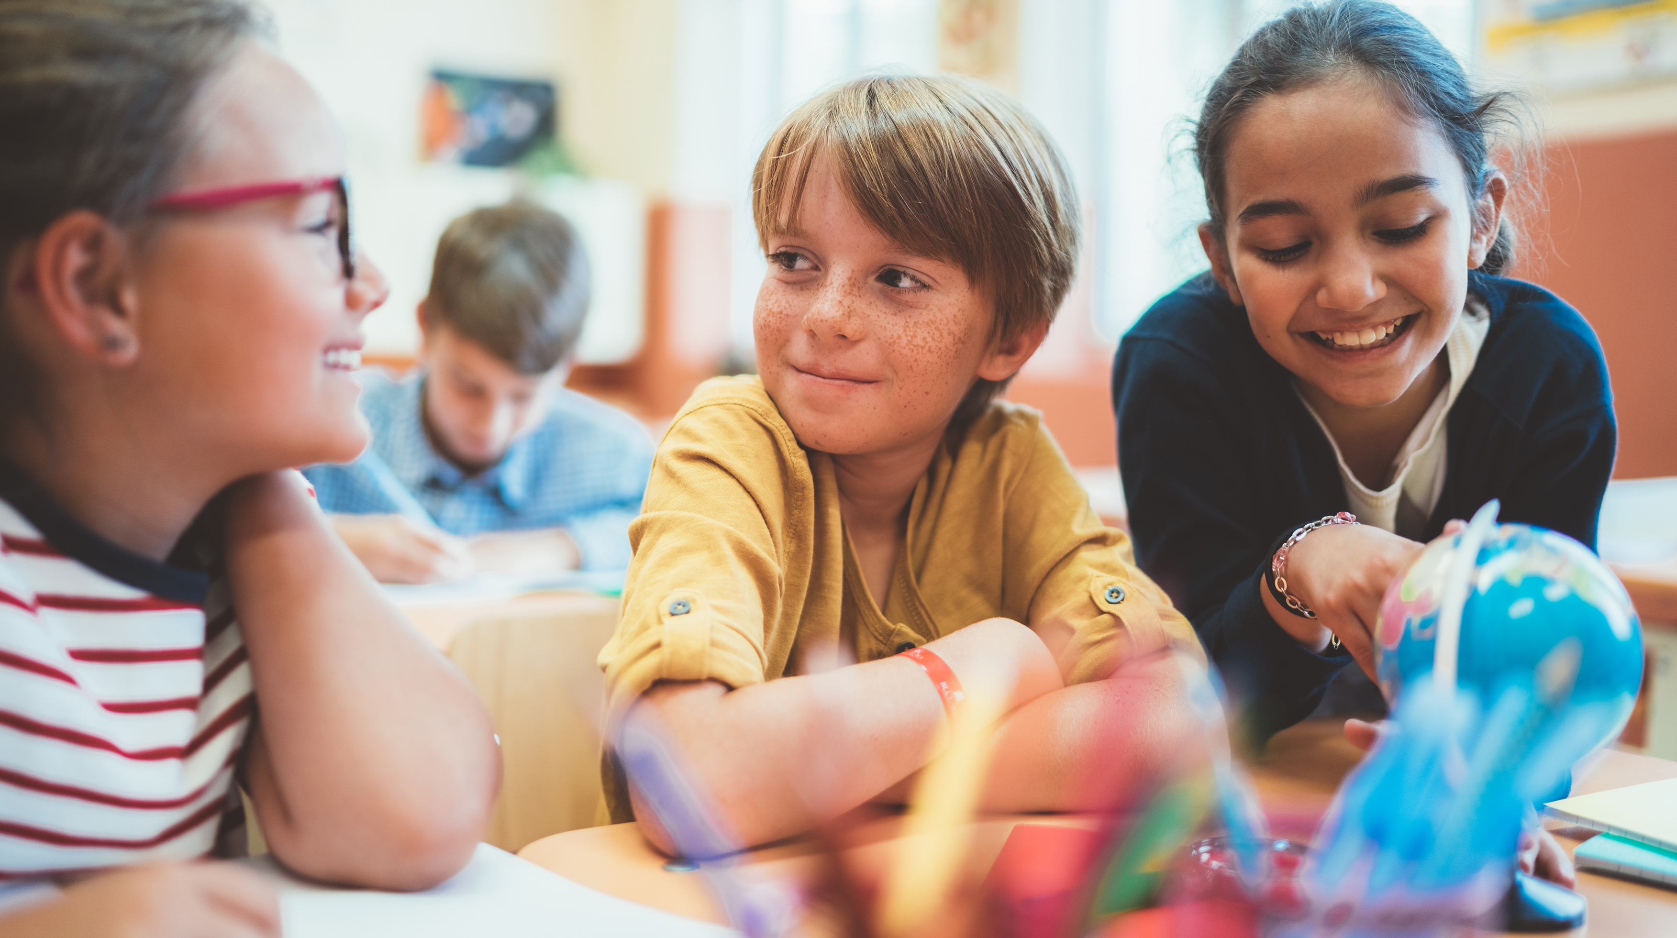
Lesson objectives:
Explain the argument for the social learning theory of prosocial behaviour
Describe the results and conclusions of the named study: prosocial media use (Prot et al.)
Explain the argument against the social learning theory of prosocial behaviour
Describe the role of biological factors in prosocial behaviour

Slide 2

Starter activity:
List your favourite:
TV programme
Film
Video game
On a scale of 1-5 (1 being not at all, 5 being very often), how often do characters in each help each other?

Slide 3
Named study: Prosocial media use (Prot et al.)
Aim: To investigate prosocial media use and prosocial behaviour across seven countries.
Participants: 2202 teenagers and young adults including males and females from Australia, China, Croatia, Germany, Japan, Romania and the USA
Procedure: Participants were asked about their favourite media. They had to list their three favourite television programmes, three favourite films and three favourite video games. The participants rated each programme, film and game for the amount of time they spent watching or playing it. Participants also gave ratings for prosocial content, e.g. ‘How often do characters help each other?’

Slide 4
Named study: Prosocial media use (Prot et al.)
Procedure: Prosocial media use was then calculated by multiplying the amount of time spent watching or playing the media with the prosocial content rating. Participants also completed questionnaires to measure their own prosocial behaviour.
Results:
Participants with higher prosocial media use reported higher levels of prosocial behaviour, such as helping others.
Across all countries, prosocial media use was linked with helping.
Conclusion: Prosocial media use can predict higher levels of prosocial behaviour, across different countries. This supports the theory that prosocial behaviour is linked with prosocial media use; learning from observing others.

Slide 5

Class discussion: How do the results and conclusions of this study support the argument for social learning theory of prosocial behaviour?

Slide 6
Read the scenario:
Max is a 5-year-old who loves watching happy cartoons like Bluey, where the characters are always helping and showing kindness.
His parents read him the book Paddington Bear, and he often talks about how "being polite is important, even to strangers."
Max’s mother is a volunteer community gardener. Every Saturday morning, Max likes to join her in the garden, watering plants together.
One morning Max noticed a new volunteer, a girl of his age, backing away nervously from an insect nearby. He noticed the fear on her face, then walked over and gave her a comforting hug.

Slide 7
Task
Using two different colour pens, highlight or underline social learning factors and other factors (e.g. biological factors) in the scenario
For each factor, write a sentence explaining how it supports the argument for the role of social learning theory in prosocial behaviour, or the argument against

Slide 8
Bluey and Paddington are prosocial media role models who Max observes and imitates. His parents mediate his prosocial media use.
Max is a 5-year-old who loves watching happy cartoons like Bluey, where the characters are always helping and showing kindness.
His parents read him the book Paddington Bear, and he often talks about how "being polite is important, even to strangers."
Max’s mother is a volunteer community gardener. Every Saturday morning, Max likes to join her in the garden, watering plants together.
One morning Max noticed a new volunteer, a girl of his age, backing away nervously from an insect nearby. He noticed the fear on her face, then walked over and gave her a comforting hug.
His mother also shows prosocial behaviour of caring about the community garden- Max’s prosocial behaviour could be genetic. Max notices fear on the girl’s face, which means his amygdala is processing emotions of others and then responding in a prosocial way (hugging).

Slide 9

Check your understanding
Create a set of flashcards including the named study:
Aim
Sample
Method
Results
Conclusions
Self-assess your knowledge and understanding of the study or test a classmate. Review your notes for any gaps in your knowledge.

