Slide 1

Lesson objectives:
Describe modelling of prosocial behaviour in the media
Explain parental mediation of media use
Explain the role of empathy in social learning theory and the media
Apply knowledge of learning from prosocial behaviour in the media to novel scenarios

Slide 2
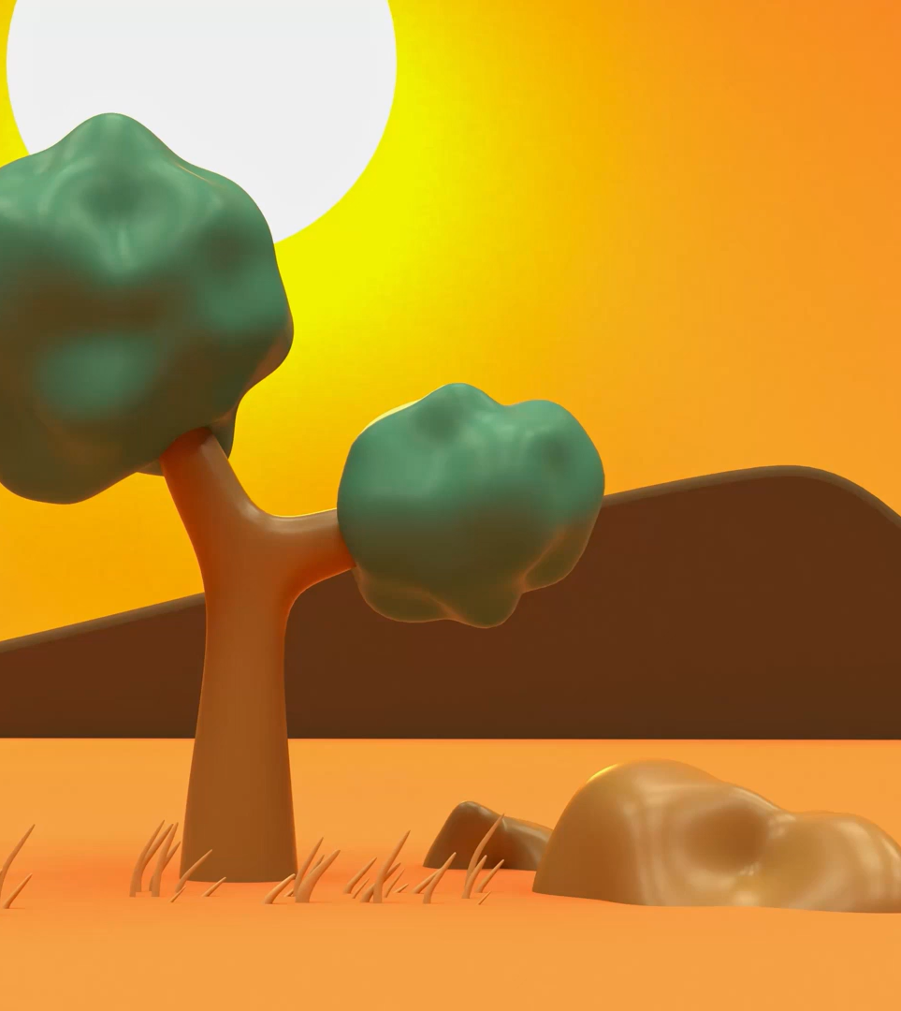
Starter activity
Choose one of the characters from the following types of media:
Books: Auggie Pullman (Wonder) or Percy Jackson (Percy Jackson & the Olympians)
Films: Anna and Elsa (Frozen) or Spider-man (Peter Parker)
TV Bluey or Avatar Aang (The Last Airbender)
Video games: Mario (SuperMario) or Link (Legend of Zelda)
Write down prosocial behaviours (helping, sharing, caring) this character demonstrates.

Slide 3
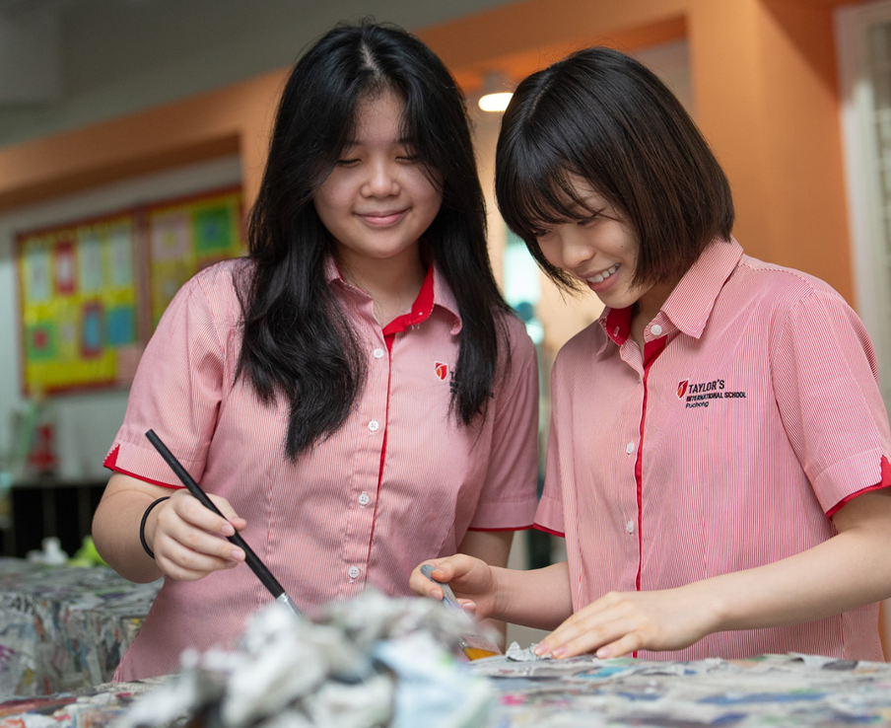
Key term
Modelling is:
‘learning by imitating or copying others (models)’
Empathy is:
‘the ability to understand another’s feelings and see things from their point of view’

Slide 4

Social learning theory and prosocial media
In pairs, apply the following aspects of social learning theory to explain how individuals might learn prosocial behaviours from the media role model you chose:
Stages of social learning theory
Modelling
Vicarious reinforcement
Empathy

Slide 5
Key term
Parental mediation of media use is:
‘strategies parents use to check, control and discuss children’s media use’

Slide 6

In small groups: Discuss what you think are ways that parents can positively influence or mediate their children’s use of media

Slide 7
Parental mediation of media use
Media can model both prosocial and antisocial/aggressive behavior
Without mediation, children may be exposed to harmful content
With good strategies, parents can promote positive behavior through media:
    Use of shared spaces for media (e.g., living room) are better than bedrooms
    Parents can use control software to monitor device use
    Discussion is key – talk about rules, dangers, and concerns

Slide 8
Group project: Design a poster for one type of media to explain how it can lead to social learning of prosocial behaviours

Slide 9
Check your understanding
Review the posters produced in class. For each poster:
Identify two positive aspects (is the information clearly presented? Have key terms from the topic been used?)
Identify one area for improvement (are the concepts clearly explained? Are there enough examples from the media?)

