Slide 1

Lesson objectives:
Explain the role of the amygdala in prosocial behaviour
Explain the role of the prefrontal cortex in prosocial behaviour
Apply knowledge of the role of brain areas in prosocial behaviour to novel scenarios

Slide 2

Starter activity
What is the amygdala?
Where in the brain is the amygdala located?
What role does the amygdala play in our emotions?

Slide 3

Discussion activity: The amygdala - what do we already know?

Slide 4

Key term
The amygdala is:
‘part of the limbic system active in empathetic responses’

Slide 5
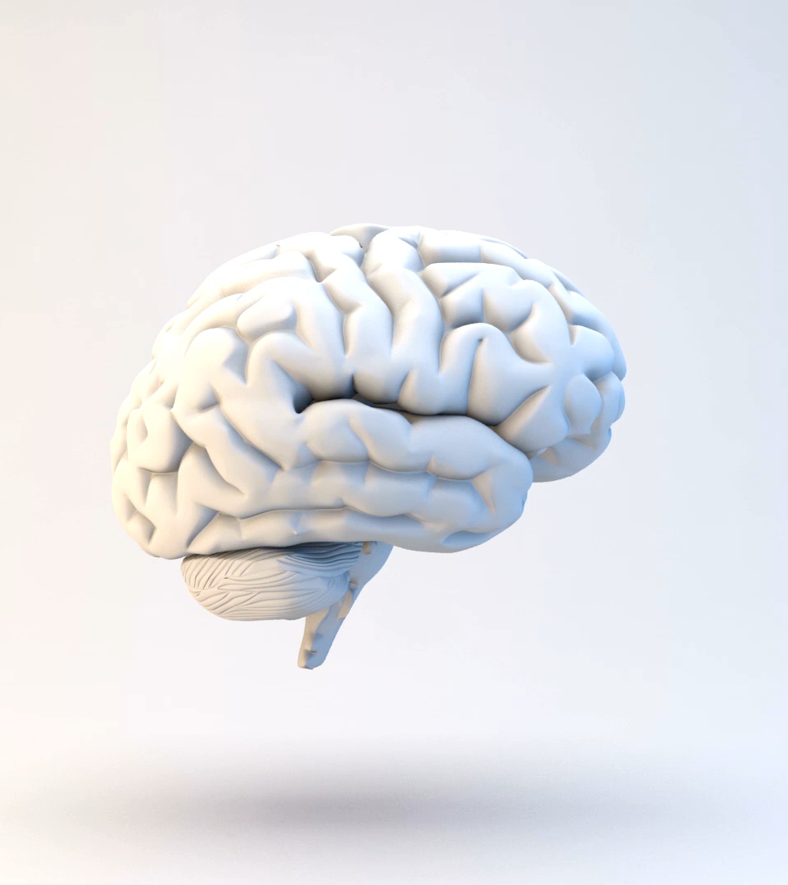
Role of the amygdala in prosocial behaviour
Part of the limbic system in the brain
Involved in empathy (seeing things from other people’s point of view)
Processes social cues from others
Processes threats in the environment

Slide 6
The prefrontal cortex
Watch this video on the prefrontal cortex and make notes on its:
Location
Function

Slide 7
Key term
The prefrontal cortex is:
‘part of the cerebral cortex involved in attention, emotional expression and social behaviours’

Slide 8
Role of the prefrontal cortex in prosocial behaviour
Part of the cerebral cortex
Located at the front of the brain
Involved in attention, decision-making, emotional expression and social behaviours

Slide 9
Role of the brain areas in prosocial behaviour
Example:
You see a child at the top of the stairs, and they start to fall over
Amygdala:
Processes the danger of falling
Interprets the expression of fear on child’s face
Prefrontal cortex:
Pays attention to the child
Involved in decision to act
Prosocial behaviour: You reach out to help stop the child from falling down the stairs

Slide 10
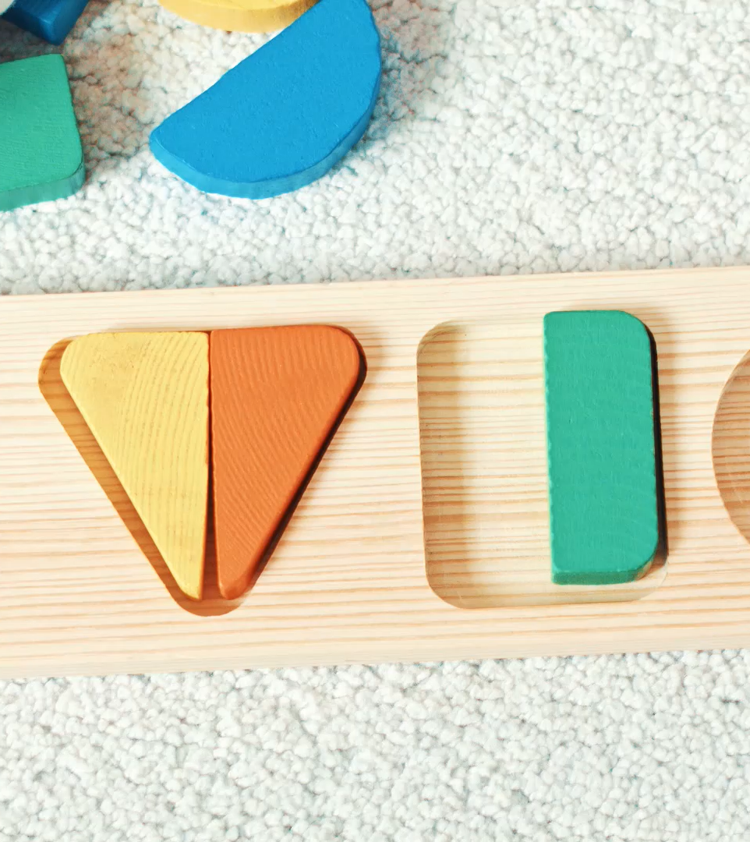
Check your understanding
Choose one of the following scenarios:
A young family member is upset when they accidentally break a new toy
A person in the market struggles to carry their shopping
A new student at school is confused about how to get to a classroom
Explain the role of the amygdala and the prefrontal cortex in each scenario.
Describe what a prosocial response could be for that scenario.

