Slide 1
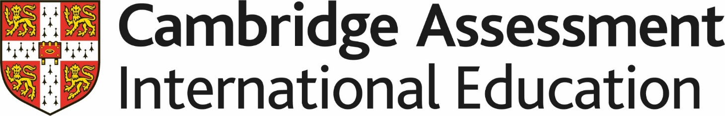
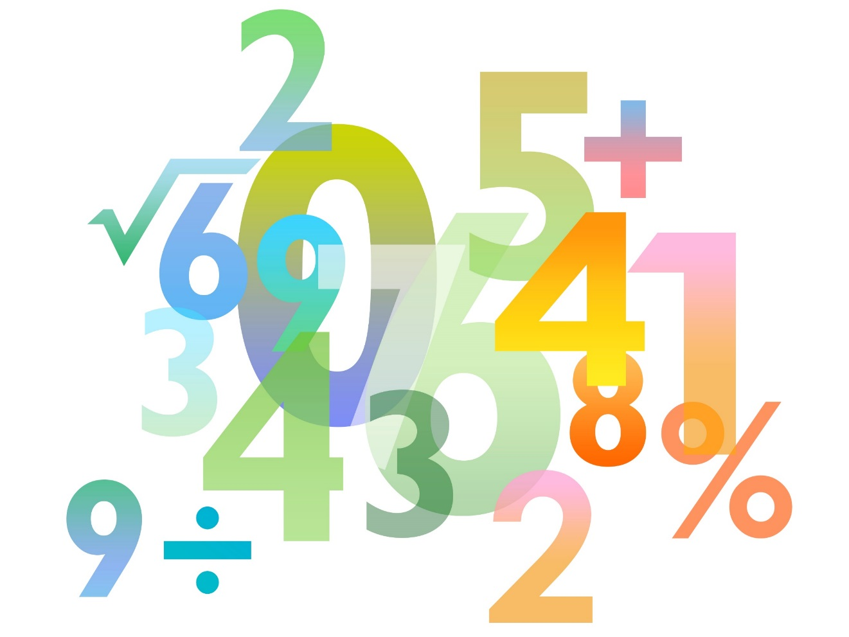

Skills Pack – Exact trigonometric values
Lesson 3
Cambridge IGCSE™/ IGCSE (9-1)
Mathematics 0580 / 0980
Version 0.1

Slide 2
Solving trigonometric equations
A quick review of last lesson…

Slide 3
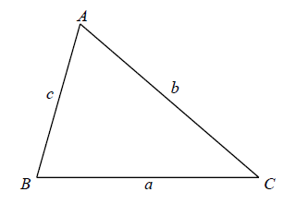
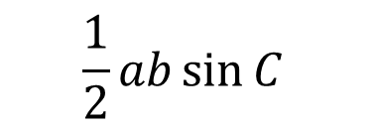
Working with non-right-angle triangles
$$\frac{1}{2}ab\sin{C}$$
Area of triangle =

Slide 4
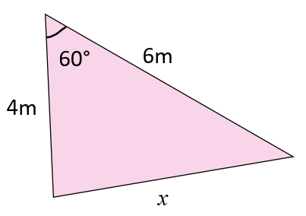
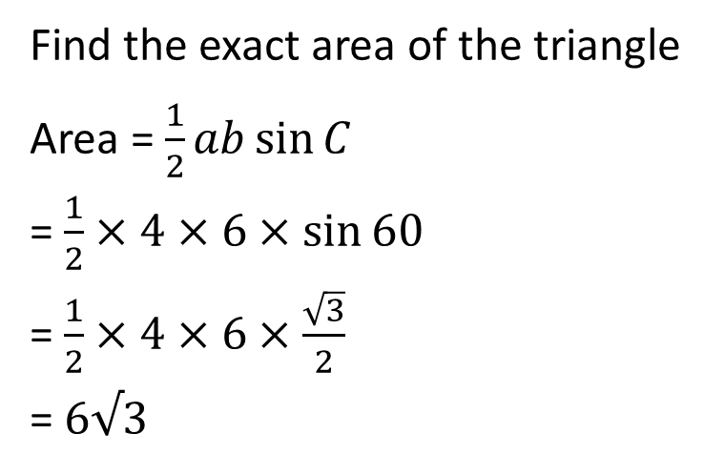
Working with non-right-angle triangles
Find the exact area of the triangle
Area = $\frac{1}{2}ab\sin{C}$
= $\frac{1}{2}×4×6×\sin{60}$
= $\frac{1}{2}×4×6×\frac{\sqrt{3}}{2}$
= $6√3$
C
b
a
A
B
c

Slide 5
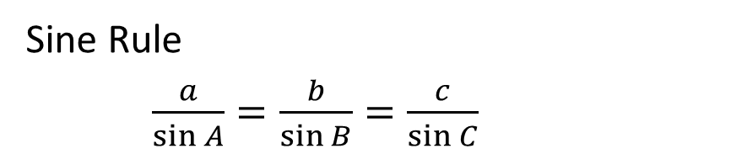
Working with non-right-angle triangles
Sine Rule
$\frac{a}{\sin{A}}=\frac{b}{\sin{B}}=\frac{c}{\sin{C}}$

Slide 6
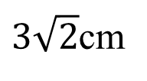

Working with non-right-angle triangles
Work out the value of x
C
b
A
Sine Rule
$\frac{a}{\sin{A}}=\frac{c}{\sin{C}}$
$\frac{3\sqrt{2}}{\sin{30}}=\frac{x}{\sin{45}}$
$\frac{3\sqrt{2}}{\frac{1}{2}}=\frac{x}{\frac{1}{\sqrt{2}}}$
$2×3\sqrt{2}=x\sqrt{2}$
$\frac{2×3\sqrt{2}}{\sqrt{2}}=x$
x = 6
45°
30°
$3\sqrt{2}$cm
x
a
c
B

Slide 7
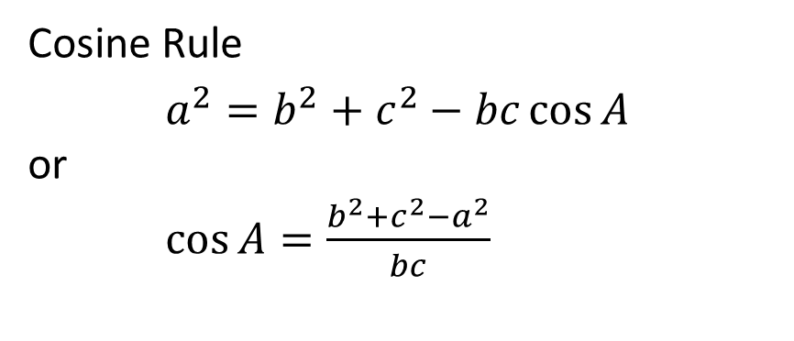
Working with non-right-angle triangles
Cosine Rule
$a^{2}=b^{2}+c^{2}−bc\cos{A}$
or
$\cos{A}=\frac{b^{2}+c^{2}−a^{2}}{bc}$

Slide 8
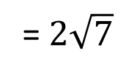
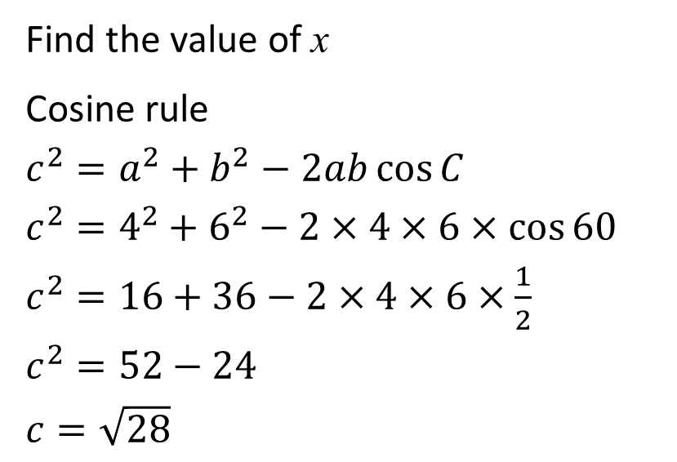
Working with non-right-angle triangles
Find the value of x
Cosine rule
$c^{2}=a^{2}+b^{2}−2ab\cos{C}$
$c^{2}=4^{2}+6^{2}−2×4×6×\cos{60}$
$c^{2}=16+36−2×4×6×\frac{1}{2}$
$c^{2}=52−24$
$c=\sqrt{28}$
C
60°
6m
b
4m
a
A
= 28
x
= $2\sqrt{7}$
B
c

Slide 9
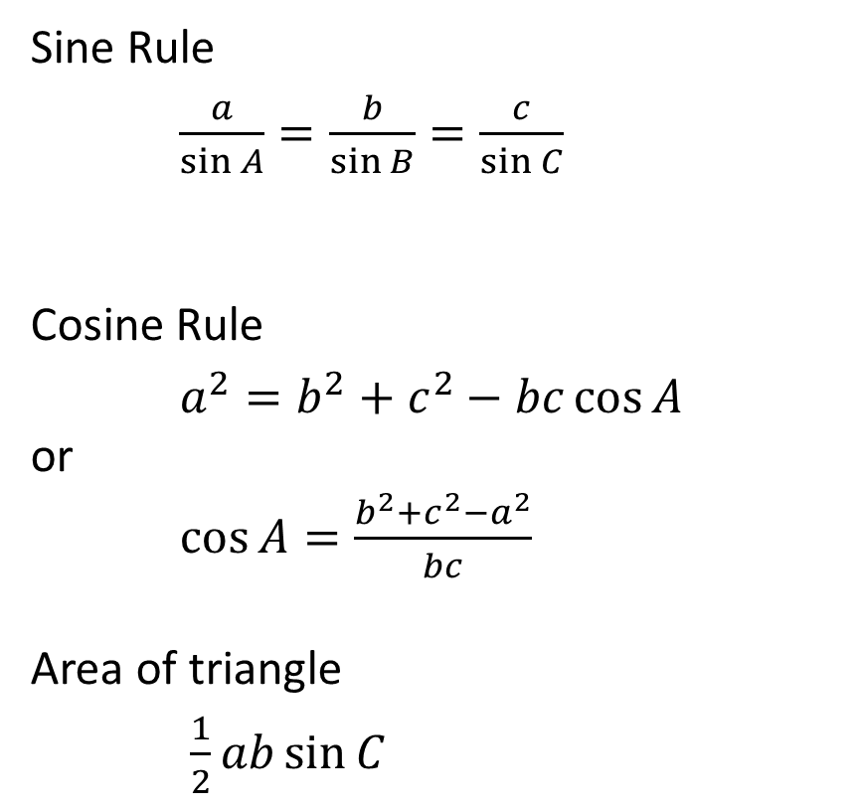
Working with non-right-angle triangles
Sine Rule
$\frac{a}{\sin{A}}=\frac{b}{\sin{B}}=\frac{c}{\sin{C}}$
Cosine Rule
$a^{2}=b^{2}+c^{2}−bc\cos{A}$
or
$\cos{A}=\frac{b^{2}+c^{2}−a^{2}}{bc}$
Area of triangle
$\frac{1}{2}ab\sin{C}$

Slide 10
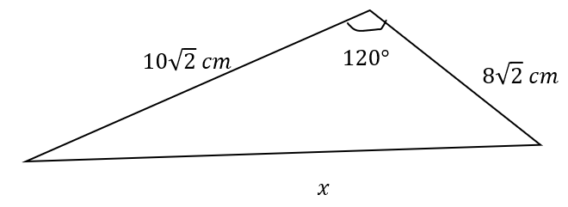



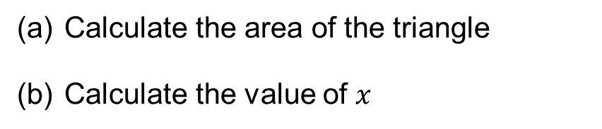





Working with non-right-angle triangles
(a)
$area=\frac{1}{2}ab\sin{C}$
$area=\frac{1}{2}×8\sqrt{2}×10\sqrt{2}×\sin{120}$
$area=80×\frac{\sqrt{3}}{2}$
$$area=40\sqrt{3}$$
(b)
$$x^{2}={(8\sqrt{2})}^{2}+{\left(10\sqrt{2}\right)}^{2}−2×8\sqrt{2}×10\sqrt{2}×\cos{120}$$
Calculate the area of the triangle
Calculate the value of $x$
$x^{2}=128+200−320×−\frac{1}{2}$
$$x^{2}=264+160=424$$
$$x=\sqrt{424}$$
$$=2\sqrt{106}$$

