Slide 1
Skills Pack – Exact trigonometric values
Lesson 2
Cambridge IGCSE™/ IGCSE (9-1)
Mathematics 0580 / 0980
Version 0.1

Slide 2
Angles larger than 90 degrees
90°
S
sine
A
all
180°
0° or 360°
T
tan
C
cosine
270°

Slide 3
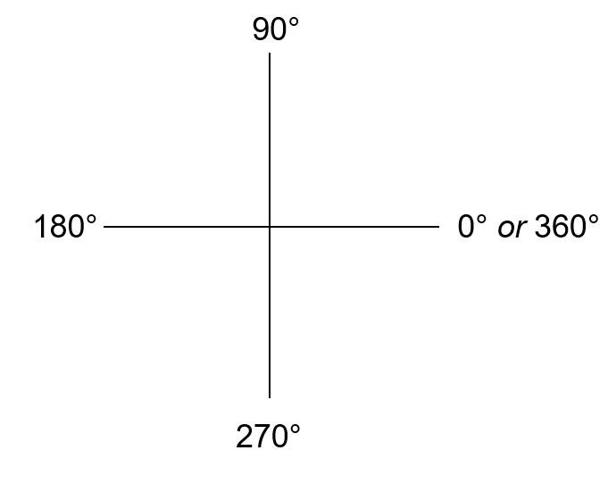
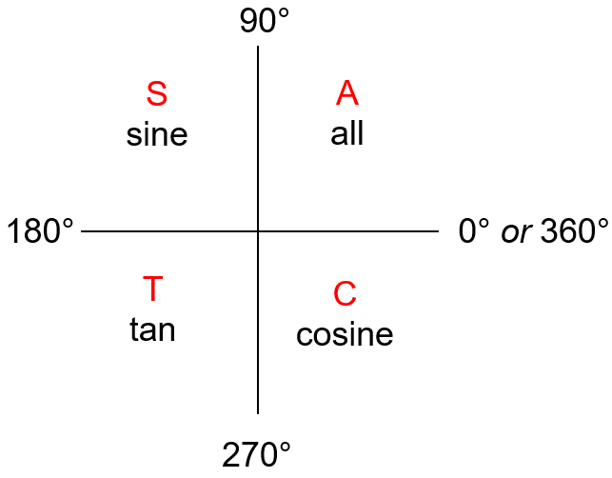
Angles larger than 90 degrees
Find sin 210°
30°
210°
sin 210°
= − sin 30°
= $−\frac{1}{2}$

Slide 4
Angles large than 90 degrees
Find cosine 330°
330
= $\frac{\sqrt{3}}{2}$
Cos 330°
= cos 30°
30

Slide 5
Angles large than 90 degrees
Find tan 150°
= − tan 30°
30
150
= $−\frac{1}{\sqrt{3}}$

Slide 6
Exact trigonometric values
angle | sin | cos | tan
150º |  |  | $−\frac{1}{\sqrt{3}}$
210º | $−\frac{1}{2}$
225º
315º
330º |  | $\frac{\sqrt{3}}{2}$

Slide 7
Exact trigonometric values
angle | sin | cos | tan
150º | $\frac{1}{2}$ | $−\frac{\sqrt{3}}{2}$ | $−\frac{1}{\sqrt{3}}$
210º | $−\frac{1}{2}$ | $−\frac{\sqrt{3}}{2}$ | $\frac{1}{\sqrt{3}}$
225º | $−\frac{1}{\sqrt{2}}$ | $−\frac{1}{\sqrt{2}}$ | $$1$$
315º | $−\frac{1}{\sqrt{2}}$ | $\frac{1}{\sqrt{2}}$ | $−1$
330º | $−\frac{1}{2}$ | $\frac{\sqrt{3}}{2}$ | $−\frac{1}{\sqrt{3}}$

Slide 8
Solving trigonometric equations
What angles have $\sin{x}=\frac{1}{2}$?
$$x=30°$$
$$x=180−30$$
$$x=150°$$
30
30
S$olve \sin{x}=\frac{1}{2}$ for $0°≤x≤360°$
$$x=30° or 150°$$

Slide 9
Solving trigonometric equations
S$olve \tan{x}=\sqrt{3}$ for $0°≤x≤360°$
$$x=60°$$
$$x=180+60$$
$$x=240°$$
60
60

Slide 10
Solving trigonometric equations
S$olve 2\sqrt{3}\tan{x}+7=5$ for $0°≤x≤360°$
$2\sqrt{3}\tan{x}=−2$
$$\tan{x}=−\frac{2}{2\sqrt{3}}$$
$$=−\frac{1}{\sqrt{3}}$$
$$x=180−30$$
$$x=150°$$
30
30
$$x=150+180$$
$$x=330°$$

