Slide 1

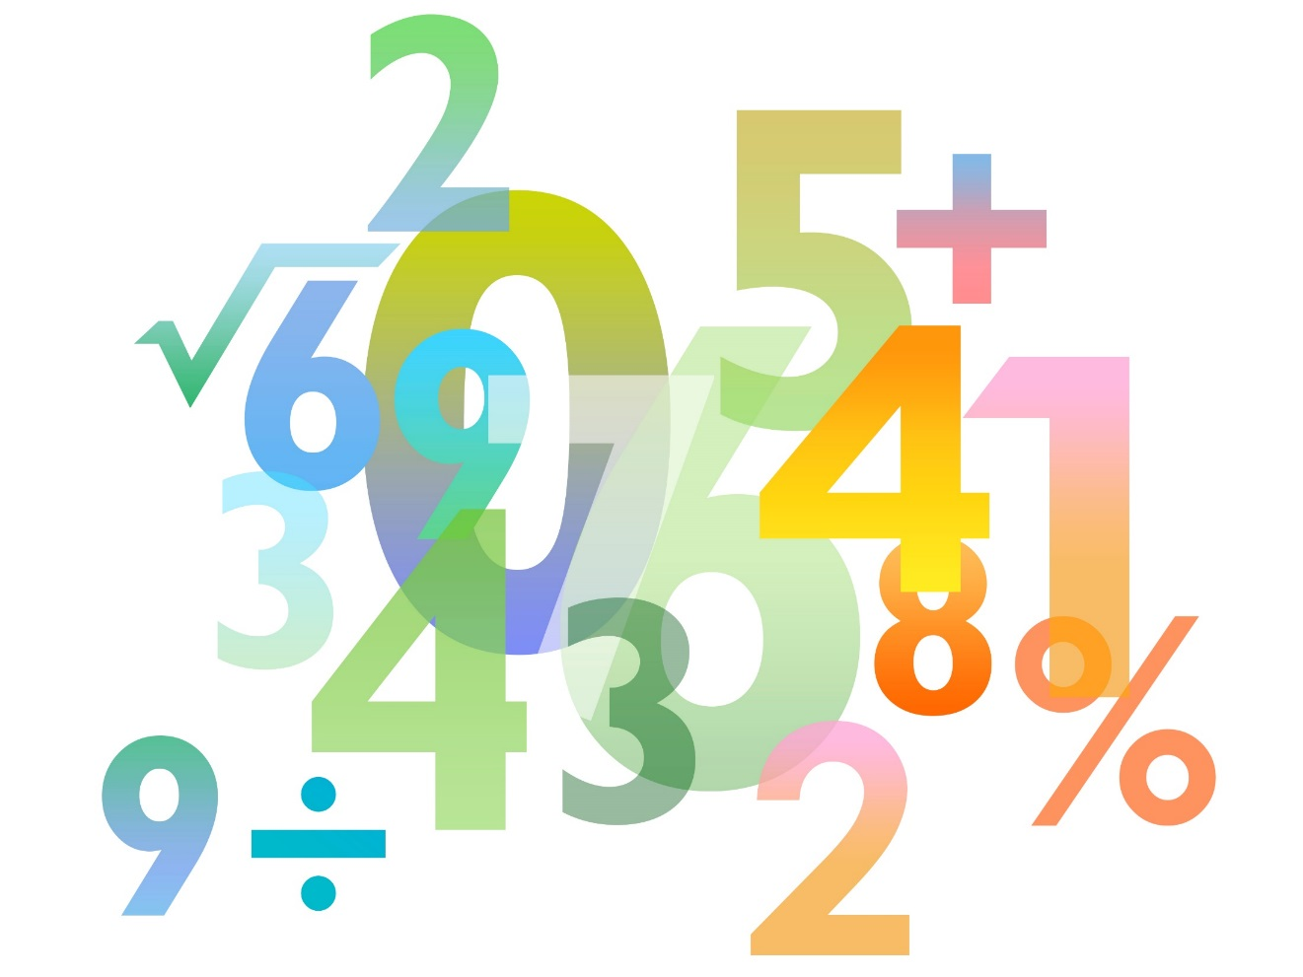

Skills Pack – Exact trigonometric values
Lesson 1
Cambridge IGCSE™/ IGCSE (9-1)
Mathematics 0580 / 0980
Version 0.1

Slide 2
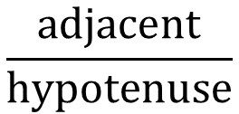
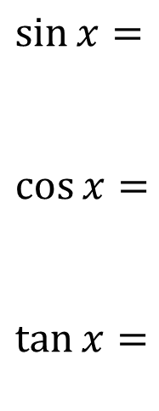
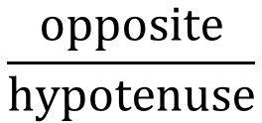
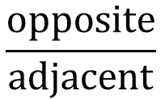
Trigonometry refresh
$$\frac{opposite}{hypotenuse}$$
$\sin{x= }$
$\cos{x= }$
$\tan{x=}$
hypotenuse
$$\frac{adjacent}{hypotenuse}$$
opposite
x
$$\frac{opposite}{adjacent}$$
adjacent

Slide 3
Helpful triangles
An equilateral triangle
An isosceles right angle triangle
45º
30º
2
√2
1
√3
60º
45º
1
1

Slide 4



Exact trigonometric values
45º
30º
2
√2
√3
1
60º
45º
1
1
angle | sin | cos | tan
0º
30º
45º
60º
90º
$\frac{\sqrt{3}}{2}$
$\frac{1}{2}$
$\frac{\sqrt{3}}{1}$ $=\sqrt{3}$

Slide 5
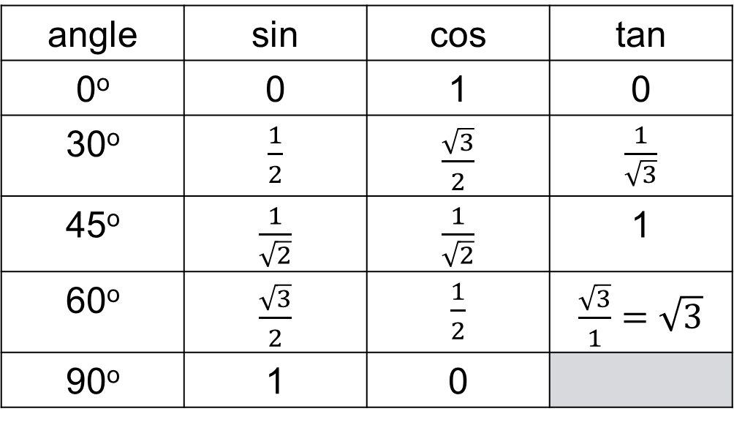
Exact trigonometric values
30º
45º
2
1
√2
√3
60º
45º
1
1
angle | sin | cos | tan
0º | 0 | 1 | 0
30º | $\frac{1}{2}$ | $\frac{\sqrt{3}}{2}$ | $\frac{1}{\sqrt{3}}$
45º | $\frac{1}{\sqrt{2}}$ | $\frac{1}{\sqrt{2}}$ | 1
60º | $\frac{\sqrt{3}}{2}$ | $\frac{1}{2}$ | $\frac{\sqrt{3}}{1}$ $=\sqrt{3}$
90º | 1 | 0

Slide 6
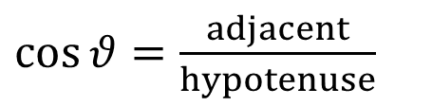
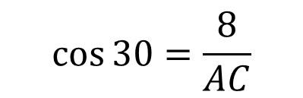

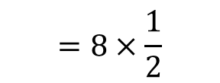

Try this
B
In triangle ABC, BC is 8 cm in length. Angle ACB is 30°.
Find the length of AC.
$\cos{θ}=\frac{adjacent}{hypotenuse}$
A
$$\cos{30}=\frac{8}{AC}$$
C
$$AC=8×\cos{30}$$
$$=8×\frac{1}{2}$$
$$=4 cm$$

Slide 7
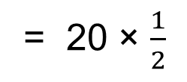

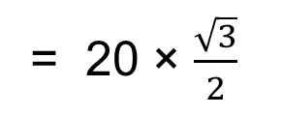


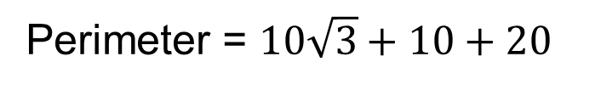
How about this one?
B
What is the perimeter of triangle ABC?
20
BC =
20 × sin 60
= 20 × $\frac{\sqrt{3}}{2}$
$$\text{= }10\sqrt{3}$$
60º
AC =
20 × cos 60
C
A
= 20 × $\frac{1}{2}$
$$=10$$
Perimeter = $10\sqrt{3}+10+20$
$$=30+10\sqrt{3}$$

Slide 8
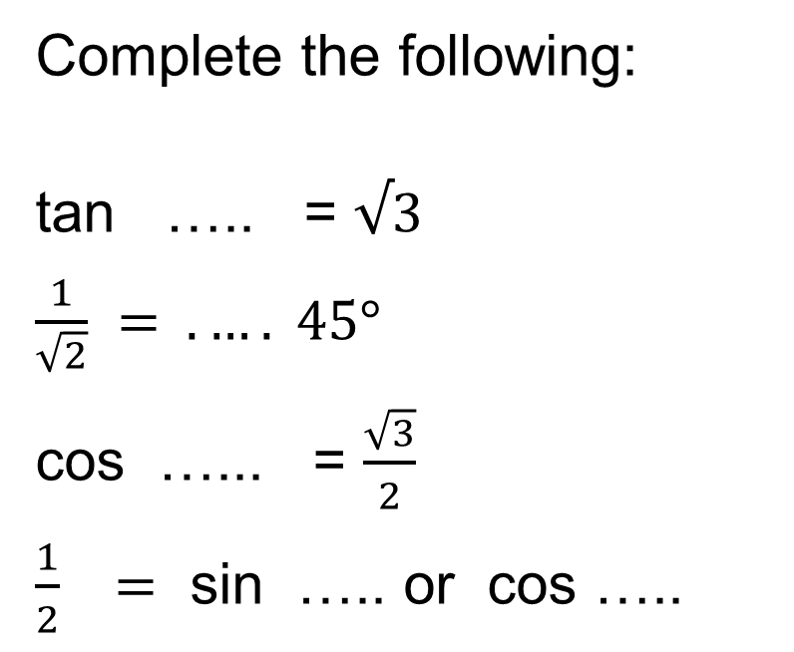
Final check…
Complete the following:
tan ….. = $√3$
$\frac{1}{\sqrt{2}} = . …. 45°$
cos …... = $\frac{\sqrt{3}}{2}$
$\frac{1}{2} =$ sin ….. or cos …..
60°
cos or sin 45°
30°
30° 60°

