Slide 1
Skills Pack – Pythagoras’ Theorem and Trigonometry in 3D
Lesson 2: Trigonometry in 3D #1
Cambridge IGCSE™
Mathematics 0580
Version 0.1

Slide 2
Quick recap on trigonometry in right-angled triangles
Find the missing values.
Leave answers to 1 decimal place
$$5 cm$$
$$y$$
$$x$$
$$12 cm$$
$$400$$
$$7.5 cm$$
Answers:
$x= \tan^{−1}\left(\frac{5}{12}\right) = 22.60$
$y= \frac{7.5}{sin⁡400} = 11.7 cm$

Slide 3
Planes
B
A plane is simply a flat surface.
Like a table-top, or a flat wall.
N
A
To find the angle a line segment makes with a plane, you need to find the point that is ‘below’ the end that is not connected to the plane.

Slide 4
Example 1:
Find the angle that line segment $AG$makes with the plane $EFGH.$
$$A$$
$$B$$
The point ‘below’ $A$ that is on the plane is point $E$.
$$D$$
$$8 cm$$
$$C$$
$$A$$
$$17 cm$$
$$17 cm$$
$$8 cm$$
$$x$$
$$E$$
$$F$$
$$E$$
$$G$$
We need one more length
$$9 cm$$
$$AG= \sqrt{9^{2}+{12}^{2}+8^{2}}$$
$= 17 cm$
$$H$$
12$cm$
$$G$$
Angle $AGE = \sin^{−1}\left(\frac{8}{17}\right)$
$= 28.10$
Now we can use right-angled trigonometry
Notes:
Both of the following examples will take some time to go through. Learners often find it hard to imagine the yellow triangle is the one they need, and often try to find other angles (e.g. AGH) so make sure they understand the other point has to be ‘below’ the other point.

Slide 5
Example 2:
$$E$$
This shape is a square-based pyramid$.$
Find the angle that $EC$ makes with the base.
$$12 cm$$
$$A$$
$$B$$
The point ‘below’ $E$ that is on the plane is in the middle of the square. We could call it $M$.
$$M$$
$$10 cm$$
$$E$$
$$D$$
$$C$$
$$10 cm$$
$$12 cm$$
We can use the triangle $ACD$ to find length $AC$ and halve it for $MC$.
$$A$$
$$AC= \sqrt{{10}^{2}+{10}^{2}}$$
$= 14.14.. cm$
$MC=7.07$
Back to the purple triangle:
Angle $ECM = \cos^{−1}\left(\frac{7.07}{12}\right)$
$= 53.90$
$$x$$
$$M$$
$$C$$
$$10 cm$$
$$7.07 cm$$
We need one more length!
$$D$$
$$C$$
$$10 cm$$

Slide 6
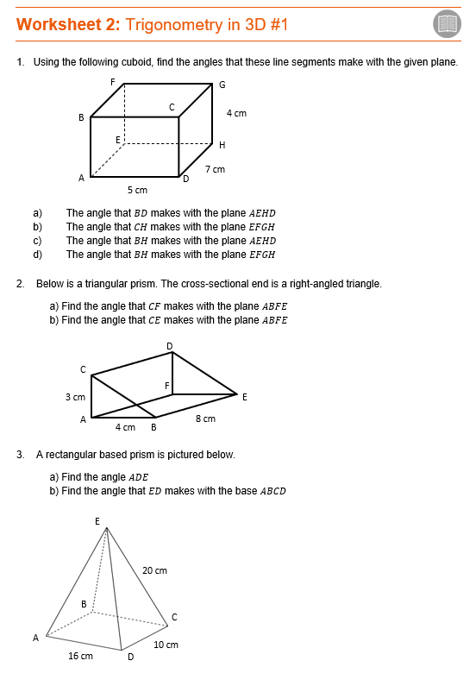
Now Work Through Worksheet 2

