Slide 1
Teaching Pack – Statistics
Lesson 3: Representations, restrictions and relationships of data
Cambridge IGCSETM
Mathematics 0580
Version 1

Slide 2
Feedback from homework
In pairs, look at each other’s homework and answer the following:
What parts of their data presentation have worked well?
What different types of data representation could they have used?
How do the data representations of the 5 people compare to those of 20 people – are the results the same? Why / why not?
What restrictions did they have in gathering this data?
We will discuss these points as a class shortly!

Slide 3
Discussion
What did you notice about your results of 5 people versus of 20 people?
Notes:
Discuss with class and note down valid responses. Ask learners which results they felt were more accurate/reliable and why; does this mean larger samples are better?

Slide 4
Discussion
What makes a particular type of data representation good?
Notes:
Discuss with class and note down valid responses (for example, easy to read)

Slide 5
Discussion
What restrictions did you face when gathering the data?
Notes:
Discuss with class and note down valid responses. Follow on point: When is the data we view restricted? From what sources? Hopefully learners will name newspapers and social media, but you can always guide the conversation in that direction.

Slide 6
Correlation
What does correlation mean?
Notes:
This definition may have already been discussed last lesson during charades, in which case this quick recap with no further discussion is fine.

Slide 7
Spot the difference
Notes:
Ask learners what they know about the positive line. Hopefully someone will note their positive and negative gradients is what makes them go in opposite directions.

Slide 8
Correlation
Strong positive correlation
Weak positive correlation
No correlation
Strong negative correlation
Weak negative correlation
Notes:
Ask learners to describe the correlations, and question their reasoning. If learners are struggling, ask them to describe the gradient and if the relationship looks to be strong or weak? How can we be sure of these things?

Slide 9
Stem-and-leaf diagrams
What does a stem-and-leaf diagram look like?
stem | leaf
0 | 5 7
1 | 1 3 5 9
2 | 0 4
3 | 5
4 | 0 3
Key: 1 │ 7 means 1.7
Notes:
Ask learners the question before revealing the diagram. Hence, ask learners for the lowest value, highest value, if 2.2 is included in the data and any other questions related to the diagram dependent on the class’ prior knowledge

Slide 10
Stem-and-leaf diagrams
What is a stem-and-leaf diagram with two sets of data called?
girls |  | boys
5 | 14
7 5 5 5 4 | 15 | 3 8 9
8 4 2 1 0 | 16 | 2 5 7 7 7 8 8 9
9 8 7 6 6 4 2 1 1 0 0 | 17 | 0 2 3 6 6 7 7
 | 18 | 0 1 4 5

Slide 11
Example
A short reminder on how to find the median of a stem-and-leaf diagram…
stem | leaf
12 | 2 6
13 | 0 2 5
14 | 1 2 4 6
15 | 2 3 7 8
16 | 1 2 4 6 8
17 | 5 7 8
18 | 1 3
Key: 12 │ 2 means 14.2
Notes:
Ask the class if they have any ideas where to begin. Click through animations explaining to class that you cross off from each side until you get to the middle number. Ask learners what to do if there are two numbers in the middle (find the mean of the two numbers)

Slide 12
Example
A short reminder on how to find the mode of a stem-and-leaf diagram
stem | leaf
4 | 1 3 9
5 | 7
6 | 7 8 9
7 | 0 2 3 3 3 3 3 4 4 5 6 7
8 | 1 2 2
9 | 2 6
10 | 8
11 | 4
12 | 3
Key: 4 │ 3 represents 43
Notes:
Ask the class if they have any ideas where to begin, checking their definition of ‘mode’.

Slide 13
Example
A short reminder on how to find the range of a stem-and-leaf diagram…
stem | leaf
12 | 2 6
13 | 0 2 5
14 | 1 2 4 6
15 | 2 3 7 8
16 | 1 2 4 6 8
17 | 5 7 8
18 | 1 3
18.3 – 12.2 = 6.1
Key: 12 │ 2 means 14.2
Notes:
Ask the class if they have any ideas where to begin

Slide 14
Your turn
Use Worksheet C to check your understanding of stem-and-leaf diagrams.

Slide 15
Answers
Manjit counted the number of letters in each of 30 sentences in the school newsletter. She showed her results in a stem-and-leaf diagram.
2 sentences have 36 letters
The range is 45 – 8 = 37 letters
To find the median you cross off the numbers of ordered data from each end until you get to the middle value.
The median is:
27 + 27 = 54
54 ÷ 2 = 27
∴ The median is 27

Slide 16
Answers
A stem-and-leaf diagram has been drawn for the number of people entering a shop over a number of days.
The people were counted for 17 days
The modal number of people is 17
The median number of people is 17

Slide 17
IQR
I
Q
R
Notes:
Ask the class if anyone knows what these letters stand for first.

Slide 18
IQR
I
Inter
Q
Quartile
R
Range
Notes:
Ask the class if anyone knows what these letters stand for first.

Slide 19
IQR
I
Inter
Between
Notes:
Ask the class if anyone knows what these letters stand for first.

Slide 20
IQR
Q
Quartile
Like quarter, split into four
Notes:
Ask the class if anyone knows what these letters stand for first.

Slide 21
IQR
R
Range
Highest - lowest
Notes:
Ask the class if anyone knows what these letters stand for first.

Slide 22
IQR
I
Inter
Between
Q
Quartile
Like quarter, split into four
R
Range
Highest - lowest
Notes:
Get learners to note this into their books, alternatively print this slide and get learners to paste it in.

Slide 23
Example
The times, in seconds, taken by 11 learners to finish a race are listed in order
4 12 13 17 18 20 22 24 25 30 34
Find
(i) the lower quartile, ………………………. seconds
(ii) the interquartile range. ………………………. seconds
First thing we need to find is the median

Slide 24
Example
The times, in seconds, taken by 11 learners to finish a race are listed in order
4 12 13 17 18 20 22 24 25 30 34
Median = 20 seconds
Find
(i) the lower quartile, ………………………. seconds
(ii) the interquartile range. ………………………. seconds
Next we split the data into quartiles

Slide 25
Example
The times, in seconds, taken by 11 learners to finish a race are listed in order
4 12 13 17 18 20 22 24 25 30 34
Median = 20 seconds
Lower quartile = 13 seconds
Upper quartile = 25 seconds
Find
(i) the lower quartile, ………………………. seconds
(ii) the interquartile range. ………………………. seconds

Slide 26
Example
The times, in seconds, taken by 11 learners to finish a race are listed in order
4 12 13 17 18 20 22 24 25 30 34
Median = 20 seconds
Lower quartile = 13 seconds
Upper quartile = 25 seconds
Find
(i) the lower quartile, 13 seconds
(ii) the interquartile range. ………………………. seconds

Slide 27
Example
The times, in seconds, taken by 11 learners to finish a race are listed in order
4 12 13 17 18 20 22 24 25 30 34
Median = 20 seconds
Lower quartile = 13 seconds
Upper quartile = 25 seconds
Find
(i) the lower quartile, 13 seconds
(ii) the interquartile range. IQR = UQ – LQ seconds

Slide 28
Example
The times, in seconds, taken by 11 learners to finish a race are listed in order
4 12 13 17 18 20 22 24 25 30 34
Median = 20 seconds
Lower quartile = 13 seconds
Upper quartile = 25 seconds
Find
(i) the lower quartile, 13 seconds
(ii) the interquartile range. IQR = UQ – LQ
25 - 13 seconds

Slide 29
Example
The times, in seconds, taken by 11 learners to finish a race are listed in order
4 12 13 17 18 20 22 24 25 30 34
Median = 20 seconds
Lower quartile = 13 seconds
Upper quartile = 25 seconds
Find
(i) the lower quartile, 13 seconds
(ii) the interquartile range. IQR = UQ – LQ
25 - 13
12 seconds

Slide 30
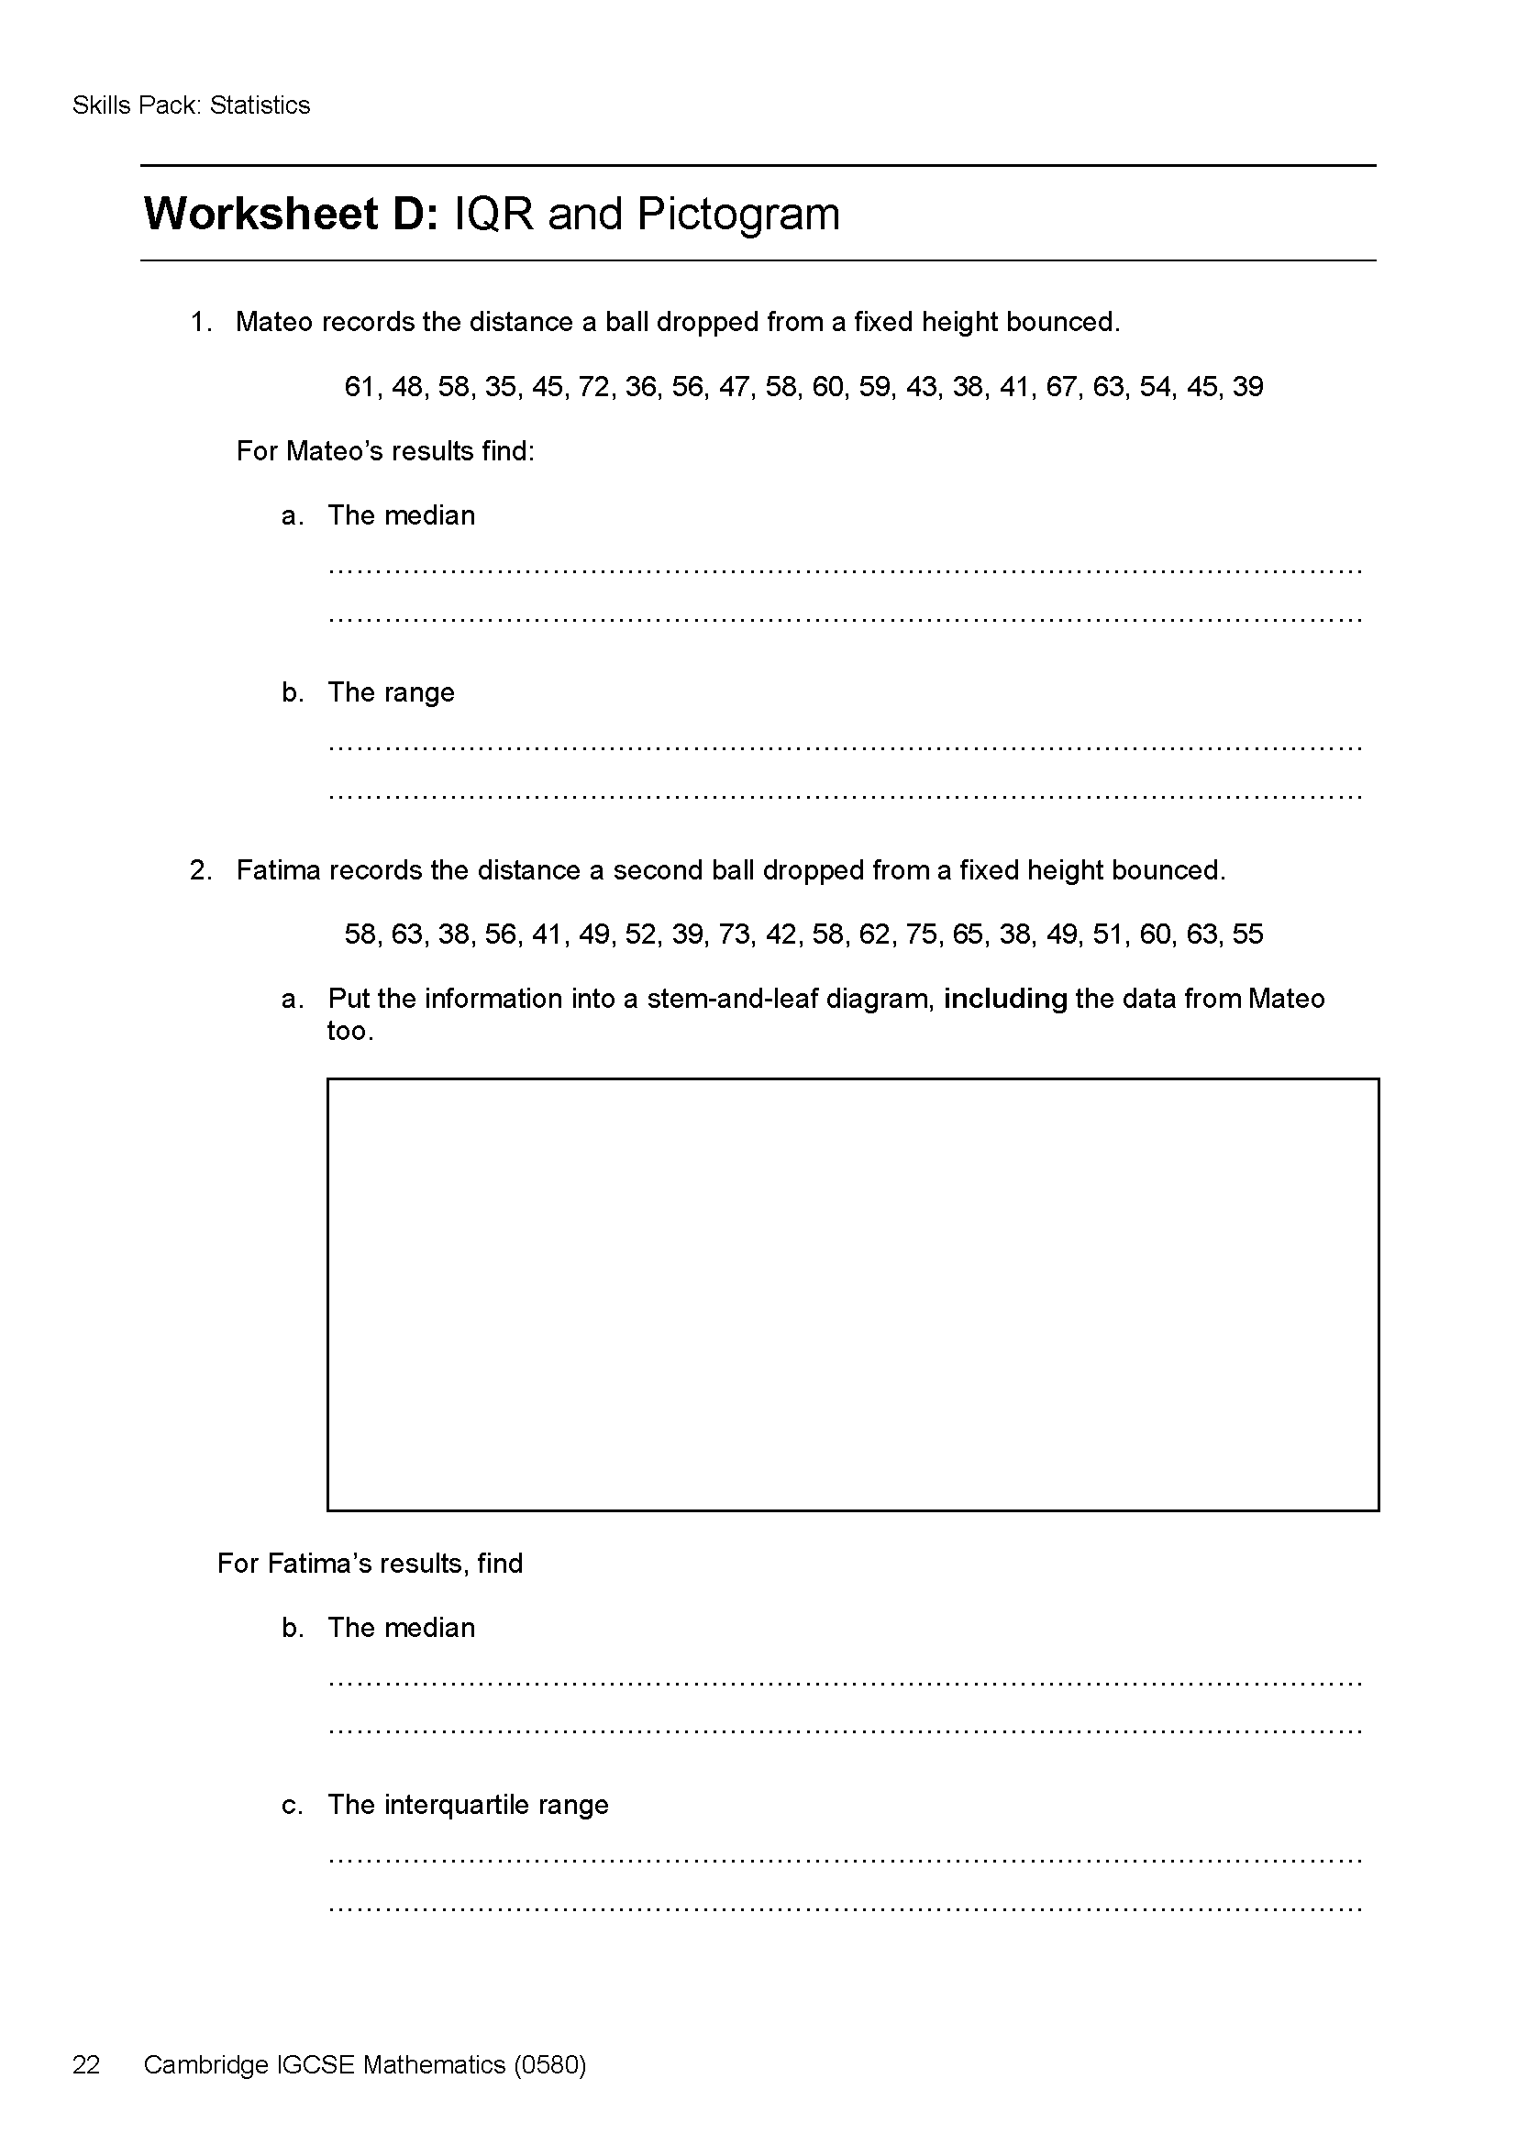
Homework
Worksheet D: IQR and Pictogram
You will have some IQR questions to complete alongside drawing a pictogram of your typical weekday.
Notes:
Do not remind learners what a pictogram is when setting this homework. If learners ask, then tell them they must research what it is as part of their homework.

