Slide 1
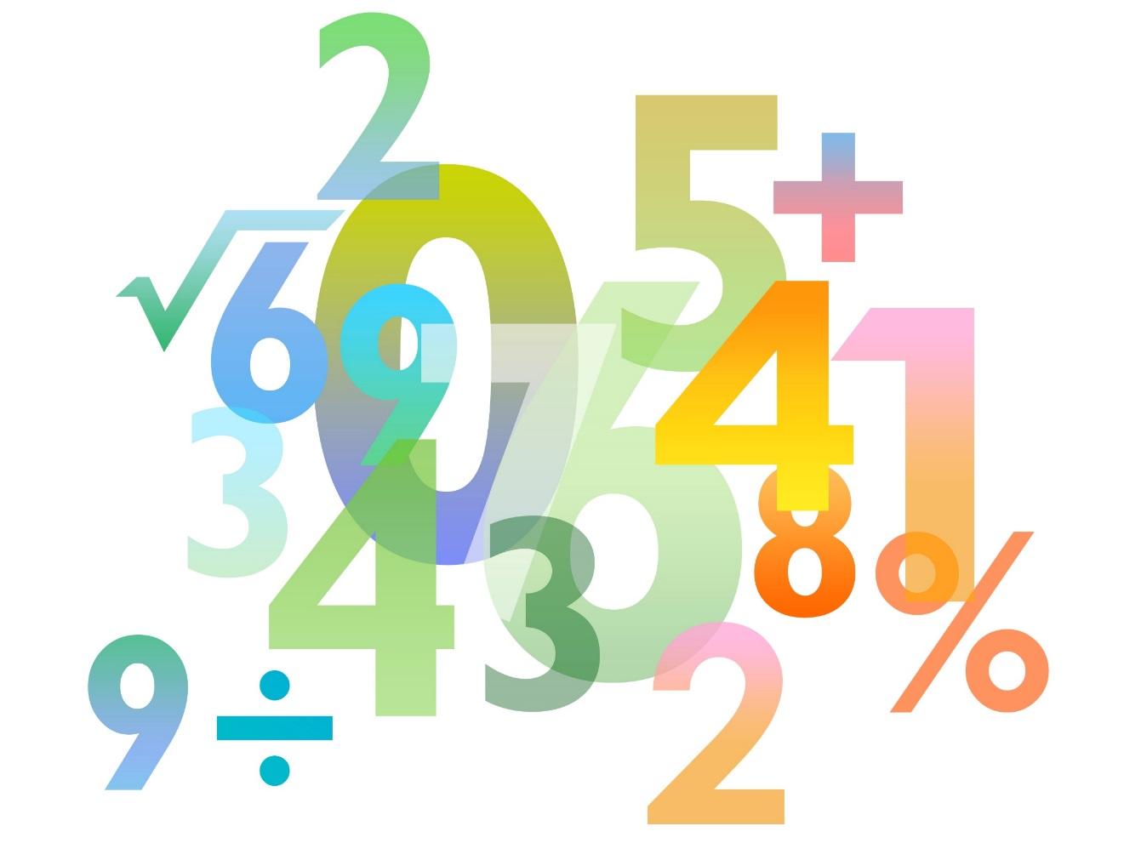
Teaching Pack – Statistics
Lesson 2: Bar Charts and Histograms
Cambridge IGCSETM
Mathematics 0580
Version 1

Slide 2
Feedback from Homework
In pairs, ask each other the questions from your questionnaires.
Make sure you don’t reveal which is the biased questionnaire.
Note down which one you think is biased, and any other notes you may have on your partner’s work.
Critique don’t criticise!
Now spend some time improving your unbiased questionnaire using the feedback from your partner.

Slide 3
Next Homework Task
Using your new and improved ‘fair’ questionnaire, you now have to go out and collate your own data.
First of all select 5 people to use your questionnaire with. You need to present the data from this group separately.
Then select another 15 people so that in total, 20 people have answered your questionnaire. The data from all 20 people should then be presented together.
Your completed homework should be made up of two sets of data from the same questionnaire. You may represent both sets of your data in any format you like.
Notes:
Depending on the group, learners could be given a demographic of the people they can interview and this homework could be completed as groupwork if appropriate.

Slide 4
Charades
I will choose a learner to come to the board – they will be facing you, so cannot see the board.
A word will appear above their head.
The rest of you will have the opportunity to give them hints without mentioning the word.
Ready?
Notes:
If appropriate, ask the learners to take notes during the game of any definitions they are unsure of

Slide 5
Charades: Example
Questionnaire
Notes:
A set of questions

Slide 6
Charades
Mean
Notes:
Add all the numbers together and divide by the total amount

Slide 7
Charades
Pie chart
Notes:
Circular in shape where each section is divided into a proportion of 360°

Slide 8
Charades
Range
Notes:
The difference between the largest and the smallest values in a set of data

Slide 9
Charades
Line of best fit
Notes:
Something to predict future trends on a scatter diagram

Slide 10
Charades
Median
Notes:
The middle of ordered data

Slide 11
Charades
Pictogram
Notes:
A data representation using small images to represent amounts

Slide 12
Charades
Correlation
Notes:
How the axis relate to each other

Slide 13
Charades
Scatter graph
Notes:
A data representation using axis, data is plotted with points or crosses

Slide 14
Charades
Interquartile range
Notes:
The difference between the upper quartile and the lower quartile of the data

Slide 15
Charades
Qualitative data
Notes:
Results/options that are not numbers

Slide 16
Charades
Bar chart
Notes:
A data representation where rectangles of different heights are used. It has gaps between the rectangles. Typically used for qualitative data.

Slide 17
Charades
Mode
Notes:
The most popular/frequent number

Slide 18
Charades
Fair
Notes:
Something without unfair advantage

Slide 19
Charades
Population
Notes:
The entire group which could be surveyed

Slide 20
Charades
Outlier
Notes:
A piece of data that differs to the norm

Slide 21
Charades
Quantitative data
Notes:
Results/options that are numbers

Slide 22
Charades
Box-and-whisker plot
Notes:
A data representation using a rectangle where the widths indicate the lower and upper quartiles. The line in the middle of this rectangle is the median and the lines either side of it are the outliers of the data.

Slide 23
Charades
Bias
Notes:
Something with unfair advantage

Slide 24
Charades
Histogram
Notes:
A data representation where rectangles of different heights are used. It has no gaps between the rectangles. Typically used for quantitative data. X-axis does not have to begin at 0.

Slide 25
Charades
Stem-and-leaf diagram
Notes:
Data split by place value with a key.

Slide 26
Recap
MMMR
Median
Mean
Range
Mean
Median
Median
Range
Mode
Notes:
Fill in definitions to these words with your class and ask them how they remember them

Slide 27
Exploration
There are five positive whole numbers that have a mean of 4,
a median of 3 and mode of 3. What could these numbers be?
Notes:
This question should be explored as a class, some solutions are:
1) 1, 2, 3, 3, 11 2) 1, 3, 3, 5, 8 3) 2, 3, 3, 3, 9 You could ask the class if there are any rules that can be followed to help solve this problem. (For example, the third number will always be 3 with smaller and larger numbers either side as it is the median)
As an extension you could ask the class how the question would change if the range was added in (for example, a range of 7)

Slide 28
Your turn
Marco lays some number cards out on the table in front of him.
Choose 3 of the number cards to make new groups which have:
a) a mode of 3
b) no mode, median of 3
c) no mode, median of 5 and range of 8
3
9
3
5
5
7
6
1

Slide 29
Your turn
Marco now chooses the following four cards and chooses a 5th from a set of cards numbered 1 to 9.
Which card should he choose to complete the set so it has the averages and ranges shown below?
d) no mode, median of 5, mean of 5 and range of 8
e) mode of 5, median of 5, mean of 4.2 and range of 2
9
1
3
5
?
Extension: Draw bar charts of d) and e)
3
3
5
5
?
Notes:
Learners should not be reminded how to do a bar chart. This extension task is a diagnostic question to ensure that learners understand the difference between a bar chart and a histogram (hopefully they’ll remember from the game earlier!)

Slide 30
Answers
Choose 3 of the number cards to make new groups which have:
a) a mode of 3 3,3 and any other card
b) no mode, median of 3 3, 3 and 9
c) no mode, median of 5 and range of 8 1, 5 and 9
3
9
3
5
5
7
6
1
9
1
3
5
7
3
3
5
5
5

Slide 31
Extension Answers
3
5
Notes:
Ask the group if they know why they should leave gaps and change slide as the discussion unfolds

Slide 32
Discussion
What are the differences between a bar chart and a histogram?
Notes:
Get ideas from the class before giving them the information. The obvious differences are that bar charts have spaces with equally wide bars and are usually used for qualitative data; and histograms do not have spaces, may have unequal bars and are usually used for quantitative data.
The main idea the teacher should make sure that the class leave with is that histograms can display continuous data, or numbers between intervals.

Slide 33
Name that chart!
Notes:
Ask different learners whether the charts are bar charts or histograms.
This is a histogram

Slide 34
Name that chart!
Notes:
Ask different learners whether the charts are bar charts or histograms.
This is a histogram

Slide 35
Name that chart!
Notes:
Ask different learners whether the charts are bar charts or histograms.
This is a bar chart

Slide 36
Name that chart!
Notes:
Ask different learners whether the charts are bar charts or histograms.
This is a bar chart

Slide 37
How can we improve this chart?
Notes:
As the graph is showing discrete data, a bar chart should be used.
This is set up like a histogram with no spaces between the bars.

Slide 38
Homework
Using your new and improved ‘fair’ questionnaire, you now have to go out and collate your own data.
First of all select 5 people to use your questionnaire with. You need to present the data from this group separately.
Then select another 15 people so that in total, 20 people have answered your questionnaire. The data from all 20 people should then be presented together.
Your completed homework should be made up of two sets of data from the same questionnaire. You may represent both sets of your data in any format you like.

