Slide 1
Lesson slides
Topic E2.13: Functions
Lesson 1: Function notation
Cambridge IGCSE™
Mathematics 0580
Version 1

Slide 2
Starter – Substitution Practice
Non-Calculator
Substitute $x=2$ into all of the following equations.
$$y=5x−1$$
$$y=9$$
$y=4x^{2}$
$$y=16$$
$y= \frac{100}{x^{2}}$
$$y=25$$
$y=8^{x}$
$$y=64$$

Slide 3
What is a Function?
A function is a mapping such that every element of the domain is mapped to exactly one element of the range.
To help you understand it: every input is mapped to exactly one output.
It is the same concept that you have used when substituting into expressions previously. (You may have called it the ‘number machines’.)

Slide 4
What is a Function?
Here is an example comparing use of function notation compared to $y$ and $x$.
This is pronounced: ‘f’ of ‘x’
$$y=2x+1$$
$$f(x)=2x+1$$
When $x=3:$
$$f(3)=2(3)+1$$
$$y=2(3)+1$$
$$=6+1$$
$$=6+1$$
$$=7$$
$$=7$$
It can be more efficient to use function notation, particularly when you have more than one function.

Slide 5
Function notation
$f\left(x\right)=3x^{2}+1$
Find $f(2)$.
Find $f(−5)$.
Find $f(0.9)$.
$$f\left(2\right)=3{(2)}^{2}+1$$
$$f\left(−5\right)=3{(−5)}^{2}+1$$
$$f\left(0.9\right)=3{(0.9)}^{2}+1$$
$=3(4)+1$
$=3(25)+1$
$=3(0.81)+1$
$=3(12)+1$
$=3(25)+1$
$=2.43+1$
$=13$
$=76$
$=3.43$

Slide 6
Your turn
$f\left(x\right)=\frac{2x}{3}−1$
Non-Calculator
Find $f(3)$.
Find $f(9)$.
Find $f(−30)$.
$$f\left(3\right)=\frac{2 (3)}{3}−1$$
$$f\left(9\right)=\frac{2 (9)}{3}−1$$
$$f\left(−30\right)=\frac{2 (−30)}{3}−1$$
$$f\left(3\right)=\frac{6}{3}−1$$
$$f\left(9\right)=\frac{18}{3}−1$$
$$f\left(−30\right)=\frac{−60}{3}−1$$
$=2 −1$
$=6 −1$
$=−20 −1$
$=1$
$=5$
$=−21$

Slide 7
Challenge
$f\left(x\right)=4x(10+\sqrt{x})$
Find $f(9)$.
$$f\left(9\right)=4(9)(10+\sqrt{9 })$$
$=36\left(10+3\right)$
$=36\left(13\right)$
$$=468$$

Slide 8
Challenge
$f\left(x\right)= \frac{2x}{3+\sqrt{x}}$
Non-Calculator
Calculator
Find $f(4)$.
Find $f(0.64)$ to 3 decimal places.
$$f\left(4\right)=\frac{2 (4)}{3+ \sqrt{4}}$$
$$f\left(0.64\right)=\frac{2 (0.64)}{3+ \sqrt{0.64}}$$
$$=\frac{8}{3+2}$$
$$=\frac{1.28}{3.8}$$
$$=\frac{8}{5}$$
$$=0.337$$

Slide 9
Finding the input that gave a certain output
$f\left(x\right)=7x−4$
Find the value of $a$ when $f\left(a\right)=−18$.
$$7a−4=−18$$
$$7a=−14$$
$$a=−2$$

Slide 10
Finding the input that gave a certain output
$f\left(x\right)=x^{2 }−7x−2$
Find the value of $b$ when $f\left(b\right)=−1$4.
$$b^{2}−7b−2=−14$$
You can always check your answers by substituting them back into the original equation.
$$b^{2}−7b+12=0$$
$$\left(b−3\right)\left(b−4\right)=0$$
$$f\left(3\right)= 3^{2 }−7\left(3\right)−2$$
$$b=3 or b=4$$
$$=9−21−2$$
$$=−14$$

Slide 11
Your turn
Non-Calculator
$f\left(x\right)= \frac{5}{x}$
$g\left(x\right)= x^{2}−7x+1$
Find the value of $a$ when $f\left(a\right)=20$.
Find the value of $b$ when g$\left(b\right)=−9$.
$$\frac{5}{a}=20$$
$$b^{2}−7b+1=−9$$
$$b^{2}−7b+10=0$$
$$5=20 a$$
$$b^{2}−7b+10=0$$
$$a=\frac{1}{4}$$
$\left(b−5\right)\left(b−2\right)=0$
$$b=5 or b=2$$

Slide 12
The domain of a function
The domain of a function is the set of inputs accepted by the function.
Think of it as “what $x$ can be”.

Slide 13
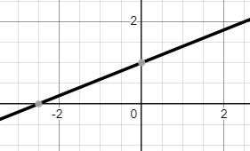
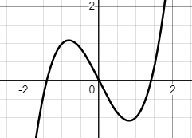
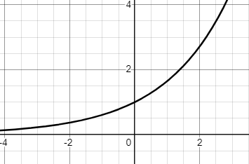
The domain of a function
Some functions must have a domain because you cannot substitute all numbers into it.
Do not require a domain:
Linear
Cubic
Exponential
They span the graph infinitely from left to right, without any gaps.

Slide 14
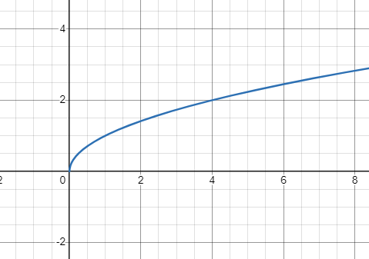
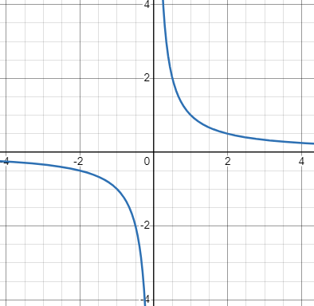
The domain of a function
Some functions must have a domain because you cannot substitute all numbers into it.
Requires a domain:
$$y= \frac{1}{x}$$
$$y=\sqrt{x}$$
$$x ≥0$$
$$x ≠0$$
As you cannot square root negative values.
As you cannot divide by zero.

Slide 15
The range of a function
The range of a function is the set of all output values of a function.

Slide 16
The range of a function
Functions that have no limit in their range:
Cubic
Linear
They span the graph infinitely from top to bottom, without any gaps.

Slide 17
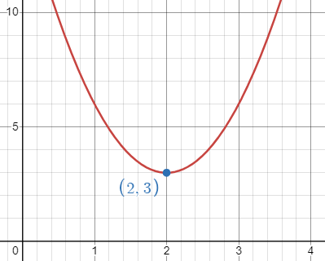
The range of a function
Functions that have a limit in their range:
Exponential
Quadratic
$$f(x)> 0$$
$$f\left(x\right)≥3$$
As the graph never goes negative (below the x axis) or reaches zero.
As this point is the minimum point, it never goes below it.

Slide 18
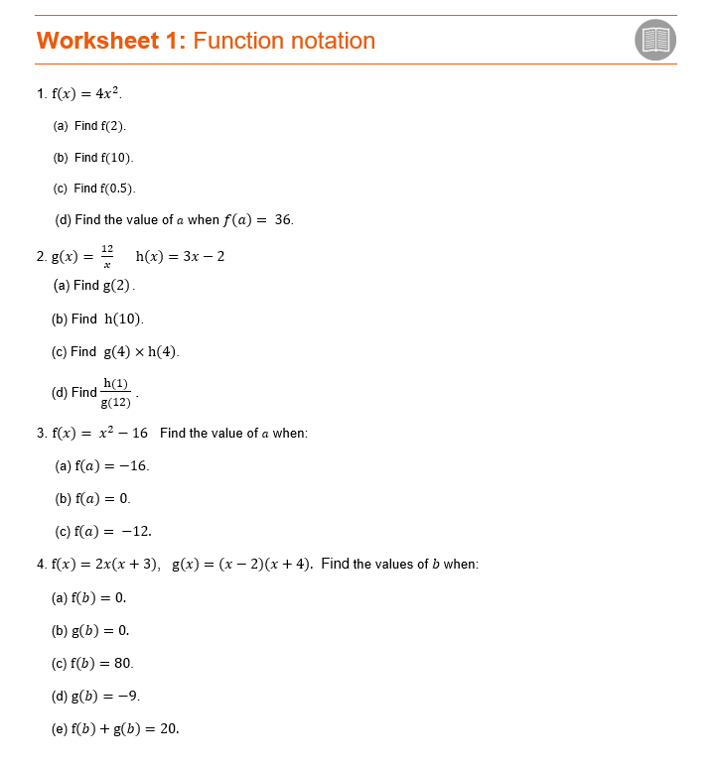
Now work through worksheet 1

