Slide 1
Lesson slides Topic 1.2: Functions Lesson 1: Graph transformations - translations
Version 1

Slide 2
Transforming Functions
You may recall from Cambridge IGCSETM that we can transform 2D shapes in the following ways:
Translation Moving a shape
Enlargement Changing the size of a shape
Reflection Reflecting a shape using a mirror line
We can apply all these transformations to graphs of functions.

Slide 3
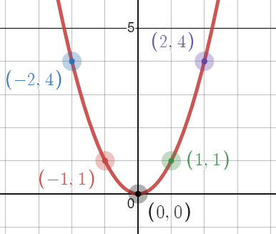
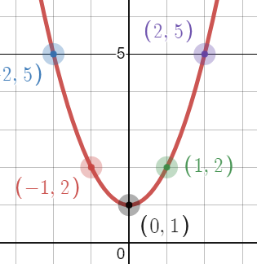
Translating graphs vertically
What happens to a function when we add numbers to it?
Using a graph we know well, $y=x^{2}$
Here’s what $y=x^{2}+1$ looks like:
Discussion: What do you notice?
As you have added 1 uniformly to all of the coordinates, they are all now 1 larger.
On the graph, it looks like we’ve translated the graph up by 1 unit.

Slide 4
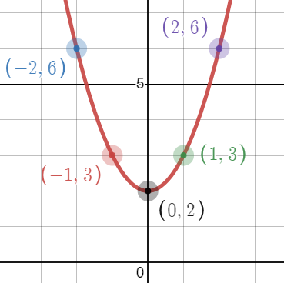
Translating Graphs Vertically
Predict: what will $y=x^{2}+2$ look like?
Same as before, it looks like we’ve translated the graph up, but this time by 2 units.

Slide 5
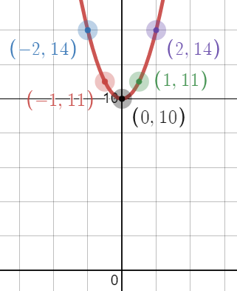
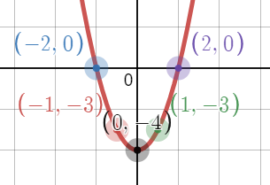
Translating Graphs Vertically
This works for any number that you add on.
For instance, $y=x^{2}+10$ looks like it has been translated 10 units upwards:
Discussion: How could we translate the graph downwards?
Subtraction
Here’s $y=x^{2}−4$

Slide 6
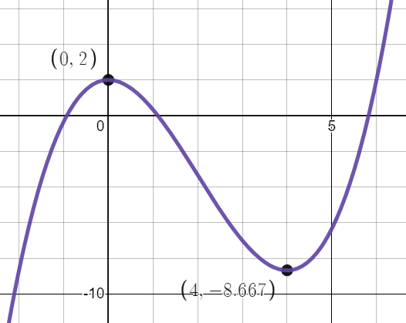
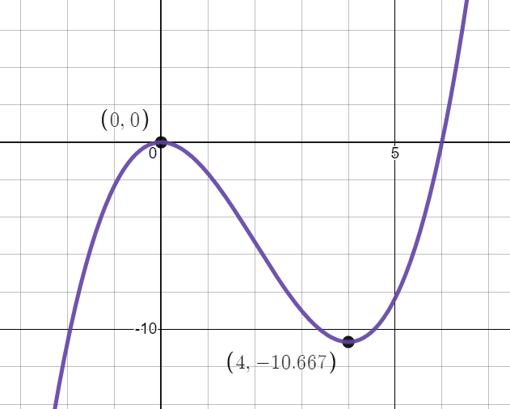
Translating Graphs Vertically
This also works for any function.
Look at this example:$y=\frac{x^{3}}{3}−2x^{2}$.
Here’s $y=\frac{x^{3}}{3}−2x^{2}+2$.
The graph has been translated 2 units vertically.

Slide 7
Translating Graphs Vertically
In general:
$f\left(x\right)+a$
$$+$$
Translation $\left(\begin{matrix}0 \\ a\end{matrix}\right)$
$$−$$

Slide 8
Plotting task
If you have access to graphing software/websites, or even a graphical calculator, then try plotting different types of functions and applying the transformations to them.
www.desmos.com
www.geogebra.com
Pre-made example:
Graph Transformations | Desmos

Slide 9
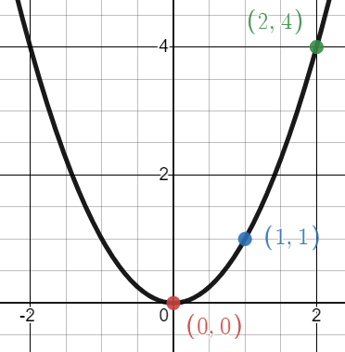
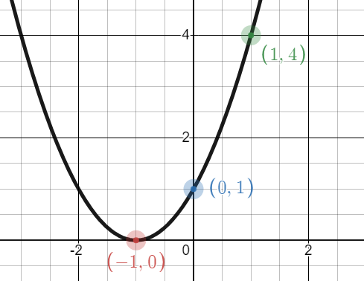
Translating Graphs Horizontally
If adding numbers to functions affects the vertical direction, we need a different method to translate graphs horizontally.
Here’s $y=x^{2}$.
Here’s what $y={(x+1)}^{2}$ looks like.
Discussion: what do you notice?
It translates the graph 1 unit, however it translated it to the left.

Slide 10
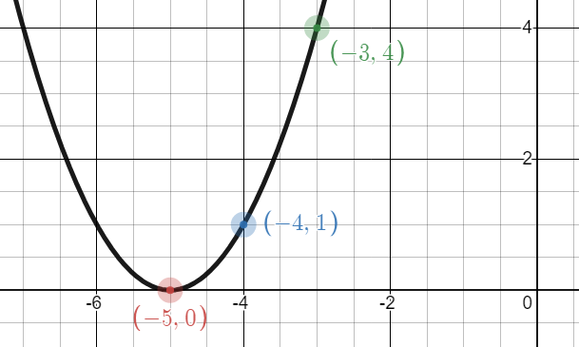
Translating Graphs Horizontally
What will $y={(x+5)}^{2}$ look like?
Same as before, it looks like we’ve translated the graph left, but this time by 5 units.

Slide 11
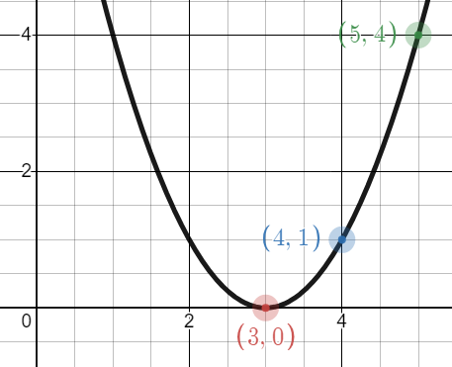
Translating Graphs Horizontally
How could we translate the graph to the right?
Subtraction
Here’s what $y={(x−3)}^{2}$ looks like.

Slide 12
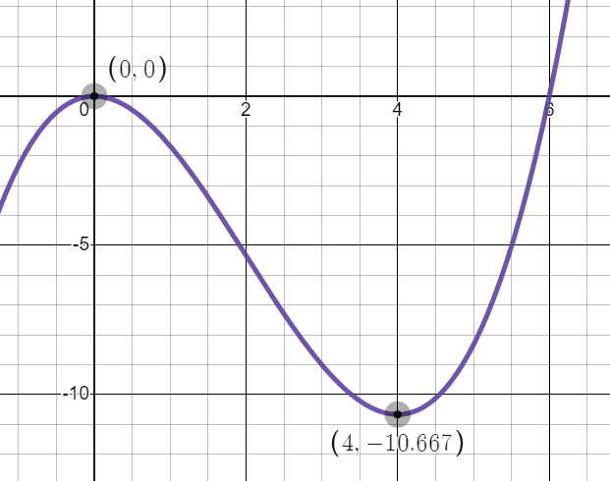
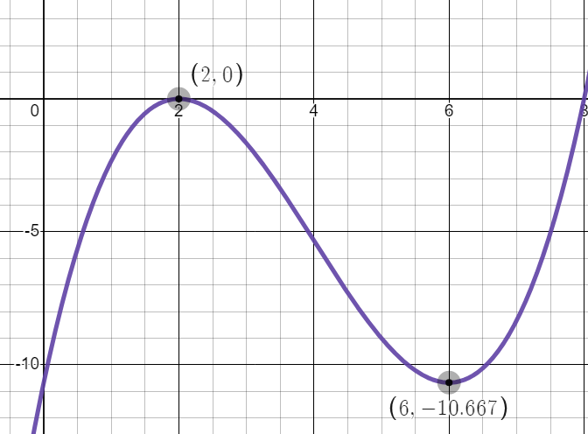
Translating Graphs Horizontally
We can apply this to any function.
$$y=f(x)$$
$$y=f(x−2)$$

Slide 13
Translating Graphs Horizontally
In general:
$f\left(x+a\right)$
Translation $\left(\begin{matrix}−a \\ 0\end{matrix}\right)$
$$+$$
$$−$$

Slide 14
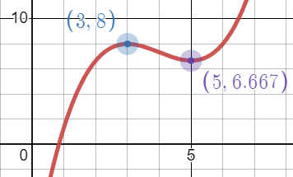
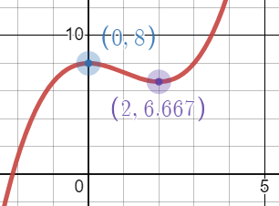
Describing a Transformation
Describe the transformation that has taken place here.
Translation $\left(\begin{matrix}−3 \\ 0\end{matrix}\right)$
(You shouldn’t say ‘move’ or ‘shift’)

Slide 15
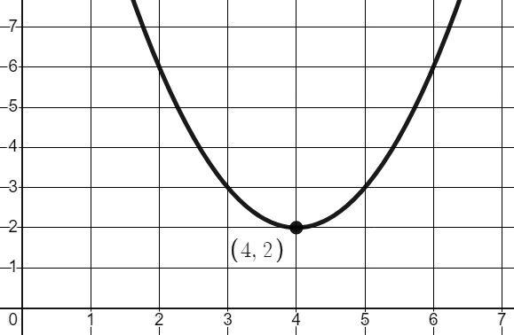
Combining Translations
It is easy to translate a graph both horizontally and vertically.
Using $y=x^{2}$
Here’s what $y={(x−4)}^{2}+ 2$ looks like.
$$\left(\begin{matrix}4 \\ 2\end{matrix}\right)$$
Syllabus link:
$y={(x−4)}^{2}+ 2$ is the same as writing a quadratic in completed square form.

Slide 16
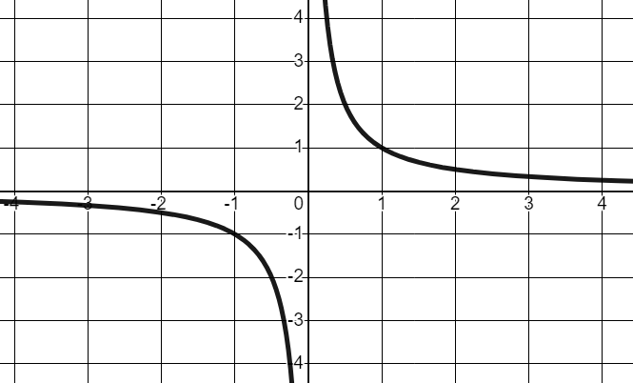
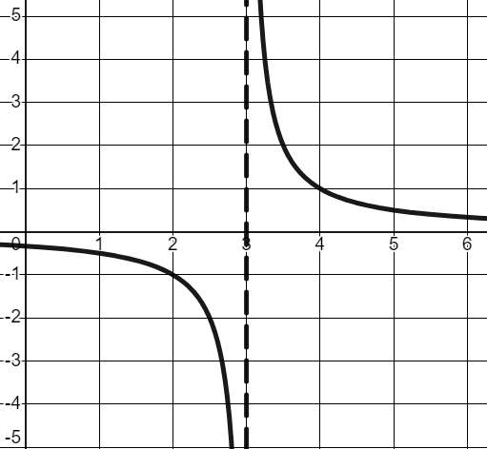
Sketching Reciprocal Graphs
It can be quite difficult to translate reciprocal graphs at first.
The easiest thing to do is to translate the asymptotes first, then sketch the rest of the graph from there.
Here’s $y=\frac{1}{x−3}$
The vertical asymptote translates right 3 units. The horizontal asymptote stays on the $x$axis.

Slide 17
Worksheet A: Translating Functions
Now work through all questions on Worksheet A.
Squared paper would be useful for sketching your graphs.

