Slide 1
Teaching Pack – Vectors
Lesson 1 – Properties of vectors
Cambridge IGCSE™
Mathematics 0580
Version 1.0

Slide 2
Lesson objective
To be able to identify and use vector notation.
To understand the difference between a vector and a scalar quantity and multiply a vector by a scalar.
In this lesson we will cover:
The difference between a scalar and a vector quantity,
How to represent a vector,
The different types of notation used to identify a vector,
How to multiply a vector by a scalar.
Notes:
The lesson begins by……..

Slide 3
Try this!
A water skier is being pulled through the water by a boat. Consider the following questions.
Is the water skier moving in the same direction as the rope?
What forces are acting on the water skier?
Which directions are the forces acting in?
Upthrust
Tension
Friction
Weight
Notes:
The situation of the water skier is an example of the sort of real life questions that can be modeled with the use of vectors. This diagram could be used to illustrate the forces acting on the water skier who is modeled as a point. This diagram is a highly simplified version of the actual situation. In order to create this model we have made a number of assumptions. Extensions : Can you suggest some assumption we will have made?
All the forces on the skier are acting through his centre of mass in a direct inline up/down and forward/back direction. None of this will be strictly true in reality. However, as is always the case with a mathematical model it is a starting point and hopefully it will have made you think about how useful vectors are when solving many real life problems.
Vectors can be used to model some very complex real life situations. In future lessons we will look at some simple examples. In preparation for that in this first lesson we are going to be looking at the basic properties of vectors.

Slide 4
Scalar or vector
A quantity that can be completely described by its magnitude, and has no direction associated with it, is a scalar. The mass of a bus (10 tonnes) for example is a scalar. The “weight” of the bus however is a vector as it involves the forces of gravity on the bus.
A vector is a quantity that has both magnitude and direction.

Slide 5
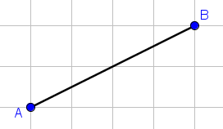
Properties of vectors
A vector can be represented by a straight line, with an arrow to show its direction. The length of the line may represent the magnitude of the vector.
a
This vector a represents the translation or movement from A to B.
Instead of being an arrow, a vector could just be a line connecting two points, in which case the same principles apply.
Notes:
We are now going to formalise work done describing a translation in terms of horizontal and vertical shifts and see how we can illustrate the information that defines a specific translation as a vector.
You will have experienced a translation described as (xy), where x is a movement parallel to the x-axis and y is a movement parallel to the y-axis. This means that (xy) is a vector, since it has magnitude and direction.

Slide 6
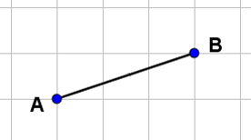
Properties of vectors
The vector from A to B would be written :$\vec{\text{AB}}$
a
To go from B to A you would write: $\vec{\text{BA}}$
You should be able to see that this is exactly the opposite of going from A to B.
$$\vec{\text{AB}}=− \vec{\text{BA}}$$

Slide 7
Vector notation
A vector may be shown as a small letter, such as a, printed in bold.
You may also write the vector a as $\vec{\text{AB}}$. The arrow above the letter shows the direction of movement which in this case is from A to B. The vector B to A has the same magnitude but acts in the opposite direction, so you write it as $\vec{\text{BA}}$. The first letter is always the starting point and the second letter is the finishing point.
Notes:
Communication is crucial to this area of mathematics. So we need to be careful and adhere to convention in terms of notation. You can write vectors in a number of ways here are the two most common ones.

Slide 8
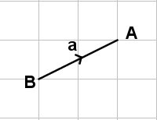
Column vectors
You can also write a vector as a column. So for example vector a could be described by the column vector.
$$\vec{\text{BA}}\text{= }\left(\begin{aligned}\text{2} \\ \text{1}\end{aligned}\right)$$

Slide 9
Multiplying a vector by a scalar quantity
When we multiply a vector by a scalar quantity, it is called scaling the vector because it changes the magnitude or how big or small the vector is but the overall direction of the vector will be the same although it can be in the opposite direction.
Notes:
We have already looked at the difference between a vector and the scalar.

Slide 10
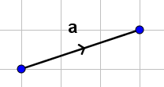
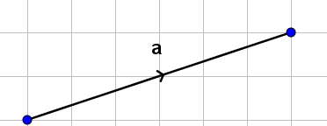
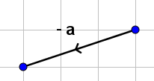
Multiplying a vector by a scalar quantity
If vector a is represented by column vector ,
then vector 2a will be represented by the column vector
As you can see this agrees with the vector diagram.
The vector –a would be represented by the column vector .
Notes:
Remember multiplying a vector by a number (scalar) alters its magnitude (length) but not its direction. When you multiply a vector by a scalar it is often called "scaling" a vector, because you change how big or small the vector is. Use some text book examples of multiplying a vector by a scalar.

Slide 11
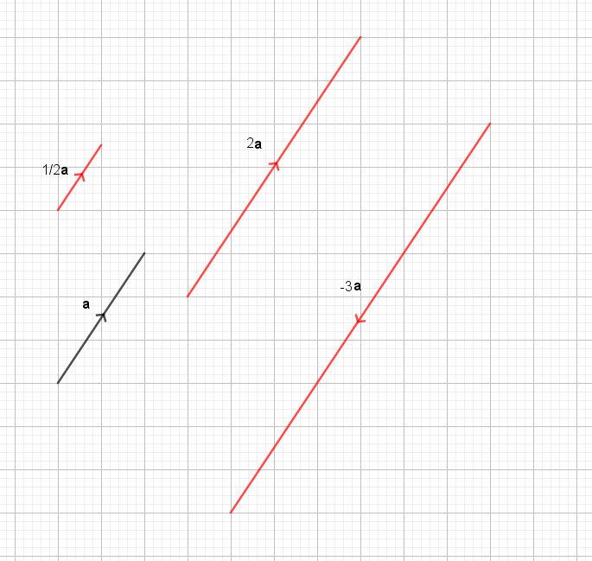
Try this!
Vector a can be described by the column vector .
On some squared paper draw vector a and the following scalar multiples.
2a
-3a
$\frac{\text{1}}{\text{2}}$a
All these vectors are parallel to one another.
Notes:
Learners will need some squared paper for this activity.

Slide 12
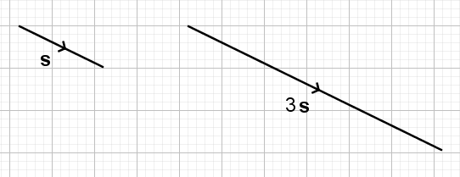
Try this!
Suppose a displacement s metres is given by
Find the displacement that is three times as far and in the same direction.

