Slide 1
Teacher tutorial Topic: 2.3 Trigonometry Lesson 1: Solving Trigonometric Equations
Version 1

Slide 2
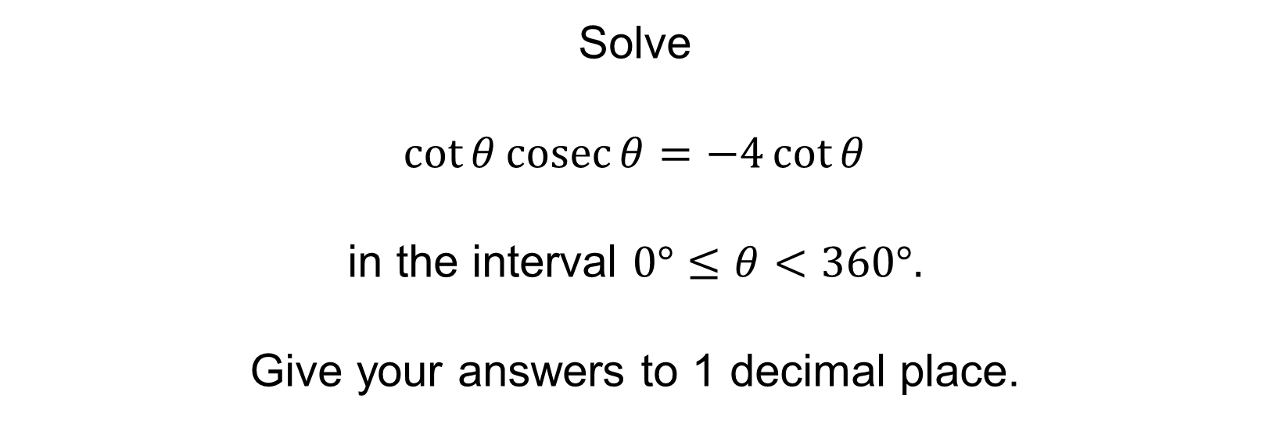
Trigonometric Equations
Solve
$\cot{θ\operatorname{cosec}{θ=−4\cot{θ}}}$
in the interval $0°≤θ<360°.$
Give your answers to 1 decimal place.
Notes:
This PowerPoint is used to demonstrate how to solve a trigonometric equation where it is important to factorise an expression rather than cancel terms, which would result in solutions being lost.
The example also looks at the importance of giving answers to a required degree of accuracy.
As the question is in degrees, answers should be given to 1 decimal place rather than the usual 3 significant figures used generally, or in the case of angles given in radians. Note that a question in degrees may not explicitly ask for solutions to be given to 1 decimal place.

Slide 3
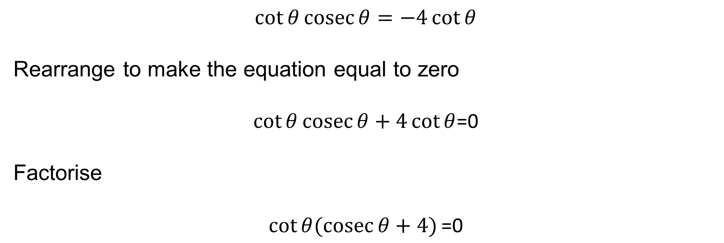
Trigonometric Equations
$$\cot{θ\operatorname{cosec}{θ=−4\cot{θ}}}$$
Rearrange to make the equation equal to zero
$\cot{θ\operatorname{cosec}{θ+4\cot{θ}}}$=0
Factorise
$$\cot{θ(\operatorname{cosec}{θ+4)}}\text{=0}$$
Notes:
Rearrange to make the equation equal to zero.
Do NOT cancel by cot θ at any stage, as solutions will be lost.
Instead, factorise using cot θ.
This is highlighted in Worksheet A where in Q1 and Q2 solutions are lost if the x variable is cancelled. Enforce this as an error, as some learners do not realise the same issue applies when solving trigonometric equations.
Similarly in Q2 of Worksheet A, a solution is lost if the negative square root is ignored; ensure learners can transfer this skill (taking both positive and negative square roots) to trigonometric equations. Q1 and Q3 on Worksheet C test this skill.

Slide 4

Trigonometric Equations
$$\cot{θ(\operatorname{cosec}{θ+4)}}\text{= 0}$$
Make each factor equal to zero
$\cot{θ=0}$ or $\operatorname{cosec}{θ+4=0}$
$\cot{θ=0}$ gives answers of
$θ=90°$or $270°$
Notes:
Use the factors to set up two linear equations.
When solving cot θ = 0 ensure both solutions for $0°≤θ<360°$are found.
You may wish to practice using the CAST diagram or graphs to ensure all solutions within the required interval are found.

Slide 5
Trigonometric Equations
$\operatorname{cosec}{θ+4=0}$ gives
$\operatorname{cosec}{θ=−4}$ or $\sin{θ=−\frac{1}{4}}$
Using a calculator gives
$$θ=\sin^{−1}\left(−\frac{1}{4}\right)=−14.477…$$
Using the CAST diagram or sine graph gives
$θ=$194.477… or 345.522…
So to 1 decimal place all the solutions are
$θ=90.0°,$ $270.0°,$ $194.5° ,345.5°$
(No other solutions should be given, even outside the given range.)
Notes:
Solutions given to an incorrect degree of accuracy is often an area where marks are lost within the topic of solving trigonometric equations.
This is highlighted in Worksheet A where in Q3 and Q4 solutions are lost if the solutions are not given to 1 decimal place (Q3) or not given to 3 significant figures (Q4).
Note in this example that if answers of 194 or 346 are given as the final answers, this could result in marks being lost as when working in degrees; 1 decimal place rather than 3 significant figures are required.
Similarly, if answers are too accurate, for example 194.48, marks can still be lost as the question has specified answers are required to 1 decimal place.
Also note, that if cot θ has been cancelled at the beginning of the question, 2 solutions are lost.

