Slide 1
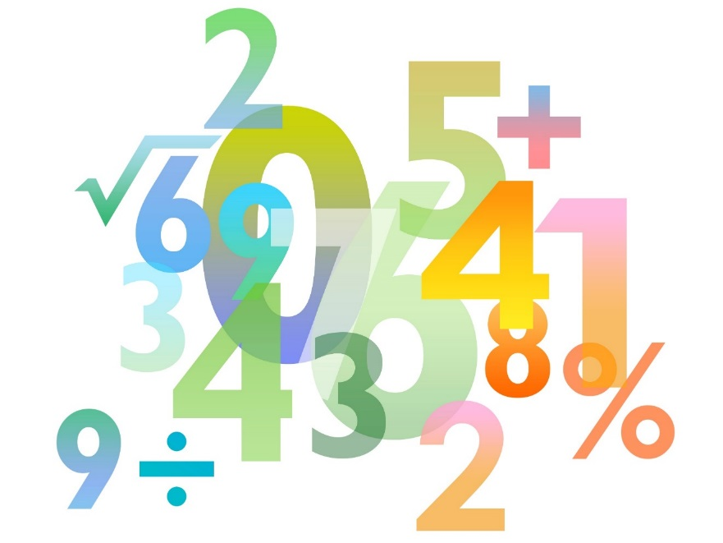
Teaching Pack – Probability of combined events
Lesson 2 – Finding probabilities using fraction multiplication
Cambridge IGCSE™
Mathematics 0580
Version 1.0

Slide 2
Lesson objectives
To be able to calculate probabilities of combined events using fraction arithmetic instead of a possibility space diagram.

Slide 3
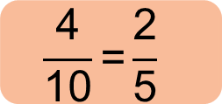
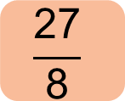
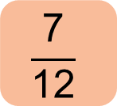
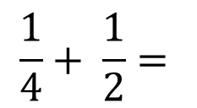
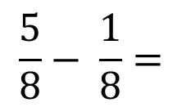
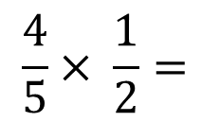
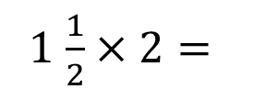
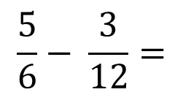
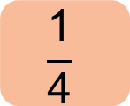
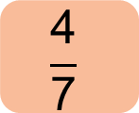
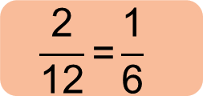
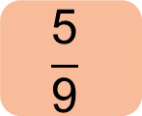
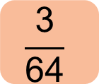
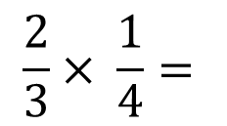
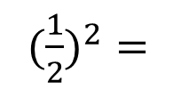
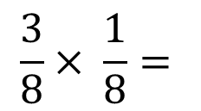
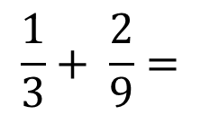
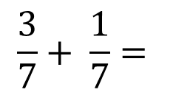
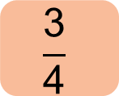
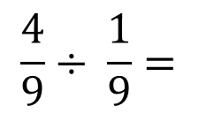
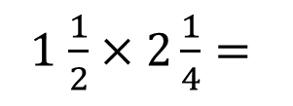
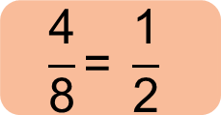
Fraction arithmetic - recap
$$\frac{1}{4}+ \frac{1}{2}=$$
1 $\frac{1}{2}×2\frac{1}{4}=$
$$\frac{\text{27}}{\text{8}}$$
$$\frac{\text{3}}{\text{4}}$$
$$\frac{2}{3}× \frac{1}{4}=$$
(${\frac{1}{2})}^{2}=$
$$\frac{\text{1}}{\text{4}}$$
$$\frac{\text{2}}{\text{12}}\text{=}\frac{\text{1}}{\text{6}}$$
$$\frac{4}{5}× \frac{1}{2}=$$
$$\frac{\text{4}}{\text{10}}\text{=}\frac{\text{2}}{\text{5}}$$
$$\frac{5}{6}− \frac{3}{12}=$$
$$\frac{\text{7}}{\text{12}}$$
$$\frac{4}{9}÷ \frac{1}{9}=$$
4
$$\frac{3}{7}+ \frac{1}{7}=$$
$$\frac{\text{4}}{\text{7}}$$
$$\frac{1}{3}+ \frac{2}{9}=$$
$$\frac{\text{5}}{\text{9}}$$
$$\frac{5}{8}− \frac{1}{8}=$$
$$\frac{\text{4}}{\text{8}}\text{= }\frac{\text{1}}{\text{2}}$$
1 $\frac{1}{2}×2=$
3
$$\frac{3}{8}× \frac{1}{8}=$$
$$\frac{\text{3}}{\text{64}}$$
Notes:
Fraction arithmetic (multiplication and addition) is vital in using probability tree diagrams. The starter addresses this. Students should attempt as many of the questions as they can. The teacher can then ask students to give their answers and explain their method, before clicking on the square to reveal the correct answer. Could do this as a competitive game between left and right halves of the room etc. Make certain pupils can multiply fractions and add with a common denominator before attempting the lesson.

Slide 4
Try this!
A bag contains 5 tickets.
3 of them winning tickets.
2 are not winning tickets.
A student takes two tickets from the bag.
Before drawing the second ticket the first ticket must be returned to the bag.
Draw a possibility space diagram to show the number of different ways that two tickets can be drawn from the bag.
Use this to calculate the probability that the student draws two winning tickets.
Notes:
Pupils should be able to answer this question using a possibility space diagram.
Get them to do the question independently. We are then going to show how you can answer the same question using fraction multiplication.

Slide 5
Try this!
1st ticket
+
W
W
W
L
L
So Probability of getting exactly one winning ticket is $\frac{\text{9}}{\text{25}}$.
W
x
x
x
2nd ticket
W
x
x
x
Notice that:
W
x
x
x
$$\frac{\text{9}}{\text{25}}\text{= }\frac{\text{3}}{\text{5}} \text{×} \frac{\text{3}}{\text{5}}$$
L
L
P(getting 2 wins) = P(1st ticket wins) × P(2nd ticket wins)
In general it is true that:
P(A followed by B followed by C …..)
= P(A) × P(B) × P(C) …………
Notes:
We can use this answer slide to demonstrate that we could get the answer to the problem really quickly by doing a simple fraction multiplication instead of drawing the possibility space diagram. This is the main point of the lesson.

Slide 6
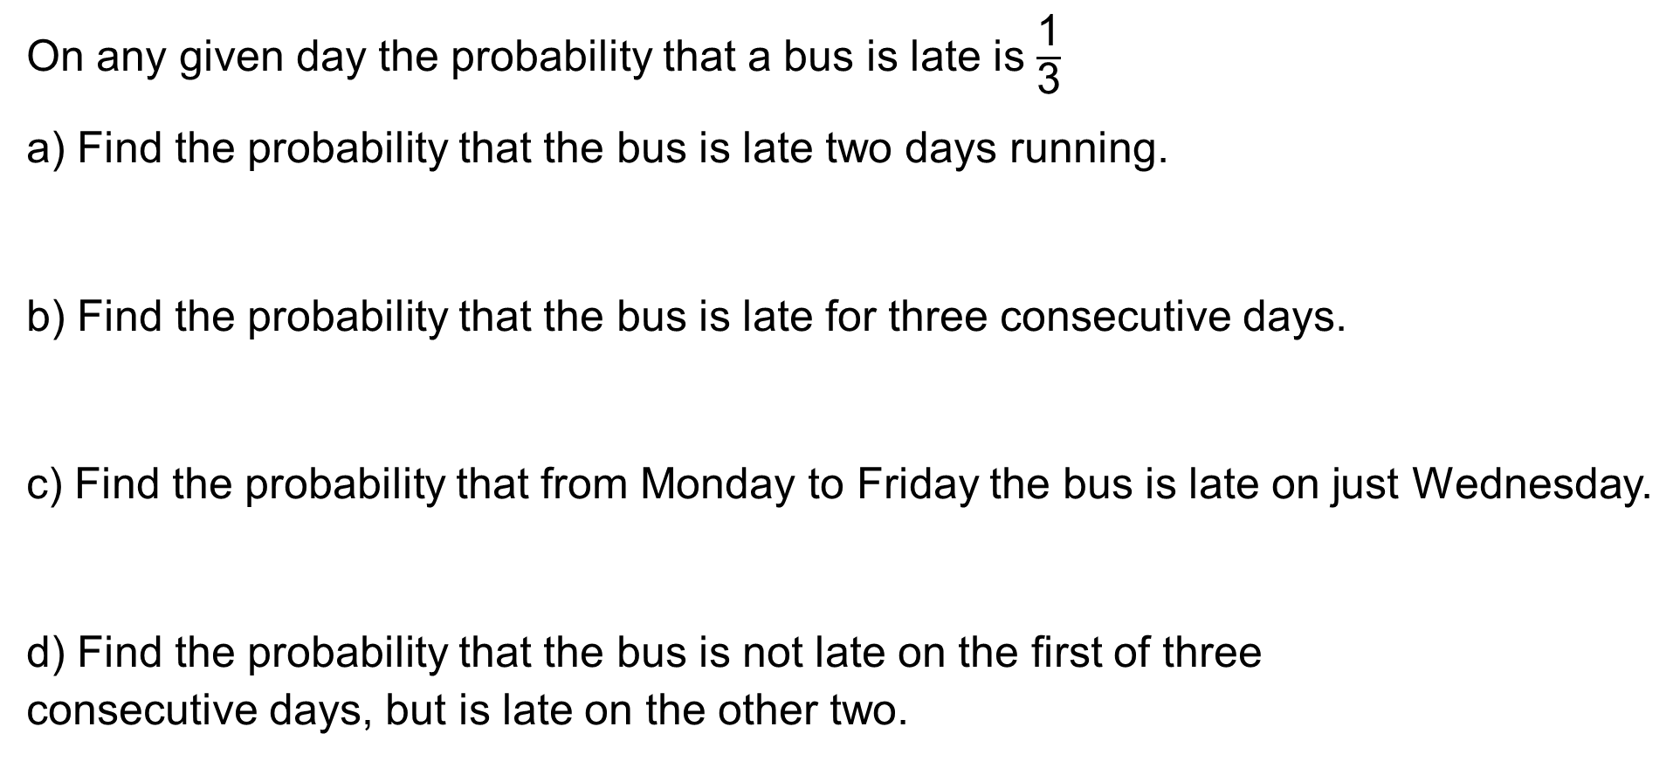

Try this!
On any given day the probability that a bus is late is $\frac{\text{1}}{\text{3}}$
a) Find the probability that the bus is late two days running.
b) Find the probability that the bus is late for three consecutive days.
c) Find the probability that from Monday to Friday the bus is late on just Wednesday.
d) Find the probability that the bus is not late on the first of three
consecutive days, but is late on the other two.
$$\frac{\text{1}}{\text{3}}\text{×}\frac{\text{1}}{\text{3}}\text{= }\frac{\text{1}}{\text{9}}$$
$$\frac{\text{1}}{\text{3}}\text{×}\frac{\text{1}}{\text{3}}\text{×}\frac{\text{1}}{\text{3}}\text{= }\frac{\text{1}}{\text{27}}$$
$$\frac{\text{2}}{\text{3}}\text{×}\frac{\text{2}}{\text{3}}\text{×}\frac{\text{1}}{\text{3}}\text{×}\frac{\text{2}}{\text{3}}\text{×}\frac{\text{2}}{\text{3}}\text{= }\frac{\text{16}}{\text{243}}$$
$$\frac{\text{2}}{\text{3}}\text{×}\frac{\text{1}}{\text{3}}\text{×}\frac{\text{1}}{\text{3}}\text{= }\frac{\text{2}}{\text{27}}$$
Notes:
Go through these examples to show how you can simply multiply the events together to get the right answer.
a) ¹/₃ x ¹/₃ = ¹/₉ b) ¹/₃ x ¹/₃ x ¹/₃ = ¹/₂₇ c) ²/₃ x ²/₃ x ¹/₃ x ²/₃ x ²/₃ = ¹⁶/₂₄₃ d) ²/₃ x ¹/₃ x ¹/₃ = ²/₂₇

Slide 7
Try this!
I spin a coin three times.
What is the probability that it will show heads, then tails, then heads?
$$\frac{\text{1}}{\text{2}}\text{×}\frac{\text{1}}{\text{2}}\text{×}\frac{\text{1}}{\text{2}}\text{= }\frac{\text{1}}{\text{8}}$$
Notes:
Mini white board slides to practise the skill of finding probabilities by multiplying fractions: ½ x ½ x ½ = ¹/₈

Slide 8
Try this!
On any given day the probability that it rains is $\frac{\text{2}}{\text{3}}$ .
What is the probability that it rains three days in a row?
$$\frac{\text{2}}{\text{3}}\text{×}\frac{\text{2}}{\text{3}}\text{×}\frac{\text{2}}{\text{3}}\text{= }\frac{\text{8}}{\text{27}}$$
Notes:
Mini white board slides to practise the skill of finding probabilities by multiplying fractions: ²/₃ x ²/₃ x ²/₃ = ⁸/₂₇

Slide 9
Try this!
The probability that a computer fails to start in the morning is $\frac{3}{4}$.
What is the probability that it works on Monday morning, but not on Tuesday or Wednesday morning?
$$\frac{1}{4}×\frac{3}{4}×\frac{3}{4}= \frac{9}{64}$$
Notes:
Mini white board slides to practise the skill of finding probabilities by multiplying fractions: ¹/₄ x ³/₄ x ³/₄ = ⁹/₆₄

Slide 10
Try this!
On any given day the probability that it rains is $\frac{\text{1}}{\text{10}}$ .
What is the probability that it rains on only the last day of a three day period?
What is the probability that it rains on only the middle day of a three day period?
$$\frac{\text{9}}{\text{10}}\text{×}\frac{\text{9}}{\text{10}}\text{×}\frac{\text{1}}{\text{10}}\text{= }\frac{\text{81}}{\text{10}\text{0}\text{0}}$$
$$\frac{\text{9}}{\text{10}}\text{×}\frac{\text{1}}{\text{10}}\text{×}\frac{\text{9}}{\text{10}}\text{= }\frac{\text{81}}{\text{10}\text{0}\text{0}}$$
Notes:
Mini white board slides to practise the skill of finding probabilities by multiplying fractions: ⁹/₁₀ x ⁹/₁₀ x ¹/₁₀ = ⁸¹/₁₀₀₀
Mini white board slides to practise the skill of finding probabilities by multiplying fractions: ⁹/₁₀ x ¹/₁₀ x ⁹/₁₀ = ⁸¹/₁₀₀₀

Slide 11
Try this!
A bag contains 5 red balls and 3 green balls. I take a ball out of the bag record its colour and then return it to the bag before drawing a second ball.
What is the probability that both balls are red?
$$\frac{\text{5}}{\text{8}}\text{×}\frac{\text{5}}{\text{8}}\text{= }\frac{\text{25}}{\text{64}}$$
What is the probability that I get a red ball followed by a green ball?
$$\frac{\text{5}}{\text{8}}\text{×}\frac{\text{3}}{\text{8}}\text{= }\frac{\text{15}}{\text{64}}$$
Notes:
Mini white board slides to practise the skill of finding probabilities by multiplying fractions: ⁵/₈ x ⁵/₈ = ²⁵/₆₄
Mini white board slides to practise the skill of finding probabilities by multiplying fractions: ⁵/₈ x ³/₈ = ¹⁵/₆₄

Slide 12
Try this!
A bag contains 5 tickets.
3 of them winning tickets.
2 are not winning tickets.
A student takes two tickets from the bag.
Before drawing the second ticket the first ticket must be returned to the bag.
Lets revisit our ticket problem again:
Suppose the student wins if they get just one winning ticket.
How can we calculate the probability of them winning?
Notes:
The aim of this plenary question is to get the pupils to understand that there are two ways that the pupil can get a winning ticket and that we have to calculate them both separately and then add them together. Answers to this slide are on the next slide. The possibility space diagram helps to make this clear. This is an advanced skill.

Slide 13
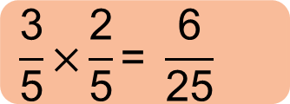
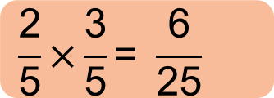
Try this!
1st ticket
+
W
W
W
L
L
There are two ways we can win with exactly one ticket:
W
x
x
2nd ticket
W
x
x
W
x
x
L
x
x
x
L
x
x
x
$$\frac{\text{3}}{\text{5}}\text{×}\frac{\text{2}}{\text{5}}\text{= }\frac{\text{6}}{\text{25}}$$
Win the first ticket and lose the second ticket =
Lose with first ticket and win with second ticket =
$$\frac{\text{2}}{\text{5}}\text{×}\frac{\text{3}}{\text{5}}\text{= }\frac{\text{6}}{\text{25}}$$
To get the answer we need to add these together =
$$\frac{\text{6}}{\text{25}}\text{+}\frac{\text{6}}{\text{25}}\text{= }\frac{\text{12}}{\text{25}}$$

