Slide 1
Skills Pack – The circle
Lesson 2: Area of a circle
Cambridge IGCSETM
Mathematics 0580
Version 0.1

Slide 2
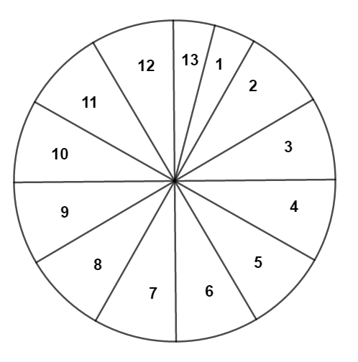
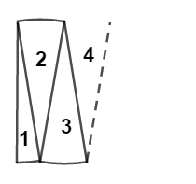
Formula for the area of a circle
The circle with radius r has been divided into 12 equal sectors. Then one sector has been divided into two separate sectors to give a total of 13 sectors.
Cut the circle into 13 sectors and then rearrange them side by side in the way shown below.
r

Slide 3
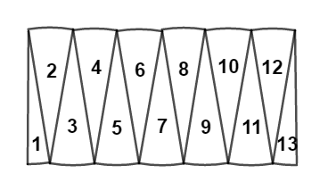
Formula for the area of a circle
Your rearrangement should look like this
What shape does the new arrangement now resemble?
What is the height of this new shape?
What is its length equal to?

Slide 4
Formula for the area of a circle
We know that the rectangle and the "bumpy edged shape" made by the sectors are not an exact match.
But we could get a better result if we divided the circle into 37 sectors (35 with an angle of 10° and 2 with an angle of 5°).
And the more we divided the circle up, the closer we get to being exactly right.

Slide 5
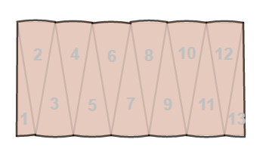
Formula for the area of a circle
r
The height of the rectangle is the circle's radius.
The width (in reality a bumpy line) is half of the curved parts around the circle .
In other words it is approximately half the circumference of the circle.

Slide 6
Formula for the area of a circle
We know that
Circumference = 2πr
r
So the width of the rectangle is approximately:
Half the circumference = πr
The area of a rectangle = width x height
Area = πr x r
Area of a circle = πr²

Slide 7
Calculating the area of a circle
Can you calculate the area of a circle when you know the circumference.
$A=π ×\frac{d^{2}}{4}$
$A=π ×\frac{d^{2}}{4}=\frac{πd^{2}}{4}= \frac{π^{2}d^{2}}{4π}$
$$A=\frac{C^{2}}{4π}$$

Slide 8
Try this!
The radius of a circle is 3 cm. What is its area? Give your answer correct to 2 decimal places.
$A=πr^{2}$
$A=π{×3}^{2}$
$A=28.27 cm2$
3 cm

Slide 9
Try this!
The diameter of a circle is 14 cm. What is its area? Use $\frac{\text{22}}{\text{7}}$ as an approximation of π.
$r=7 cm$
$A=πr^{2}$
14 cm
$A=\frac{22}{7}{× 7}^{2}$
$A=22 ×7=154 {cm}^{2}$

Slide 10
Try this!
The circumference of a circle is 20 cm. What is its area? Give your answer to 2 decimal places.
$A=\frac{C^{2}}{4 π}$
$A=\frac{{20}^{2}}{4 π}$
$A=31.83 {cm}^{2}$

Slide 11
Try this!
The area of a circle is 616 cm² what is its radius? Use $\frac{\text{22}}{\text{7}}$as an approximation for π.
$A=πr^{2}$
$r=\sqrt{\frac{A}{π}}$
$r=\sqrt{\frac{616}{\frac{22}{7}} }$ $= \sqrt{616 × \frac{7}{22}}$
r$=\sqrt{196}$
r$=$ 14 cm

Slide 12
Plenary
What is the minimum information you need to be able to find the circumference and area of a circle?
How would you go about finding the area of a circle if you know the circumference?
Why is it easy to distinguish between the formulae for the circumference and area of a circle?
All circles are similar. Use what you know about the ratio of the circumference to the diameter of a circle to help you explain this.

