Slide 1
Teaching Pack – Vectors
Lesson 4 – Vectors in real life context
Cambridge IGCSE™
Mathematics 0580
Version 1.0

Slide 2
Lesson objectives
Use all the ideas you have built up on vectors to solve multi step real life questions.
Use vectors as an example of how mathematics can be used in the real-world.

Slide 3
Magnitude and direction of a vector
So far we have learnt that vectors have a magnitude (size) and direction. We are now going to look at how we can use what we already know about Pythagoras theorem and trigonometry to solve some real life problems involving the magnitude and direction of vectors.
$$\text{v}\text{ =}\left(\begin{aligned}\text{v}\text{1} \\ \text{v}\text{2}\end{aligned}\right)$$
How can you use the triangle to find the magnitude and direction of v?
Magnitude
Direction
Notes:
Ask learners how they might use vectors v₁ and v₂ to find out the magnitude and direction of vector v. Give learners time to think about this in pairs and take feedback before animating slide. Note that we often use the same letter for a vector and its magnitude, but the vector is written in bold (or sometimes in italic) .

Slide 4
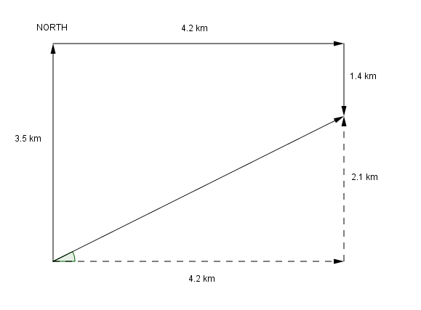
Try this!
On a hot summer day Alice goes for a walk to see if she can find a shop to buy an ice cream. She first walks 3.5 km [N], then 4.2 km [E], and finally 1.4 km [S] before getting to the ice cream. Oh, thank goodness!
Determine the distance and direction of Alice in relation to her starting point when she finds her ice cream?
The bearing is
Distance d is equal to the magnitude of the resultant vector
d
Alice is 4.7km away on a bearing of 63 degrees.
Notes:
Play the Geogebra animation. Play it in silence to demonstrate how the diagram is built up form the words and how this can then be turned into a right angled triangle that represent the vector displacement of Alice when she finds the ice cream. There is also a hardcopy of the diagram which you can use to support learners if necessary (Worksheet 4b Finding ice cream).

Slide 5
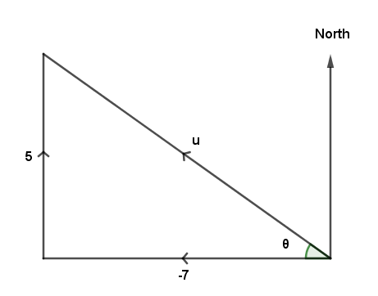
Try this!
A skier starts skiing across horizontal ground with velocity u ms⁻¹ where
Find the bearing and the speed on which he is travelling.
Direction
This gives a bearing of
Magnitude
So the skier is travelling on a bearing of and at speed of .
Notes:
Note that direction is a scalar quantity (the vector quantity is displacement)

Slide 6
Design an exam question
Now design your own exam question using some of what you have learnt in the last 4 lessons on vectors
See if you can design a question that starts fairly easily but then gets harder as you go along.
You will also need to think about a mark scheme for your question.

