Slide 1
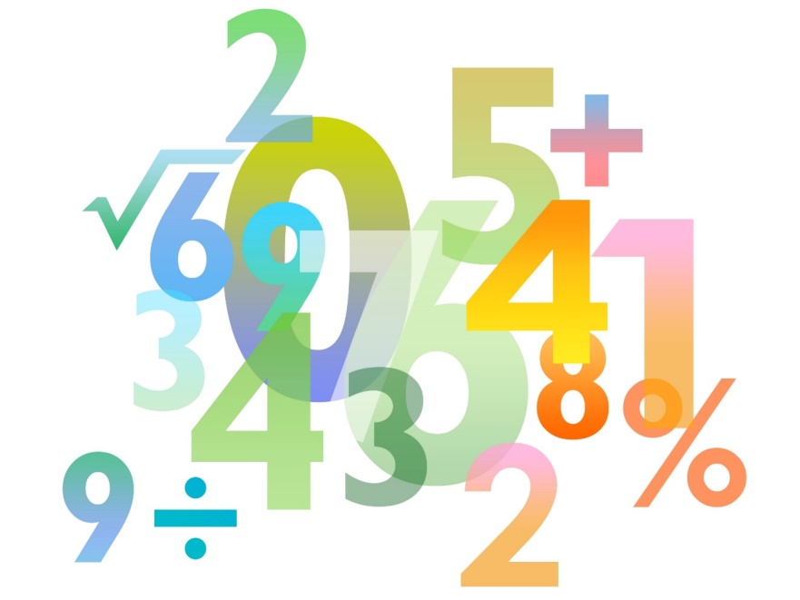
Teaching Pack – Understanding bearings
Lesson 1: Angle facts
Cambridge IGCSE™
Mathematics 0580
Version 1

Slide 2
Lesson objectives
To be able to explain confidently that angle is a measure of turn.

Slide 3
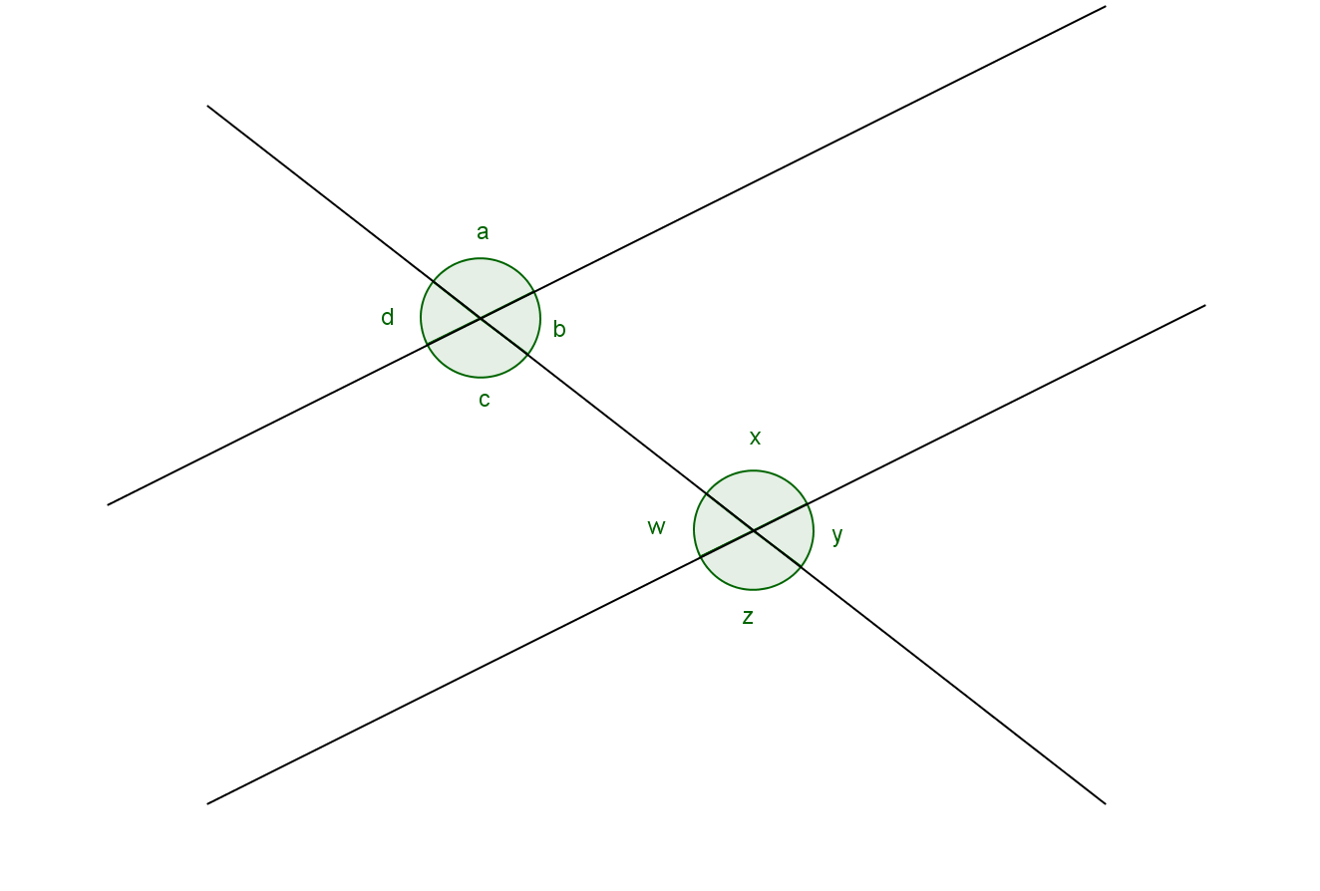
Starter Angle Facts
What can you say about the angles in the diagrams?
Try to find as many different relationships as you can.
Make sure you explain your observations.
z = c
β = 180º
w = y
θ = 90º
x + y = 180º
Notes:
Encourage students to make as many observations as they can. Encourage them to explain these observations so for example z is equal to c because they are corresponding angles, w is equal to y because they are opposite angles. x and y sum to 180° because the angles on a straight line equal 180° etc. Students can then work though Worksheet 1a: Angle Facts
http://www.mathscareers.org.uk/video/maths-in-work-navigational-officer-pride-of-hull-po-ferry/

Slide 4
Try this!
How can you use the fact that the sum of the angles on a straight line is 180° to explain why the angles at a point are 360°?

