Slide 1
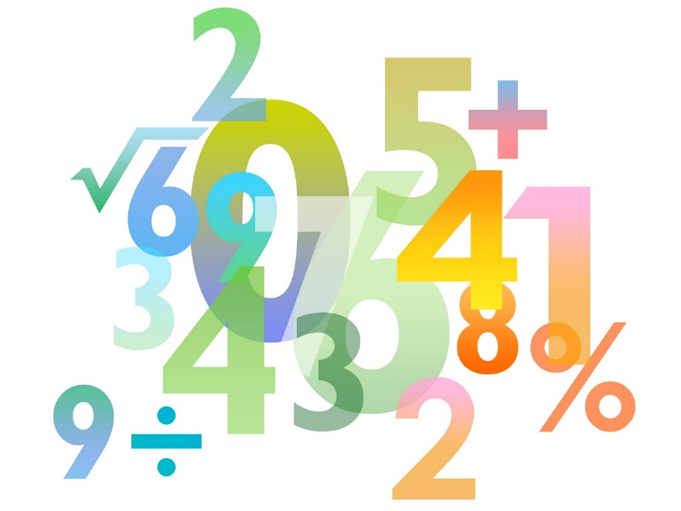
Teaching Pack – Differentiation
Lesson 1 – Introduction to differentiation
Cambridge IGCSE™
Mathematics 0580
Version 1.0

Slide 2
Lesson objectives
Be able to draw and recognise the graphs of quadratic and cubic functions.
Be able to use a tangent to estimate the gradient of a curve at a particular point.

Slide 3
Video: Overview of Calculus
Notes:
Make sure that you are logged in to Resource Plus before you attempt to play this video

Slide 4
Try this!
Find the gradient of these lines? What are the equations of each line?
Gradient 2
y = 2x-1
Gradient -1
y = 4-x
Gradient 0
y = 3
Gradient 1
y = x-2
Gradient -3
y = 4-3x
Gradient
y = x+1

Slide 5
Try this!
The graph shown is y = x³ – 2x² + 1. What can you say about the graph?
How can we estimate the gradient of the graph at the coordinate (2,1)?
We can draw a tangent to the curve at the point (2,1).
The gradient of the tangent is approximately the same as the gradient of the curve at that point.
4
In this case:
Gradient of tangent =
= 4
So the curve has a gradient of approximately 4 at the point (2,1).
1

Slide 6
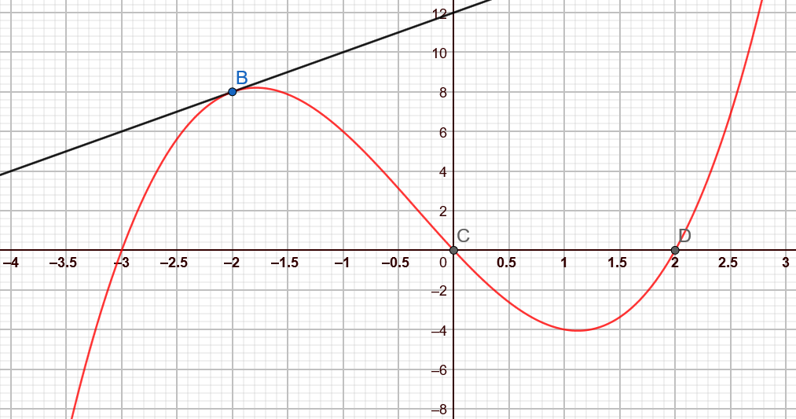
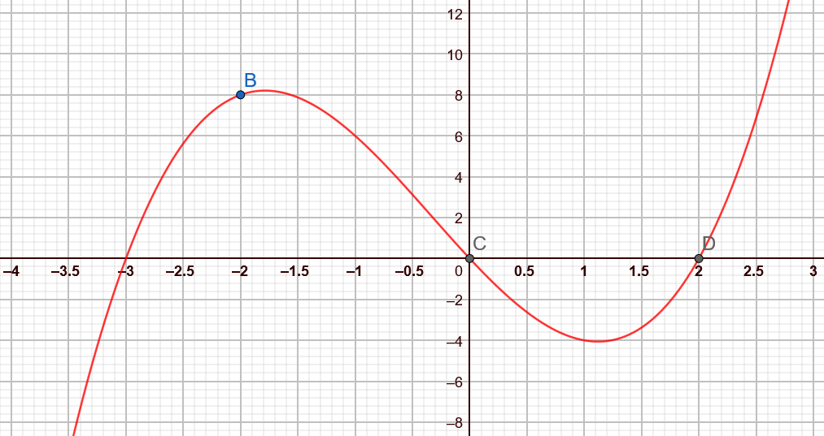
Try this!
This is a section of the graph y = x³ + x² – 6 plotted between x = -4 and x = 3.
Use tangents to estimate the gradient of the curve at the points labelled B, C and D.
8
Gradient of tangent =
= 2
So the curve has a gradient of approximately 2 at the point
labelled B.
4

Slide 7
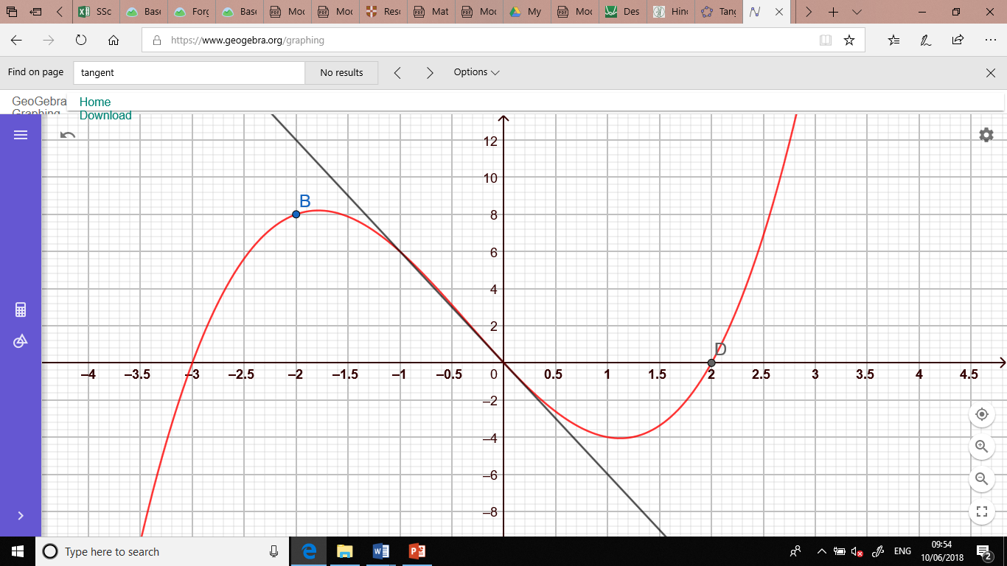
Try this!
Gradient of tangent =
=
So the curve has a gradient of approximately at the point
labelled C.
18
3

Slide 8
Try this!
Gradient of tangent =
=
So the curve has a gradient of approximately at the point
labelled D.
10
1

Slide 9
Try this!
. What is the value of y when x = 2?
20
70
16
18
. What is the value of
8
16
40
-32
. What is the value of
3
-3
Notes:
Answers 20, 16, -3

Slide 10
Try this!
What is the gradient of this line?
2
3
-2
-3
Notes:
Answer -3

Slide 11
Try this!
What is the gradient of this line?
2
-2
Notes:
Answer ½

Slide 12
Try this!
Which of these could be the graph of
A
B
C
D
Notes:
Answer D

Slide 13
Try this!
Which of these could be the graph of
A
B
C
D
Notes:
Answer B

Slide 14
Try this!
Which of these tangents has been drawn correctly?
A
B
C
D
Notes:
Answer A

Slide 15
Try this!
Which of these is not true for a tangent?
A tangent drawn on the circumference of a circle is always perpendicular to a radius.
A tangent to a point on a curve has the same gradient as the curve at that point.
It is impossible for the tangent of a curve to be a horizontal line.
Tangents can have a negative value.
Notes:
Answer: It is impossible for the tangent of a curve to be a horizontal line

