Slide 1
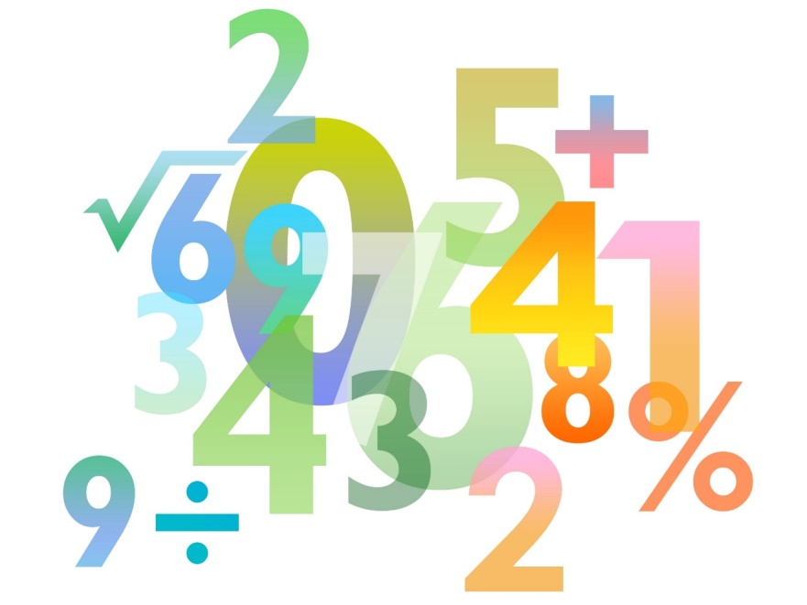
Teaching Pack – Understanding bearings
Lesson 3: Trigonometry and bearings
Cambridge IGCSE™
Mathematics 0580
Version 1

Slide 2
Lesson objective
To be able to draw diagrams to help solve bearings problems.

Slide 3
Try this!
A small passenger plane flies 3km due north then 4km due east. What is the three figure bearing of its current position from its starting position? Remember this problem from the end of lesson 2?
What is special about the triangle you drew for this problem?
It is a right angled triangle.
How did this help you to solve the problem?
The three ratios Sine, Cosine and Tangent are the functions used in Trigonometry when working with a Right-Angled Triangle.

Slide 4
Bearings and trigonometry in real life
But most real life problems involving bearings are not this simple because they involve more than one step.
For example:
A ship sails 22km on a bearing of 042° from point A, and a further 30km on a bearing of 090° to arrive at point B.
Bearings problems that involve more than one step can be worked out as you would work out any problems with non-right angled triangles and that is what we are going to look at in this lesson.

Slide 5
Sine and Cosine rules
Use the cosine rule when:
you need to find a side and you know two sides and the included angle
you need to find an angle (or bearing) and you know three sides.
Use the sine rule when:
you need to find a side and you know one sides and three angles
you need to find an angle (or bearing) and you know two sides and an angle.

