Slide 1
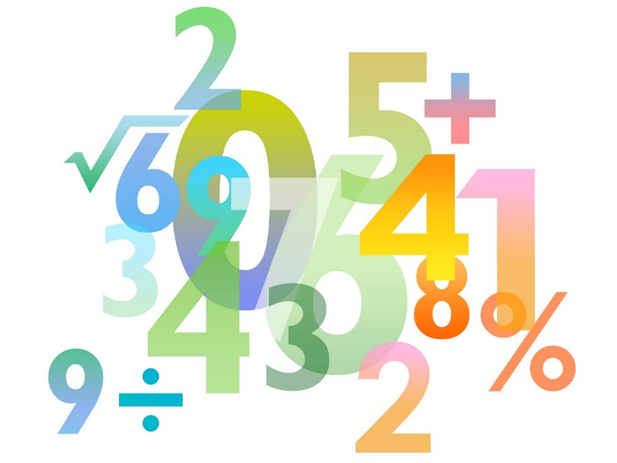
Teaching Pack – Differentiation
Lesson 2 – Finding gradients of curves
Cambridge IGCSE™
Mathematics 0580
Version 1.0

Slide 2
Lesson objectives
Be able to differentiate functions using the correct notation.
Be able to use differentiation to find the gradient function of a polynomial.

Slide 3
Try this!
Work out the value of each function and then add them up to find the total.
Function | x = | Value of the Function
3x - 5 | 3 | 4
x³ – 2x | 2 | 4
2x²-3x | 1 | -1
4 – x² | 0 | 4
1 – x³ | -1 | 2
x² – 3 | -2 | 1
 |  | Total value = 14
Function |  | Value of the Function
3x - 5 | 3
x³ – 2x | 2
2x²-3x | 1
4 – x² | 0
1 – x³ | -1
x² – 3 | -2
 |  | Total value =

Slide 4
Try this!
Extension
Which arrangement of the same x value substitutions would give the biggest total?
Function | x = | Value of the Function
3x - 5 | 3 | 4
x³ – 2x | 2 | 4
2x²-3x | 1 | -1
4 – x² | 0 | 4
1 – x³ | -1 | 2
x² – 3 | -2 | 1
 |  | Total value = 14
 | 3x-5 | x³-2x | 2x²-3x | 4-x² | 1-x³ | x²-3
3 | 4 | 21 | 9 | -5 | -26 | 6
2 | 1 | 4 | 2 | 0 | -7 | 1
1 | -2 | -1 | -1 | 3 | 0 | -2
0 | -5 | 0 | 0 | 4 | 1 | -3
-1 | -8 | 1 | 5 | 3 | 2 | -2
-2 | -11 | -4 | 14 | 0 | 9 | 1
Total = 40

Slide 5
Video: Introduction to Calculus
Notes:
Make sure that you are logged in to Resource Plus before you attempt to play this video

Slide 6
Derivative and differentiating
A curve has a gradient that changes depending on the value of the x coordinate (that is why it curves!).
Instead of finding the gradient as a value, we can instead, describe the gradient using a formula in terms of x.
The gradient formula of a function is called its derivative and is found by differentiating the equation of the curve.

Slide 7
Gradient formula of polynomial equation
There is a rule that lets you find the gradient formula of any polynomial equation. Look at these examples.
Can you spot the rule?

Slide 8
General method
If then the derivative of y is
Here are some examples using correct notation:
Original Function | Derivative of Function
y = 5x³ + 4x²
y = 2x² + 5x – 7
y = 3x + 1
f(x) = 6x³ – 2x² +3x –2 | f′(x) = 18x² – 4x + 3
f(x) = 7x | f′(x) = 7

Slide 9
Try this!
Find the gradient of the curve at the point (3,22).
This is the ‘gradient function’ of the curve.
At the point when x = 3
x
So at the point (3,22) the gradient is 16.

Slide 10
Try this!
Find the x-coordinate where the curve has a gradient of 7.
This is the ‘gradient function’ of the curve.
We need ‘x’ when
So 6x – 5 = 7
x = 2
The x-coordinate is 2 when the gradient of the curve is 7.
The y-coordinate at this point is 3 x 2² – 5 x 2 + 1 = 3
So the answer is (2,3).

Slide 11
Try this!
Finding the gradient Bingo
Each player needs to draw a 3 x 3 grid like the one shown below.
In each square place a random number (no repeats) between -10 and 10.
Winner is the first player to match all their numbers.

Slide 12
Finding the gradient Bingo
Find the gradient of this line

Slide 13
Finding the gradient Bingo
Find the gradient of the curve when x = 4

Slide 14
Finding the gradient Bingo
Find the gradient of the curve when x = 2

Slide 15
Finding the gradient Bingo
Find the gradient of the curve when x = -6

Slide 16
Finding the gradient Bingo
Find the gradient of the curve when x = 1

Slide 17
Finding the gradient Bingo
Find the gradient of the curve when x = -3

Slide 18
Finding the gradient Bingo
Find the gradient of the curve when x = 2

Slide 19
Finding the gradient Bingo
Find the gradient of the curve when x = 1

Slide 20
Finding the gradient Bingo
Find the gradient of the curve when x = -1

Slide 21
Finding the gradient Bingo
Find the gradient of this line

Slide 22
Finding the gradient Bingo
Find the gradient of the curve when x = 3

Slide 23
Finding the gradient Bingo
Find the gradient of the curve when x = -1

Slide 24
Finding the gradient Bingo
Find the gradient of the curve when x = 2

Slide 25
Finding the gradient Bingo
Find the gradient of the curve when x = -1

Slide 26
Finding the gradient Bingo
Find the gradient of the curve when x = 3

Slide 27
Finding the gradient Bingo
Find the gradient of the curve when x = 1

Slide 28
Finding the gradient Bingo
Find the gradient of the curve when x = 3

Slide 29
Finding the gradient Bingo
Find the gradient of this line

Slide 30
Finding the gradient Bingo
Find the gradient of the curve when x = -2

Slide 31
Finding the gradient Bingo
Find the gradient of the curve when x = ½

Slide 32
Finding the gradient Bingo
Find the gradient of the line

