Slide 1
Teaching Pack – Scale drawing
Lesson 1 – Similar shapes and scale factors
Cambridge IGCSE™
Mathematics 0580
Version 1.0
Notes:
When developing your curriculum plan for mathematics it may be worth considering teaching unit 5.1 on unit conversions before this unit. The ability to convert between units and understand the links to proportional reasoning are important for this unit. If you've not already taught unit 5.1 you will need to consider teaching elements of it to support this unit. Lesson 1 recaps the concept of similarity and the constant ratio between similar shapes as this is fundamental to being confident and fluent with scale drawings.

Slide 2
Lesson objective
In this lesson we will revisit:
in Mathematics what it means when we say two shapes are similar.
how we find a missing length when we know two shapes are similar.
Notes:
The unit begins by reminding student about similar shapes in mathematics. We will make the link between this and scale drawings in subsequent lessons.

Slide 3
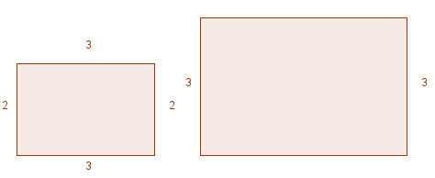
Similar shapes
Can you find the missing dimension for the larger rectangle?
What other piece of information besides what you have been given do you need to know in order to be able to find the missing dimension?
Is that helpful to know that these shapes are similar?
4.5
Yes! It tells us that all the angles are the same and that the ratio of the sides is the same.
Can you find the missing dimension now?
So the width of the larger rectangle will be
Notes:
Here is a simple example of how we can find missing dimensions in similar shapes when we know the scale factor. Students should have met similar shapes in other units for example unit conversions.

Slide 4
Scaling from p:q
The ratio of p:q is 2:3. What is the scale factor as a fraction?
2
Divide by 2 and then multiply by 3
3
The ratio of q:p is 3:2. What is the scale factor this time as a fraction?
3
Divide by 3 and then multiply by 2
2
Notes:
Use the example in the starter to remind students of this slide which they met in the conversions unit. Scale drawing is a type of conversion. If students struggle accepting the final part of this then encourage them to check it on a calculator by dividing 2 by 2 and then multiplying by 3. They could also try some other examples.
Lesson_01a_Worksheet Similar Shape and Scale factors
You could use this link to further reinforce the link between ratio and scale drawings before moving to the next lesson https://www.mathsisfun.com/numbers/ratio.html

Slide 5
Summary question
Using what you have learned, answer the following question:
Is the scaling from 1:5 the same as scaling from 5:1? Explain your answer.

