Slide 1
Unseen Prose: Tone and voice

Slide 2
1. Lesson objective: AO1−AO4 Appreciate the tone and voice/viewpoint conveyed in each text. (Unseen)
all learners should be able to: Identify the correct aspects for answering the question ‘how has the voice (speech and/or narrative voice) been successfully crafted for effect?’
most learners should be able to: Develop their own responses further and be able to analyse and appreciate the effect of the tone and techniques
some learners will be able to: Construct a sensitive and evaluative response to the effects created by tone and techniques.

Slide 3
2. How can we define this idea of ‘tone’?
Say ‘WHAT’ to a partner:
like you are asking a question
like you are angry
like you are answering someone
like you are confused.
Definition:

Slide 4
3. How many definitions of the word ‘tone’ can you think of?
Can you find some other definitions for ‘tone’?
Six nouns
Three verbs
Resources which may help you:
Online dictionary definitions: www.google.co.uk/search?q=define+tone
One minute – online stopwatch: www.online-stopwatch.com/countdown-timer/
How many did you get? Who got the most?

Slide 5
4. Words to appreciate
Successful
Impactful
Clever
Notably
Noteworthy
Influential
Crucial
Pivotal
Inspiring
Impressively
Persuasive
Authoritative
Realistic
Brilliantly
www.youtube.com/watch?v=qF25vRr7eKs
Choose someone from this selection called ‘People are awesome’. Write a sentence appreciating what they have achieved in their short video clip.
For example:
Notably, the man in the wheelchair rather inspiringly performs several really successful deep bench presses, crucially and impressively using his entire body weight.

Slide 6
5. Appreciate the tone and voice/viewpoint in each text
Read an extract from any unseen text and discuss the following two questions.
How has the narrative voice been crafted for effect? (tone/viewpoint of narrator)
How the direct speech been crafted for effect? (tone of voice)
Types of narrative voice:
https://writingmanual.pressbooks.com/chapter/types-of-narrative-voice-2/

Slide 7
6. How has the narrative voice been crafted for effect? (tone/viewpoint of narrator)
‘She did not look more than five years old, if as much, but what her natural figure was like, it would have been hard to say, for she had apparently two, if not three dresses, one above the other, and over these a thick red woollen shawl wound round about her, so that the little body presented a shapeless appearance, as, with its small feet shod in thick, nailed mountain-shoes, it slowly and laboriously plodded its way up in the heat.’
www.fullbooks.com/Heidi1.html

Slide 8
7. How has the direct speech been crafted for effect? (tone of voice)
‘“We shall soon get to the top now. You must walk bravely on a little longer, and take good long steps, and in another hour we shall be there,” said Dete in an encouraging voice.’
www.fullbooks.com/Heidi1.html

Slide 9
8. How has the direct speech been crafted for effect? (tone of voice)
‘The child stay up there with Alm-Uncle! You must be out of your senses, Dete! How can you think of such a thing!’
www.fullbooks.com/Heidi1.html

Slide 10
9. Introduction: judge the overall mood and tone
Sympathy for a young girl
An adult with a plan
A second adult who is appalled by the plan
= disturbing, unsettling, curious
What other synonyms capture the mood of this unseen extract?
Notes:
Intriguing, puzzling, irregular, bizarre, weird, strange

Slide 11
10. Building an answer on unseen texts
What is the overall tone of the piece?
What is your appreciative reaction to this?
What specific aspects of crafted voice support your reaction?
How does this evidence work at word level?
What effect does it create on the tone and reader?

Slide 12
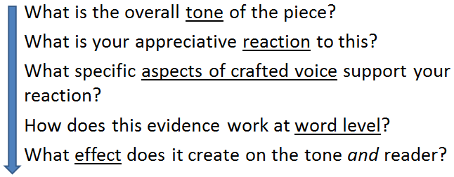
11. Building an answer on unseen texts
There is a distinctly puzzling tone in the opening extract of Heidi which really successfully forces the reader to quickly sympathise with the smaller, younger child.
The clever use of the compound sentence is notable in that the description of the many clothes worn by Heidi is mirrored in the structurally overwhelming clauses that lead the reader to suspect that she may be wearing everything she owns on this long, mountainous walk. This hint at such a young child’s vulnerability is further heightened by the use of noun phrases that oddly contrast her ‘little body’ and the heaviness of her inappropriate attire: ‘nailed mountain-shoes’.
The constant throwing up of these questions creates a disturbingly effective scene that leaves the reader feeling helpless and unsettled by the plight Heidi is in.

Slide 13
12. Building an answer on unseen texts
Highlight the text using the colours for:
tone effect
evaluation
technique
There is a distinctly puzzling tone in the opening extract of Heidi which really successfully forces the reader to quickly sympathise with the smaller, younger child. The clever use of the compound sentence is notable in that the description of the many clothes worn by Heidi is mirrored in the structurally overwhelming clauses that lead the reader to suspect that she may be wearing everything she owns on this long, mountainous walk. This hint at such a young child’s vulnerability is further heightened by the use of noun phrases that oddly contrast her “little body” and the heaviness of her inappropriate attire “nailed mountain shoes”. The constant throwing up of these questions creates a disturbingly effective scene that leaves the reader feeling helpless and unsettled by the plight Heidi is in.

Slide 14
13. Building an answer on unseen texts
There is a distinctly puzzling tone in the opening extract of Heidi which really successfully forces the reader to quickly sympathise with the smaller, younger child. The clever use of the compound sentence in the narrator’s viewpoint is notable in that the description of the many clothes worn by Heidi is mirrored in the structurally overwhelming clauses that lead the reader to suspect that she may be wearing everything she owns on this long, mountainous walk. This narrative hint at such a young child’s vulnerability is further heightened by the use of noun phrases that oddly contrast her ‘little body’ and the heaviness of her inappropriate attire: ‘nailed mountain-shoes’. The constant throwing up of these questions creates a disturbingly effective scene that leaves the reader feeling helpless and unsettled by the plight Heidi is in.

Slide 15
14. Independent writing
In pairs write your own analysis:
How has the narrative voice been crafted for effect? (tone/viewpoint of narrator)
How has the direct speech been crafted for effect? (tone of voice)

Slide 16
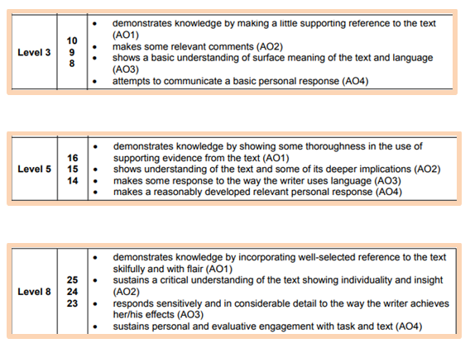
15. Reviewing our work

Slide 17
16. Independent extension / homework
Create a presentation answering the two basic questions:
How has the narrative voice been crafted for effect? (tone/viewpoint of narrator)
How has the direct speech been crafted for effect? (tone of voice)

