Slide 1
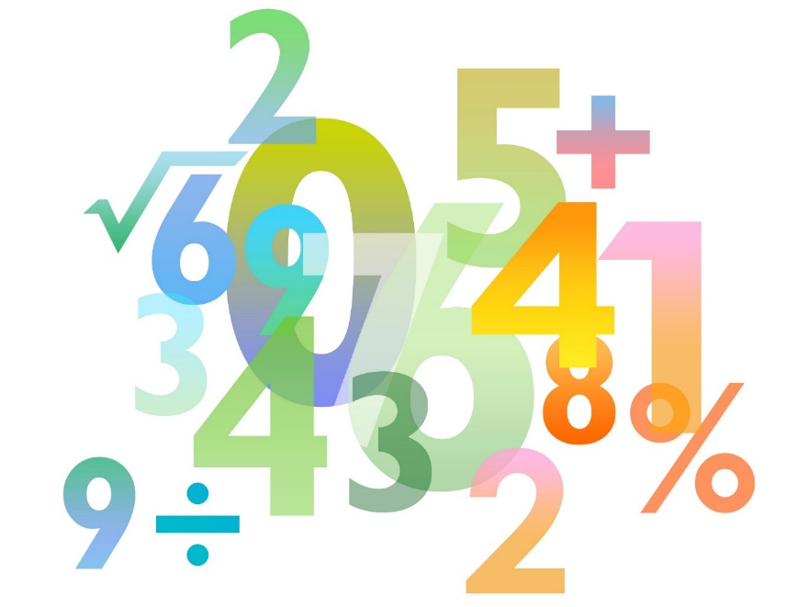
Teaching Pack – Straight line graphs
Lesson 1d: What went wrong?
Cambridge IGCSE™
Mathematics 0580
Version 1.0
Copyright © UCLES 2018

Slide 2
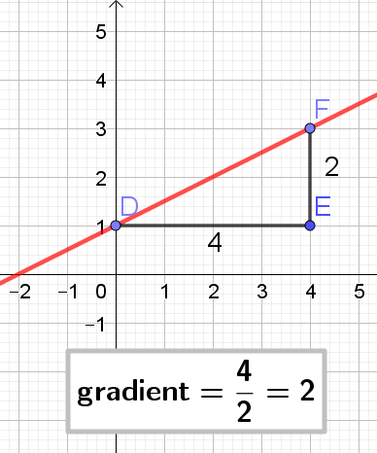
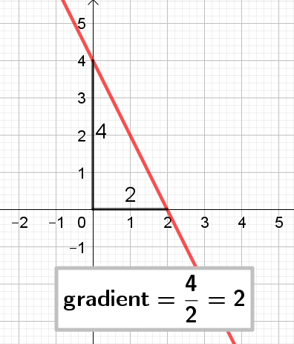
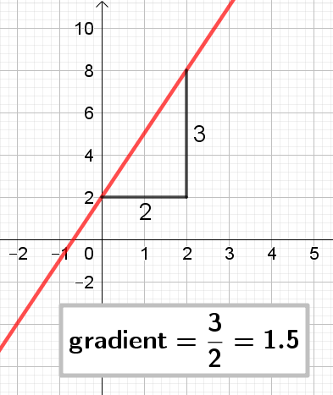
What went wrong?
rise
run
so the gradient is ½.
The gradient is negative, it should be −2.
Look at the scale. The change in y is not 3.
A
B
C
y
y
y
x
x
x

