Slide 1
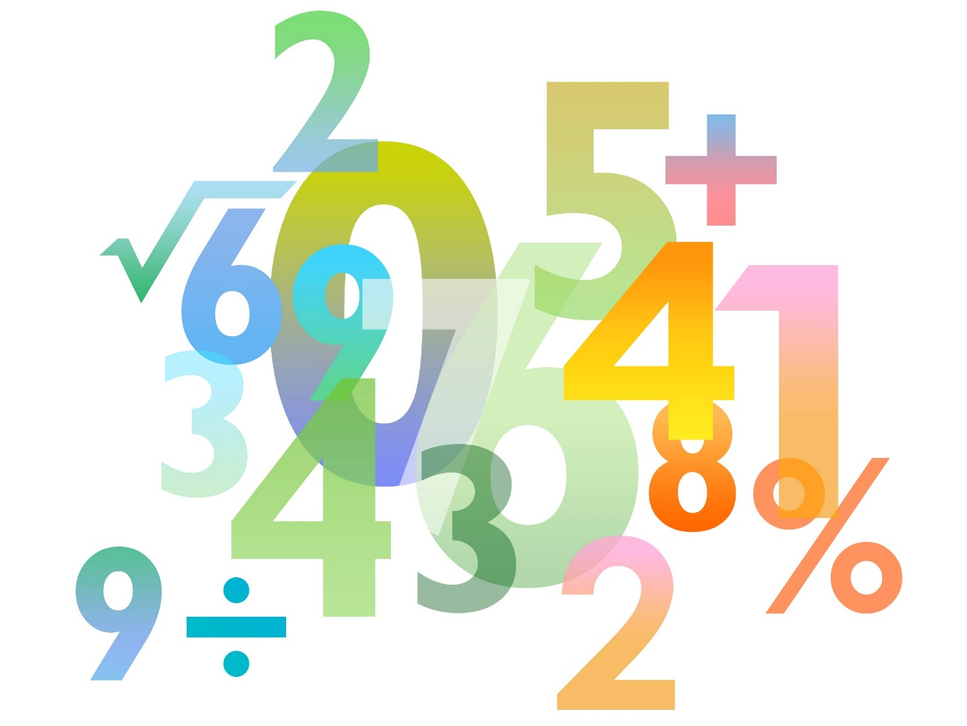
Teaching Pack – Statistics
Lesson 4: Cumulative frequency and box-and-whisker plots
Cambridge IGCSETM
Mathematics 0580
Version 1

Slide 2
Starter
Consider the following diagram. What are the implications of using a data representation like this?
Notes:
As learners work, gather in their homework. After a few minutes, change the slide to the next, revealing the box

Slide 3
Starter
Consider the following diagram. What are the implications of using a data representation like this?
Does the key change your approach to answering the question?
= 10 learners
Notes:
As learners work, gather in their homework. It is at the discretion of the teacher whether you would like to mark this or have learners mark their own work in an additional lesson. After a few minutes, change the slide to the next, revealing the box

Slide 4
Mean
How do I find the mean of a set of data?
What about this data?
Working in groups, think about how can we calculate the mean.
Cars passing in 2 minutes | 3 | 4 | 5 | 6
Frequency | 5 | 10 | 28 | 36
Notes:
Group your learners as appropriate, 2 – 4 in a group is ideal.
Decide how many minutes is appropriate for your class, before you pass out either the hint card or the next steps card from Worksheet E as suits the group’s work.

Slide 5
Mean
How do I find the mean of a set of data?
What about this data?
$$\frac{\text{15+40+140+216}}{\text{5+10+28+36}}$$
Cars passing in 2 minutes | 3 | 4 | 5 | 6
Frequency | 5 | 10 | 28 | 36

Slide 6
Mean
How do I find the mean of a set of data?
What about this data?
$$\frac{\text{411}}{\text{79}}$$
Cars passing in 2 minutes | 3 | 4 | 5 | 6
Frequency | 5 | 10 | 28 | 36

Slide 7
True or false?
You will be shown a series of statements on the next slides.
Put your hand up if you think it is true, keep your hand down if you think it is false.
✓✗
Notes:
Introduce learners to a round of true/false. They must put their hands up for true and keep them down for false. Please let learners know that they will be asked their reasoning!

Slide 8
True or false?
✓✗
Frequency is fine-tuning data
Notes:
FALSE! Frequency is how many times something occurs

Slide 9
True or false?
✓✗
The median is the middle of data
Notes:
FALSE! The median is the middle of ORDERED data

Slide 10
True or false?
✓✗
Cumulative frequency is a running total of how many times something happens
Notes:
TRUE! As we know frequency is how many times something occurs and cumulative means a running total

Slide 11
True or false?
✓✗
Cumulative frequency questions typically use a three-way table
Notes:
TRUE! The columns are the variable (which usually uses inequalities), frequency and cumulative frequency

Slide 12
True or false?
✓✗
To calculate cumulative frequency you add the previous frequency to the next
Notes:
TRUE! Remember, it’s a running total

Slide 13
True or false?
✓✗
The cumulative frequency goes along the x-axis
Notes:
FALSE! CF always goes along the y-axis, with the highest point being the final total

Slide 14
True or false?
✓✗
Cumulative frequency graphs are straight lines
Notes:
FALSE! CF graphs are curved between points

Slide 15
True or false?
✓✗
This is a cumulative frequency graph
3
2
1
1
-3
-2
-1
1
2
3
-1
-2
-3
Notes:
FALSE!

Slide 16
True or false?
✓✗
You plot a cumulative frequency graph in the same way you plot a histogram
Mark | Frequency | Cumulative frequency
1-10 | 2 | 2
11-20 | 5 | 7
21-30 | 9 | 16
31-40 | 14 | 30
41-50 | 16 | 46
51-60 | 12 | 58
61-70 | 8 | 66
71-80 | 4 | 70
Notes:
FALSE! You only use the numbers on the right hand side of the ‘mark’ column, e.g. 10. The ‘marks’ would go along the x-axis and the cumulative frequency along the y-axis

Slide 17
True/False
✓✗
You cannot calculate the median on a cumulative frequency graph
Notes:
FALSE! You half your cumulative frequency total and draw a line across and down to calculate the median, reading it from the x-axis

Slide 18
True/False
✓✗
The upper and lower quartiles on a cumulative frequency
graph are ¼ and ¾ of the cumulative frequency total
Notes:
TRUE! These are found the same way as the median.

Slide 19
True/False
✓✗
IQR stands for Into-Quarters Range
Notes:
FALSE! Although a good way to remember that IQR surrounds quarters; IQR actually stands for Inter-Quartile Range

Slide 20
Example: cumulative frequency
Class limits | Frequency | Cumulative frequency
0-10 | 0 | 0
11-15 | 3
16-20 | 3
21-25 | 8
26-30 | 14
31-35 | 6
36-40 | 3
41-45 | 3
Notes:
Annotate the example as you click through the animations.

Slide 21
Example: cumulative frequency
Class limits | Frequency | Cumulative frequency
0-10 | 0 | 0
11-15 | 3 | 3
16-20 | 3
21-25 | 8
26-30 | 14
31-35 | 6
36-40 | 3
41-45 | 3
Notes:
Annotate the example as you click through the animations.

Slide 22
Example: cumulative frequency
Class limits | Frequency | Cumulative frequency
0-10 | 0 | 0
11-15 | 3 | 3
16-20 | 3 | 6
21-25 | 8
26-30 | 14
31-35 | 6
36-40 | 3
41-45 | 3
Notes:
Annotate the example as you click through the animations.

Slide 23
Example: cumulative frequency
Class limits | Frequency | Cumulative frequency
0-10 | 0 | 0
11-15 | 3 | 3
16-20 | 3 | 6
21-25 | 8 | 14
26-30 | 14
31-35 | 6
36-40 | 3
41-45 | 3
Notes:
Annotate the example as you click through the animations.

Slide 24
Example: cumulative frequency
Class limits | Frequency | Cumulative frequency
0-10 | 0 | 0
11-15 | 3 | 3
16-20 | 3 | 6
21-25 | 8 | 14
26-30 | 14 | 28
31-35 | 6
36-40 | 3
41-45 | 3
Notes:
Annotate the example as you click through the animations.

Slide 25
Example: cumulative frequency
Class limits | Frequency | Cumulative frequency
0-10 | 0 | 0
11-15 | 3 | 3
16-20 | 3 | 6
21-25 | 8 | 14
26-30 | 14 | 28
31-35 | 6 | 34
36-40 | 3
41-45 | 3
Notes:
Annotate the example as you click through the animations.

Slide 26
Example: cumulative frequency
Class limits | Frequency | Cumulative frequency
0-10 | 0 | 0
11-15 | 3 | 3
16-20 | 3 | 6
21-25 | 8 | 14
26-30 | 14 | 28
31-35 | 6 | 34
36-40 | 3 | 37
41-45 | 3
Notes:
Annotate the example as you click through the animations.

Slide 27
Example: cumulative frequency
Class limits | Frequency | Cumulative frequency
0-10 | 0 | 0
11-15 | 3 | 3
16-20 | 3 | 6
21-25 | 8 | 14
26-30 | 14 | 28
31-35 | 6 | 34
36-40 | 3 | 37
41-45 | 3 | 40
Notes:
Annotate the example as you click through the animations.

Slide 28
Example: cumulative frequency
Class limits | Frequency | Cumulative frequency
0-10 | 0 | 0
11-15 | 3 | 3
16-20 | 3 | 6
21-25 | 8 | 14
26-30 | 14 | 28
31-35 | 6 | 34
36-40 | 3 | 37
41-45 | 3 | 40
Notes:
Annotate the example as you click through the animations.

Slide 29
Box-and-whisker plots
Can anyone explain how the diagram below displays the data in the table?
 | Minutes to complete task
Shortest time | 18
Lower quartile | 25
Median | 29
Upper quartile | 33
Longest time | 44
20
25
30
35
40
45
Notes:
Class discussion dissecting this diagram.

Slide 30
Your turn
Here are the times, in seconds, that 14 people waited to be served at a coffee shop.
Draw a box plot for this information.
Hint: You will require the median, lower and upper quartiles
Draw a box plot of some of the data you collected from your questionnaires.
5, 9, 11, 14, 15, 20, 22, 25, 27, 27, 28, 30, 32, 35

Slide 31
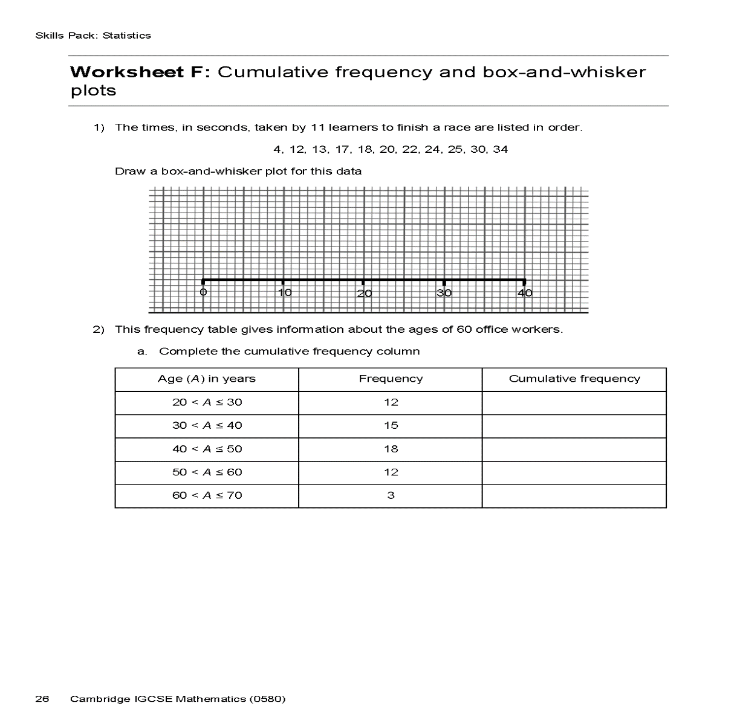
Homework
Worksheet F: Cumulative frequency and box-and-whisker plots

