Slide 1
Lesson slides Topic: Probability Lesson 3: Probability Trees
Version 1

Slide 2
Probability Trees
A probability tree is a way of organising our probabilities to help us calculate outcomes that have a number of different combinations.
Recap from Cambridge IGCSE:
P(P$∩$P) = 0.8 x 0.3 = 0.24
P
0.3
Write probabilities ON the branches
Write outcomes at the END of the branches
To calculate each outcome:
Multiply the branches leading up to it
P
0.8
0.7
F
P
0.3
0.2
F
0.7
F

Slide 3
Probability Trees – Independent Events
A student has a small box of pens.
She has 4 Red (R), 3 Blue (B)and 2 Yellow (Y).
A student picks a pen, puts it back, then picks another.
What is the probability of picking 2 different colour pens?
$$\frac{4}{9}$$
R
$$\frac{3}{9}$$
$$\frac{4}{9}×\frac{3}{9}= \frac{12}{81}$$
R
B
$$\frac{2}{9}$$
Y
$$\frac{4}{9}×\frac{2}{9}= \frac{8}{81}$$
$$\frac{4}{9}$$
$$\frac{4}{9}$$
R
$$\frac{3}{9}×\frac{4}{9}= \frac{12}{81}$$
$$\frac{3}{9}$$
$$\frac{3}{9}$$
B
B
$$\frac{2}{9}$$
Y
$$\frac{3}{9}×\frac{2}{9}= \frac{6}{81}$$
$$\frac{2}{9}$$
$$\frac{4}{9}$$
R
$$\frac{2}{9}×\frac{4}{9}= \frac{8}{81}$$
$$\frac{3}{9}$$
Y
B
$$\frac{2}{9}×\frac{3}{9}= \frac{6}{81}$$
$$\frac{2}{9}$$
Y
P(2 different colours) = $\frac{52}{81}$

Slide 4
Probability Trees – Independent Events
A student takes 2 exams.
The probability she passes Statistics is 0.8.
The probability she passes English is 0.3.
What is the probability that she passes at least one of the 2 exams?
Statistics
English
P
0.8 x 0.3 = 0.24
0.3
P
0.8
0.7
F
0.8 x 0.7 = 0.56
P
0.2 x 0.3 = 0.06
0.3
0.2
F
0.7
F
P(Pass at least one exam) = 0.86

Slide 5
Probability Trees – Dependent Events
Adjust the probabilities on the second branches to account for the first pick.
A student has a small box of chocolates.
She has 4 Mars Bars (M), 3 Kitkats (K) and 2 Lion Bars (L).
A student picks a bar, eats it, then picks another.
What is the probability of picking at least one Kitkat?
M
3/8
M
3/8
K
$$\frac{4}{9}×\frac{3}{8}= \frac{12}{72}$$
2/8
L
4/9
M
$$\frac{3}{9}×\frac{4}{8}= \frac{12}{72}$$
4/8
3/9
2/8
K
K
$$\frac{3}{9}×\frac{2}{8}= \frac{6}{72}$$
2/8
L
$$\frac{3}{9}×\frac{2}{8}= \frac{6}{72}$$
2/9
M
4/8
3/8
K
$$\frac{2}{9}×\frac{3}{8}= \frac{6}{72}$$
L
1/8
L
P(at least one KitKat ) = $\frac{42}{72}$

Slide 6
Probability Trees – Dependent Events
The probability a student is late for school is 0.1.
If they are late, the probability that she forgets a book is 0.4.
If she is on time the probability she remembers her books is 0.9.
What is the probability that the student forgets a book?
0.4
Forget
0.1 x 0.4 = 0.04
Late
0.1
0.6
Remember
0.1
Forget
0.9 x 0.1 = 0.09
0.9
Not
0.9
Remember
P(forgets a book) = 0.86

Slide 7
Probability Trees
Now work through all questions on Worksheet C.

Slide 8
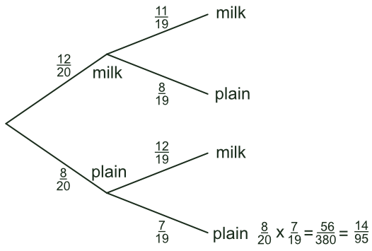
Plenary
What is the missing probability?
?
1
$$8/20$$
?
?
2
$$12$$
?
?
3
$$12/20$$
4
$$20$$
?
?

Slide 9
Plenary
What calculation is correct for ‘double milk’?
1
$$\frac{12}{20}+\frac{11}{19}$$
?
2
$$\frac{12}{20}$$
?
?
$$\frac{12}{20}×\frac{11}{19}$$
3
4
$$\frac{8}{20}×\frac{11}{19}$$
?
?

