Slide 1
Teaching Pack – Scale drawings
Lesson 4 – Extended scale and area
Cambridge IGCSE™
Mathematics 0580
Version 1.0
Notes:
When developing your curriculum plan for mathematics it may be worth considering teaching unit 5.1 on unit conversions before this unit. The ability to convert between units and understand the links to proportional reasoning are important for this unit. If you've not already taught unit 5.1 you will need to consider teaching elements of it to support this unit.

Slide 2
Lesson objective
The impact on the area of a shape when we make a scale drawing.
Notes:
This lesson will take an investigative approach to consider the impact on area when we make scale drawings.

Slide 3
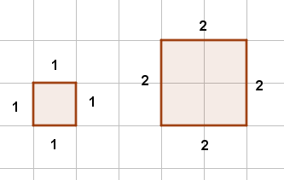
Scale drawings and area
So far we have looked at scale factors for lengths and used this to convert these lengths onto scale drawing.
We are now going to look at the impact on the area of a shape when we make a scale drawing.
This diagram shows a square with side of 1cm and a square with side of 2cm.
The area of the square with side of 1cm is 1cm² .
The area of the square with side of 2cm is 4cm².
So
When the side is multiplied by 2 the area is multiplied by: 2² = 4 .

Slide 4
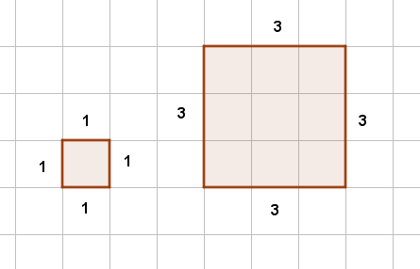
Scale drawings and area
This diagram shows a square with side of 1cm and a square with side of 3cm.
The area of the square with side of 1cm is 1cm² .
The area of the square with side of 3cm is 9cm².
So
When the side is multiplied by 3 the area is multiplied by: 3² = 9 .

Slide 5
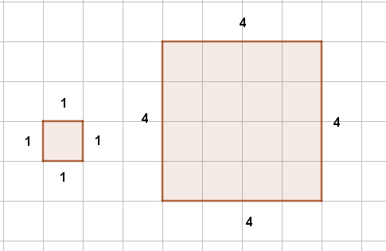
Scale drawings and area
This diagram shows a square with side of 1cm and a square with side of 4cm.
The area of the square with side of 1cm is 1cm² .
The area of the square with side of 4cm is 16cm².
So
When the side is multiplied by 4 the area is multiplied by: 4² = 16 .
Can you see the pattern?
When the side is multiplied by d the area is multiplied by d² .

Slide 6
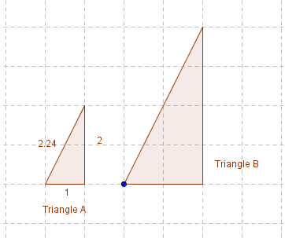
Try this!
Triangle B is a scale drawings of triangle A with a scale of 1:2.
Work out the perimeter and area of the triangle on the scale drawing?
The perimeter of triangle A is 1 + 2 + 2.24 = 5.24.
The area of triangle A is .
The perimeter of triangle B on the scale drawings is:
Perimeter of triangle A x scale factor of 2 = 10.48 cm
The area of triangle B is:
Area of triangle A x (scale factor of 2)² = 1 x 4 = 4 cm²
Notes:
PAUSE. Let students attempt this independently before animating the next slide.
If necessary remind student about the outcomes of the last slide which is that the scale factor for area is the scale factor for length squared. Ask students if their answer makes sense? Yes you can see from the diagram that the answer makes sense.
You can also challenge student to consider this algebraically by using the formula for area ½ (base × height ) if we multiply the length by a scale factor of 2 we get ½ (2 × base × 2 × height) = ½ ×4 (base × height) = 2² ×½(base × height) This is 2² times the area of the original triangle.

Slide 7
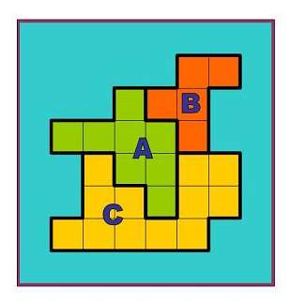
Try this!
Rescaled map https://nrich.maths.org/4958
Notes:
Students can now have a go at this extension activity Rescaled map https://nrich.maths.org/4958 You could find additional data to use with the activity at https://www.gapminder.org/data/

