Slide 1
Teacher tutorial Topic: 2.3 Trigonometry Lesson 3: Proving Trigonometric Identities
Version 1

Slide 2
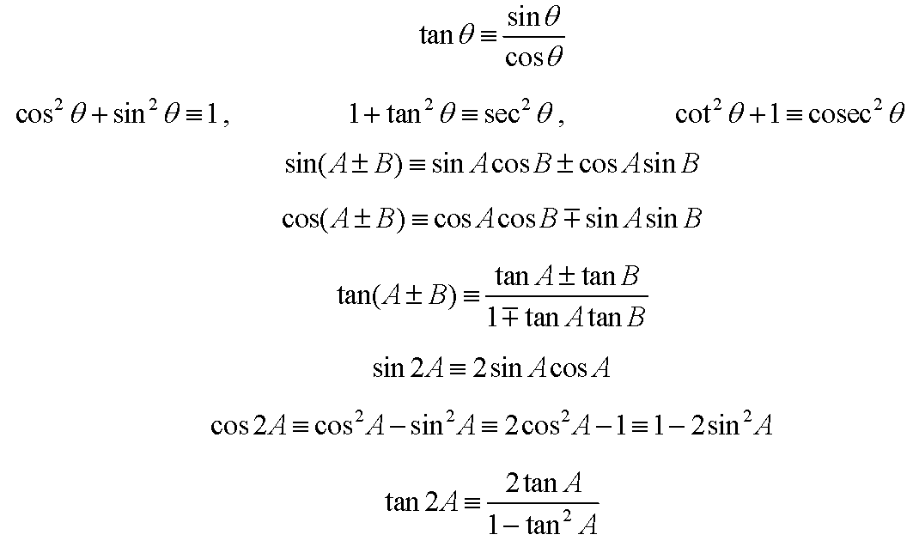
Trigonometric Identities
Notes:
The formulae relating to trigonometry given in the formula booklet are shown here. This is the same as Worksheet B, used in Lessons 1 and 2.
Make sure your learners are aware of all of these and how to use them.

Slide 3
Trigonometric Identities
Show that $\cot{(45+A)+\cot{(45−A)≡2\sec{2A}}}$
Notes:
Ask learners which side of the identity looks more complicated, and so gives more opportunity to simplify.
Ensure they are aware this is the side they should begin with when proving the identity.
They should remember to only start with one side and work towards the other.
Tell them to NEVER start on both sides and try to meet in the middle!

Slide 4
Trigonometric Identities
So
$$\cot\left(45+A\right)+\cot\left(45−A\right)≡\frac{1}{\tan{(45+A)}}+\frac{1}{\tan{(45−A)}}$$
Now use $\tan{(A±B)≡\frac{\tan{A±\tan{B}}}{1∓\tan{A\tan{B}}}}$
So
$$\frac{1}{\tan{(45+A)}}+\frac{1}{\tan{(45−A)}}≡\frac{1−\tan{45\tan{A}}}{\tan{45+\tan{A}}}+\frac{1+\tan{45\tan{A}}}{\tan{45−\tan{A}}}$$
Notes:
In this case, begin on the left side of the identity.
Remembering cot x is the reciprocal of tan x is often an issue in exams.

Slide 5
Trigonometric Identities
Use tan 45 = 1 to get
$$\frac{1−\tan{45\tan{A}}}{\tan{45+\tan{A}}}+\frac{1+\tan{45\tan{A}}}{\tan{45−\tan{A}}}≡\frac{1−\tan{A}}{1{+\tan{A}}}+\frac{1+\tan{A}}{1{−\tan{A}}}$$
Combine the fractions
$$\frac{1−\tan{A}}{1{+\tan{A}}}+\frac{1+\tan{A}}{1{−\tan{A}}}≡\frac{(1 −\tan{A)²+(1+\tan{A)²}}}{(1+\tan{A)(1−\tan{A)}}}$$
Notes:
Ensure learners remember to state tan 45 = 1
This may seem obvious to them, but if it is not stated in the proof, they may lose marks.

Slide 6
Trigonometric Identities
Expand the brackets
$$\frac{(1 −\tan{A)²+(1+\tan{A)²}}}{(1+\tan{A)(1−\tan{A)}}}≡\frac{1−2\tan{A+\tan^{2}{A}}+1+2\tan{A+\tan{²A}}}{1−\tan{A+\tan{A−\tan{²A}}}}$$
and simplify
$$\frac{1−2\tan{A+\tan^{2}{A}}+1+2\tan{A+\tan{²A}}}{1−\tan{A+\tan{A−\tan{²A}}}}≡\frac{2+2\tan{²A}}{1−\tan{²A}}$$
Notes:
Encourage learners to show all their working. Remember the aim is not just to arrive at the opposite side of the trigonometric statement, but to do so in a clear and mathematically rigorous way.

Slide 7
Trigonometric Identities
Show that $\cot{(45+A)+\cot{(45−A)≡2\sec{2A}}}$
$$\frac{2+2\tan{²A}}{1−\tan{²A}}≡\frac{2+\frac{2\sin{²A}}{\cos{²A}}}{1−\frac{\sin{²A}}{\cos{²A}}}$$
Multiply through by $\cos{²A}$ to simplify the fractions
$$\frac{2+\frac{2\sin{²A}}{\cos{²A}}}{1−\frac{\sin{²A}}{\cos{²A}}}≡\frac{2cos{²A}+2\sin{²A}}{\cos{²A}−\sin{²A}}$$
Notes:
Encourage learners to look back to see what the question asks to prove.
Double angles with sec 2A are required.
Reinforce that sec x is the reciprocal of cos x, and the double angle formulae for cos x come from a quadratic expression in cos x, or sin x, or both. This leads to writing tanA as sinA/cosA as shown.
You may wish to write the numerator as 2sec²A, and then multiply the denominator by cos²A to simplify, but remember to state you are using 1 + tan²A = sec²A if using this method.

Slide 8
Trigonometric Identities
$$\frac{2cos{²A}+2\sin{²A}}{\cos{²A}−\sin{²A}}≡\frac{2(\cos{²A+\sin{²A)}}}{\cos{²A}−\sin{²A}}$$
Use $\cos{²A+\sin{²A≡1}}$ to get
$$\frac{2(\cos{²A+\sin{²A)}}}{\cos{²A}−\sin{²A}}≡\frac{2}{\cos{²A}−\sin{²A}}$$
Use $\cos{²A}−\sin{²A}≡\cos{2A}$ to get
$$\frac{2}{\cos{²A}−\sin{²A}}≡\frac{2}{\cos{2A}}≡2\sec{2A}$$
Notes:
It may again seem obvious that the numerator is 2, but if it is not stated in a proof, learners may lose marks.
The working on these slides can be shortened considerably when writing on one piece of paper, but each step of the proof is important and formulae or identities used during the proof should be stated explicitly to ensure full marks are gained.

