Slide 1
Teaching Pack – Straight line graphs
Lesson 1a: What is gradient?
Cambridge IGCSE™
Mathematics 0580
Version 1.0
Copyright © UCLES 2018

Slide 2
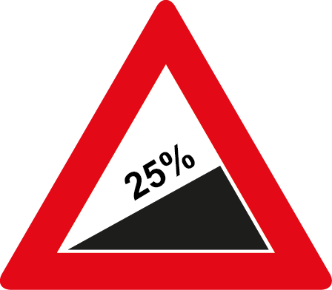
What is gradient?
This road sign tells road users the gradient of the road ahead.
25% is the same as one quarter ¼.
So you can say this gradient is ‘1 in 4’. This means you go up 1 unit vertically for every 4 units horizontally.
Notes:
Look at this road sign. It tells road users the gradient of the road ahead.
25% is the same as one quarter. So you can say this gradient is ‘1 in 4’.
This means you go up 1 unit vertically for every 4 units horizontally.
Let’s look at this on a diagram.

Slide 3
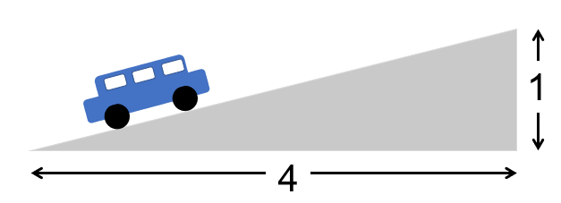
What is gradient?
This car travels 1 unit up for every 4 units along.
gradient = $\frac{\text{change} \text{in} \text{height}}{\text{horizontal} \text{distance}}$
OR
gradient = $\frac{\text{rise}}{\text{run}}$
Notes:
The car travels 1 unit up for every 4 units along.
The gradient is the change in height divided by the horizontal distance travelled. Some people call this rise over run.
Here, the gradient is the change in height, which is 1, divided by the horizontal distance, which is 4. That’s 1 divided by 4 or one quarter.

Slide 4
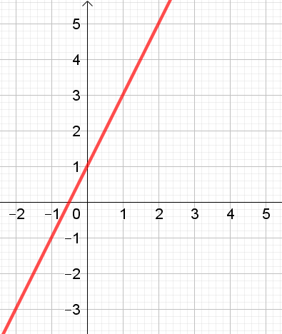
What is gradient?
The gradient tells you the slope of the line.
The larger the gradient, the steeper the slope.
y
The vertical axis is the y-axis.
x
The horizontal axis is the x-axis.
The gradient is the change in y divided by the change in x.
Notes:
You often need to find the gradient of a straight line on a graph.
The gradient tells you the slope of the line. The larger the gradient, the steeper the slope.
When we work with gradients on graphs, instead of saying the change in height divided by the horizontal distance travelled, we usually say the change in y divided by change in x.

Slide 5
What is gradient?
y
Change in y is 2.
Change in x is 1.
x
gradient = $\frac{\text{change} \text{in} \text{y}}{\text{change} \text{in} \text{x}}\text{= }\frac{\text{2}}{\text{1}}$ = 2
Notes:
For this graph, the change in y is 2 and the change in x is 1, so the gradient is 2 divided by 1 which is 2.
Another way to think of this is that the graph goes up two units for every one unit across, so the gradient is 2.

Slide 6
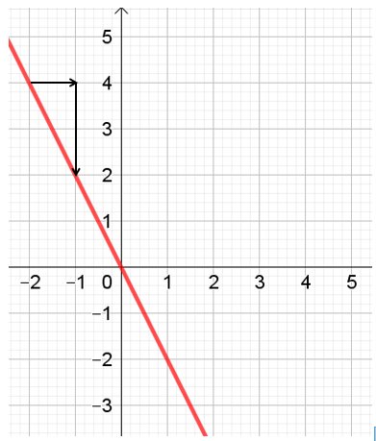
What is gradient?
What if the graph slopes in the opposite direction?
y
Change in x is 1.
Change in y is −2.
gradient = $\frac{\text{change} \text{in} \text{y}}{\text{change} \text{in} \text{x}}\text{= }\frac{−\text{2}}{\text{1}}$ = −2
x
The negative symbol shows us the line is sloping down.
Notes:
But what if the graph slopes in the opposite direction?
We still work out the change in y divided by the change in x, but this time the answer is – 2.
The negative symbol shows us the line is sloping the opposite way.
Another way to think of this is that the graph goes down two units for every one unit across, so the gradient is −2.

Slide 7
What is gradient?
Remember:
The gradient tells you the slope of a line.
The gradient is calculated from the change in y (vertical axis) divided by the change in x (horizontal axis).
gradient = $\frac{\text{change} \text{in} \text{y}}{\text{change} \text{in} \text{x}}$
Notes:
The key thing to remember is that the gradient tells you the slope of a line.
You work out the gradient by calculating the change in y divided by the change in x.

