Slide 1
Teaching Pack – Scale drawings
Lesson 3 – Other real life examples of scale drawings
Cambridge IGCSE™
Mathematics 0580
Version 1.0

Slide 2
Lesson objective
Scale drawings in different contexts.
Deciding on the best scale for any particular scale drawing.
Using Mathematics to draw scale drawings.
Extension
Converting between representational scales.

Slide 3
Try this!
Can you think of as many people as possible who might use scale drawings as part of their work?
Architects, builders, engineers, fashion designers.
What does it mean when we say a drawing is “To scale”?
It simply means that every element in a drawing is in the same proportion in relation to the real object. So in other words the ratio between the drawing and the real object in constant. The choice of scale is based in the practicality of making the drawing fit on the page.
Why don’t we draw at a ratio of 1:1?
The reason we don’t often draw at 1:1, is simply because the real drawing would often be too big, take too long to draw and take up too many pieces of paper.
Notes:
Worksheet 3a Doing the mathematics questions 1 and 2

Slide 4
Extension – Converting between representational scales
What is the same and what is different about these rectangles?
The ratio of the width to the length is the same for each rectangle but they are not congruent.
Assuming rectangle A is the original object, what is the scale factor for each of the rectangles?
1:5
B
A
Is there anything surprising in the scales?
1:2
The ratio with a bigger number to the right gives small version of the original.
C
1:10
D
Notes:
This is an introduction to the video below. Ask students what is the same what is different about these rectangles. They should be able to tell that all the rectangles are similar but not congruent. The ratio of the width to the length is the same for each rectangle.
Assuming rectangle A is the original object ask students for the scale factor for each of the other rectangles. Then animate. Ask the them if there is anything surprising in the scales. They might note the ratio with a bigger number to the right gives a smaller version of the original.
lesson 3 Video - Converting between representational scales.
Worksheet 3a Doing the mathematics question 3

Slide 5
Estimating scale in real life
Understanding scale in your everyday life will help you become confident and fluent with the concepts of scale.
Know how big your hand span is. Mine is handily exactly 20cm – so I can figure out how big things are compared to this. (The hand is a non metric unit of length standardised to 4 inches (101.6mm). It is used to measure the height of horses in some English speaking countries.
Estimate how high the ceiling is in the key spaces you use. This might be your school or bedroom.
Estimate how tall you are.
Estimate how long a car is.
Estimate how long a football pitch is.
These are only ideas and it is best to pick things that you are familiar with and come into contact with on a regular basis.
Notes:
Now let's think about how we can estimate using scale in real life. Can you think of some ways in which you can judge scale one example is given for you?
Tell students they are now going to work on a set of real life activities where scale drawing is very important to help them practice the skills they have learnt.

Slide 6
Drawing a floor plan to scale.
We are now going to put what we have done into practice by drawing a floor plan to size. Drawing a floor plan to scale is a critical part of the design process and can be very helpful for visualising things like furniture layout. To draw a floor plan to scale you need to plan carefully and it is useful to have a set of steps you can follow.
If you are making a floor plan of an actual physical space, not something you are designing or imagining, measure the length of the longest wall.
Decide on a scale that will allow you to draw this wall on the piece of paper you are using.
Measure the length of the other walls and convert these measurements to your scale.
Notes:
Start by asking students in pairs to write a set of steps that they would need to go though to draw a floor plan to scale. Then animate this slide and discuss each step.
Students can either choose their own space to draw of you can decide for them. If you think students might struggle with this you can provide them with the measurements of an imaginary space that would be easier to scale. You could also provide them with a partially completed scale drawing to complete.

Slide 7
Drawing a floor plan to scale
Make sure you place your drawing on the piece of paper so you can fit in all the external walls you need.
Then measure and convert to scale all the internal walls, windows, and doors on your floor plan. Draw each window as double lines and each door as a line with an arc that shows the actual swing path of the door. This is useful when trying to place furniture on your scale drawing.
Measure the length and width of all built-in fixture such as internal walls and cupboards, convert them to the scale you are using, and add them to your plan.
If you want you can add moveable furniture to the floor plan.
Notes:
Worksheet 3b: Drawing a floor plan to scale is a copy of the steps on slide 6 and 7, and if appropriate, learners can have a copy of this to refer to whilst drawing their own floorplan.

Slide 8
Try this!
Activity 1 – Drawing a floor plan to scale.
Activity 2 – Scale drawings of items pictured in magazines.
Activity 3 – Designing a racing track.
Activity 4 – Car park.
Notes:
There is guidance on these activities on the lesson plan for this lesson.

Slide 9
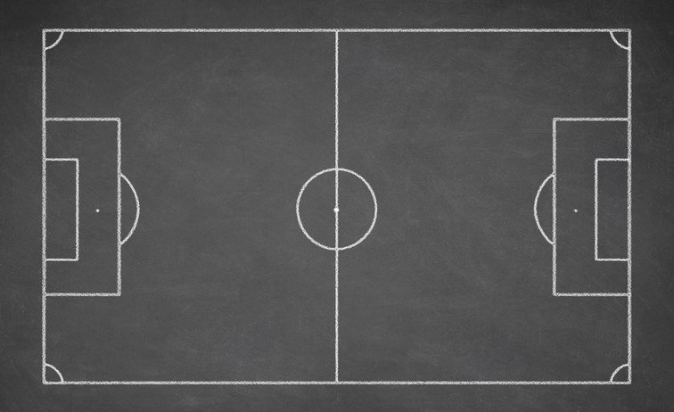
Summary question
To recreate a real world environment, such as a football field and stadium with players and fans, video game designers and artists have to know how to create images “to scale” using accurate relative sizes and proportions.
What is wrong with this image?
A giant football player on a tiny football field would not look realistic or allow accurate game play (nor would a tiny football player on a giant field), so scale is important.

