Slide 1
Lesson slides Topic 1.2: Functions Lesson 2: Graph transformations - Enlargements and Reflections
Version 1

Slide 2
Recap – Last lesson
Sketch the graph of $y=f\left(x\right)$ where $f\left(x\right)=\left(x−4\right)\left(x+2\right)$
Find the coordinate of the minimum point of the quadratic.
c) Sketch $y=f(x+3)$
d) Sketch $y=f\left(x\right)−2$

Slide 3
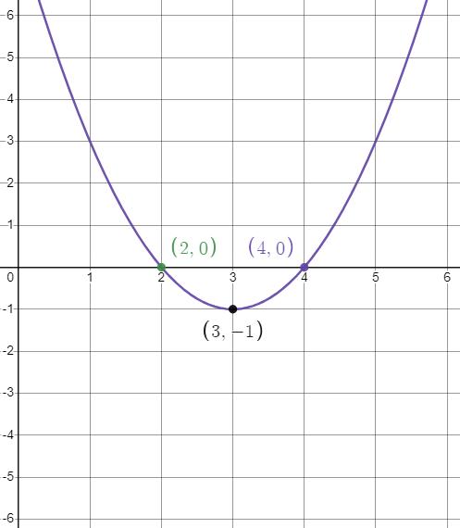
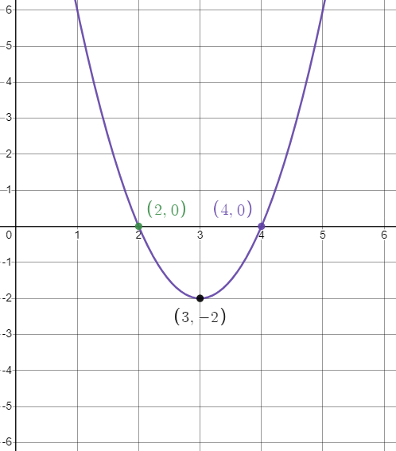
Stretching graphs vertically
What happens to a function when we multiply it by a constant?
Using the graph $y=x^{2}−6x+8.$
Here’s $y=2\left(x^{2}−6x+8\right).$
What do you notice?

Slide 4
Stretching graphs vertically
What happened?
The right-hand side of the equation equals the $y$ coordinate.
By doubling the right-hand side, you are effectively doubling every $y$ coordinate.
It gives the effect that the graph has been stretched vertically.
The only points unaffected are the roots, as they have a $y$ coordinate of zero.

Slide 5
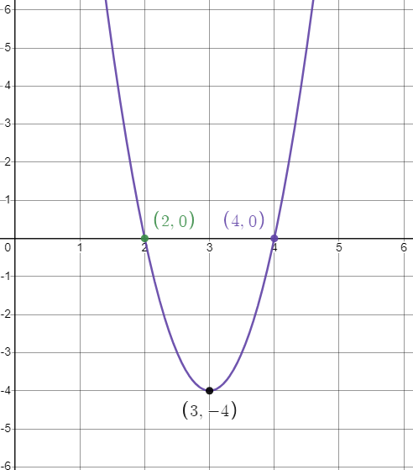
Stretching graphs vertically
Here’s $y=4(x^{2}−6x+8)$

Slide 6
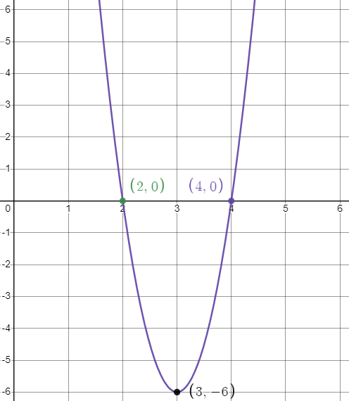
Stretching graphs vertically
What will $y=6(x^{2}−6x+8)$ look like?
Same as before, it looks stretched, and the turning point is now at (3,-6).

Slide 7
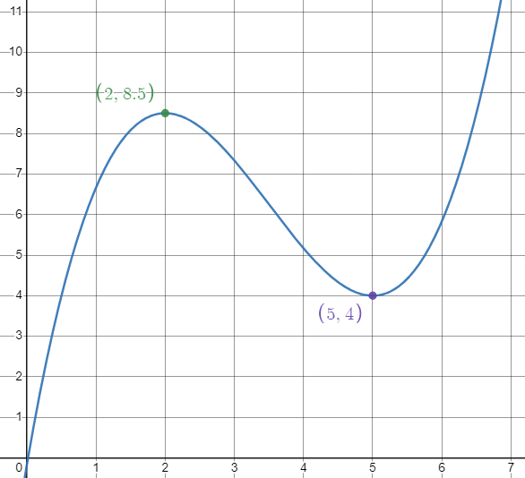
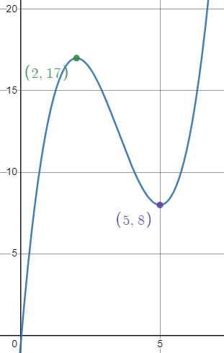
Stretching Graphs Vertically
This works for any function.
Look at this example$y=f(x)$
Here is $y=2f\left(x\right).$
The graph has been stretched scale factor 2 in the $y$ direction.

Slide 8
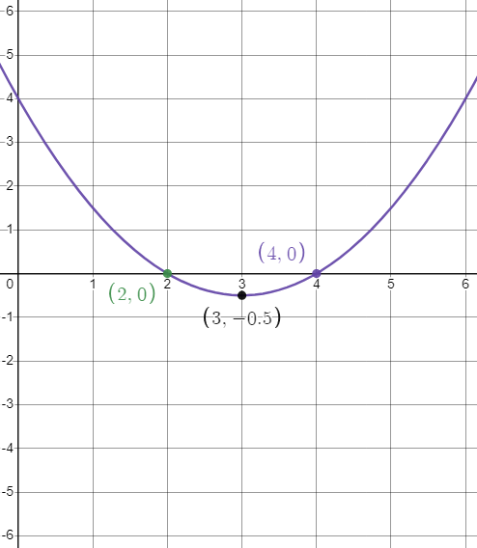
Stretching graphs vertically
How would we make the graph ‘smaller’?
Using the graph $y=x^{2}−6x+8$
Here’s $y=\frac{1}{2}(x^{2}−6x+8)$
Use a fractional scale factor smaller than 1.
It gives the impression that the graph has been ‘squashed’.

Slide 9
Stretching graphs vertically
In general:
$af\left(x\right)$
Stretch, scale factor $a$ , in the $y$ direction
$$×a$$

Slide 10
Plotting task
If you have access to graphing software/websites, or even a graphical calculator, then try plotting different types of functions and applying the transformations to them.
www.desmos.com
www.geogebra.com
Pre-made example:
Graph Transformations | Desmos

Slide 11
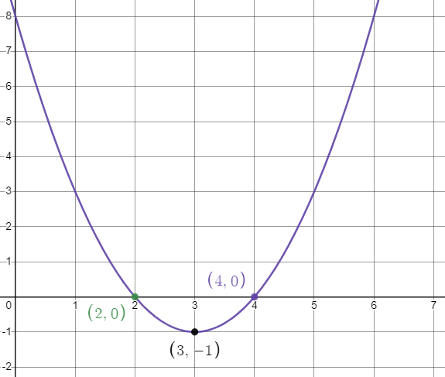
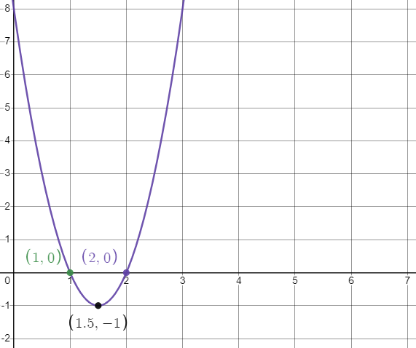
Stretching graphs horizontally
If multiplying a function by a constant affects the vertical direction, we need a different method to stretch graphs horizontally.
Here’s $y=x^{2}−6x+8.$
Here’s what $y={(2x)}^{2}−6(2x)+8$ looks like.
What do you notice?
It halves all of the $x$ coordinates.

Slide 12
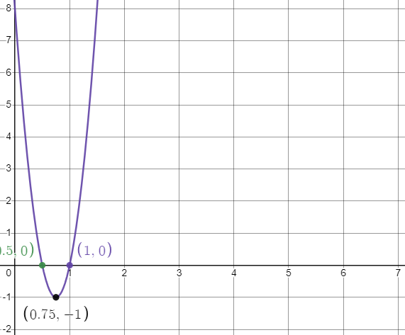
Stretching graphs horizontally
What will $y={(4x)}^{2}−6(4x)+8$ look like?
$y=x^{2}−6x+8$
It quarters all of $x$ coordinates.
It is a reciprocal relationship. If we multiply by $a$, the $x$ coordinates get multiplied by $\frac{1}{a}.$

Slide 13
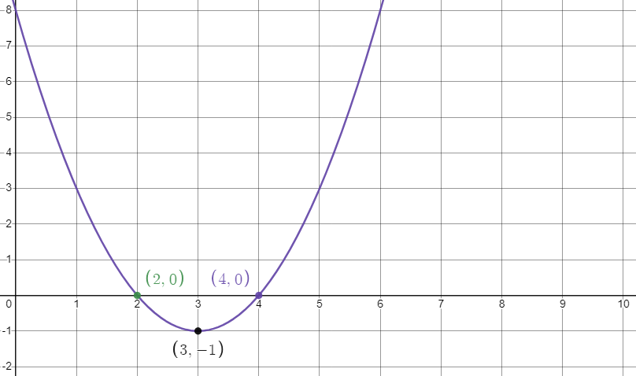
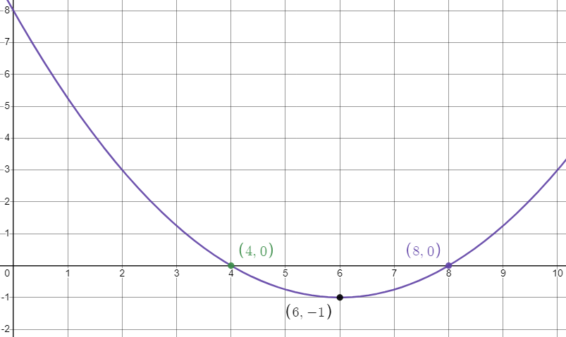
Stretching graphs horizontally
How can we stretch twice a large in the $x$ direction?
$y=x^{2}−6x+8$
Here’s $y={(\frac{1}{2}x)}^{2}−6(\frac{1}{2}x)+8.$
Multiply by half.

Slide 14
Stretching graphs horizontally
In general:
$f\left(ax\right)$
Stretch, scale factor $\frac{1}{a}$in the $x$ direction.
$$×\frac{1}{a}$$

Slide 15
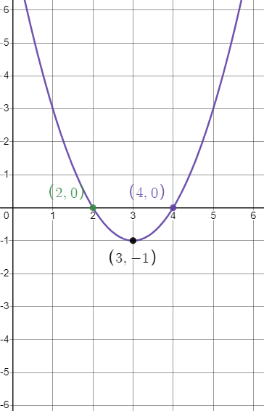
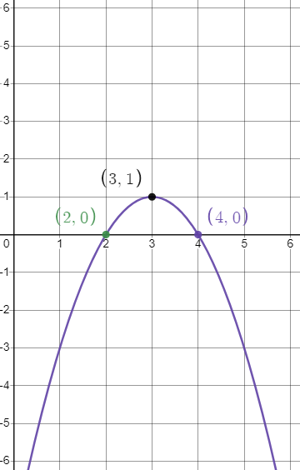
Reflection – Vertical
In order to reflect a function vertically, you need to ‘flip it upside-down’.
This requires making every $y$coordinate change sign (from positive to negative, and vice-versa)
We achieve this by multiplying every $y$ coordinate by $−1$.
$$y=−(x^{2}−6x+8)$$
$$y=x^{2}−6x+8$$

Slide 16
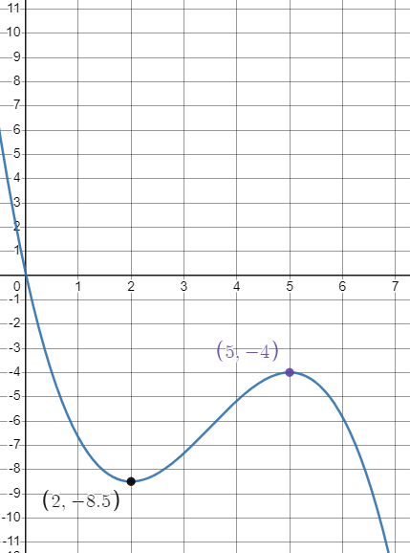
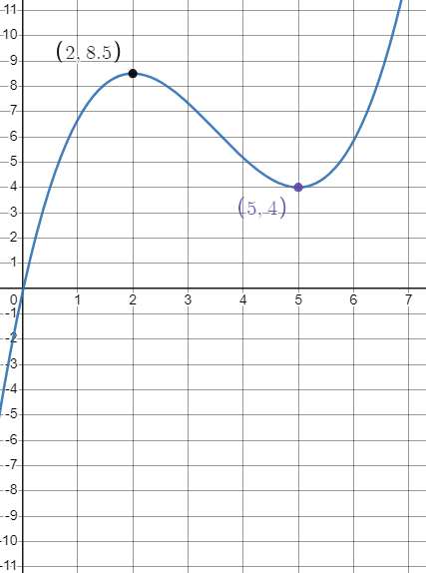
Reflection - Vertical
Another example:
$$y=f(x)$$
$$y=−f(x)$$

Slide 17
Reflection – Vertical
In general:
$−f\left(x\right)$
Reflection in the $x$ axis

Slide 18
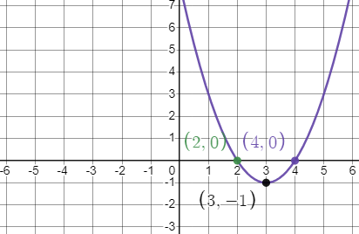
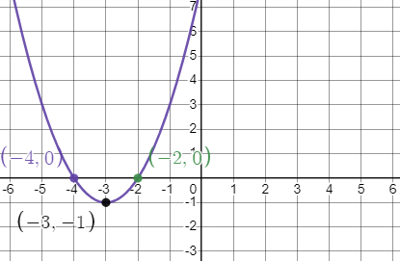
Reflection – Horizontal
In order to reflect a function horizontally, you need to swap the positive $x$ inputs with the negative ones, and vice versa.
$$y=x^{2}−6x+8$$
$$y=(−x^{2})−6(−x)+8$$

Slide 19
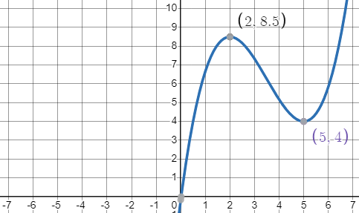
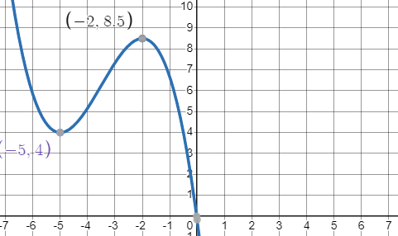
Reflection – Horizontal
Another example:
$$y=f(x)$$
$$y=f(−x)$$

Slide 20
Reflection – Horizontal
In general:
$f\left(−x\right)$
Reflection in the $y$ axis

Slide 21
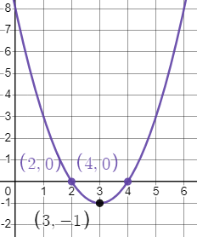
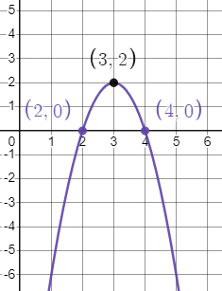
Combining Translations
It is easy to stretch and reflect a function at the same time.
You can apply the transformations one at a time. It does not matter which order you apply them in.
$$y=f(x)$$
$$y=−2f(x)$$
$−f\left(x\right)$ Reflect in $x$ axis
$2f(x)$ Stretch s.f.2 in the $y$ direction.

Slide 22
Worksheet B - Ennlargements and Reflections
Now work through all questions on Worksheet B.
Squared paper would be useful for sketching your graphs.

