Slide 1
Teaching Pack – Vectors
Lesson 3 – Adding and subtracting vectors
Cambridge IGCSE™
Mathematics 0580
Version 1.0
Notes:
In this lesson we will look at how to add and subtract vectors and scalar multiples of vectors. Use lesson_03a_Video script_Adding and subtracting vectors.
Worksheet 3a Adding and subtracting vectors
Worksheet 3c Vector walks
Extension Worksheet 3b Adding and subtracting vectors extension
https://nrich.maths.org/10734 Vectors Round a Square
https://nrich.maths.org/7453 Vector Journeys

Slide 2
Lesson objectives
Add and subtract vectors.
Use vectors to solve multi step real life questions.
Notes:
In this lesson we will look at how to add and subtract vectors and scalar multiples of vectors.

Slide 3
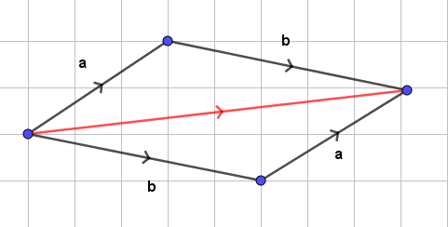
Try this!
Is vector addition commutative, in other words is a + b the same as b + a? Explain why or why not. Explain to a partner, in your own words, how to add any 2 vectors geometrically.
Yes!

Slide 4
Try this!
Is it ever possible for the resultant (sum) of two vectors to be the zero vector? If so, describe the relationship that must be true between these 2 vectors.
Yes, two vectors of equal magnitude that are pointing in opposite directions will sum to zero. Two vectors of unequal magnitude can never sum to zero. If they point along the same line, since their magnitudes are different, the sum will not be zero.

