Slide 1
Teaching Pack – Statistics
Lesson 1: Predicting trends, considering data models
and effective questioning
Cambridge IGCSETM
Mathematics 0580
Version 1

Slide 2
Starter: Rainfall
Notes:
learners should have this scatter graph handed to them as they enter the room for the starter.
The lesson begins with a discussion on the data shown (either in pairs, at tables or as a whole class): what happened in April? Why could this be? (There was a high amount of rainfall in March).
Which month had the highest amount of rainfall? (December, month 12).
Given this information, the teacher should ask the learners to draw the line of best fit on their scatter diagram and use this information to predict how much rainfall would occur in January 2018 (month 13).

Slide 3
Starter: Rainfall
Notes:
learners will be shown what happened in January, and the line of best fit that would now suit this graph.

Slide 4
Question
What is happening when we are using a line of best fit?
What are we doing?
Notes:
Pose this question to the class.
We are of course predicting by using the line of best fit!
The teacher should then ask the class: what is the best method of predicting and where have we seen this?

Slide 5
Discussion
Where have we seen predictions?
Weather forecasts
Political polls
Stock markets
Notes:
This mind map should begin a class discussion.
Please delete any of the above suggestions if they are inappropriate for your setting and fill in around the mind map with answers from your learners.
You should explain that statistics is the analysis of data which can then be used to predict future trends.

Slide 6
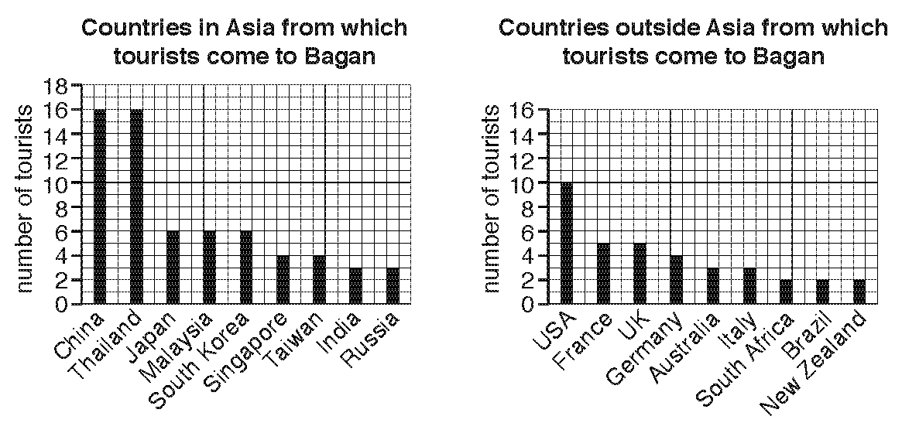
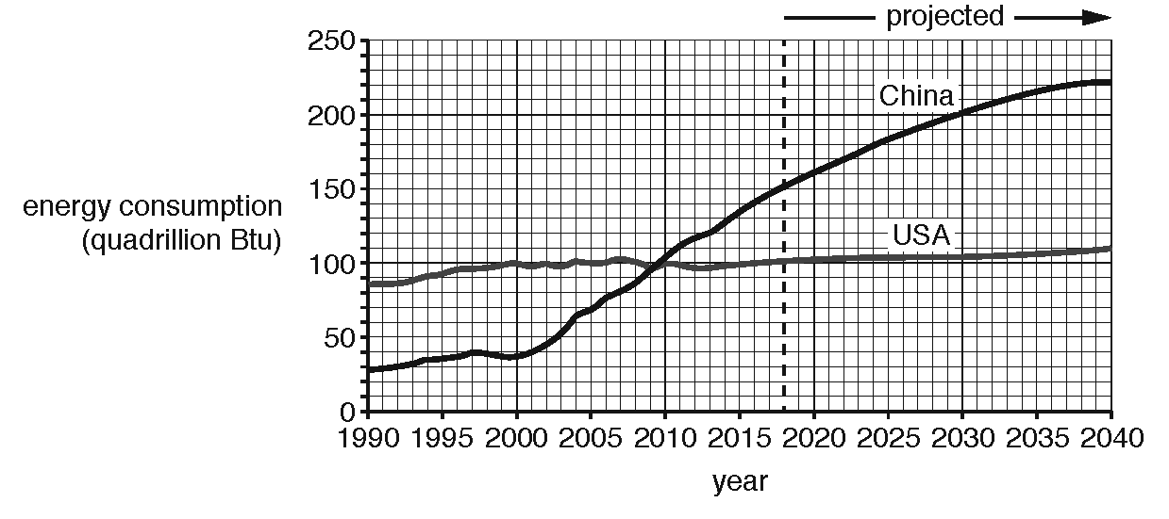
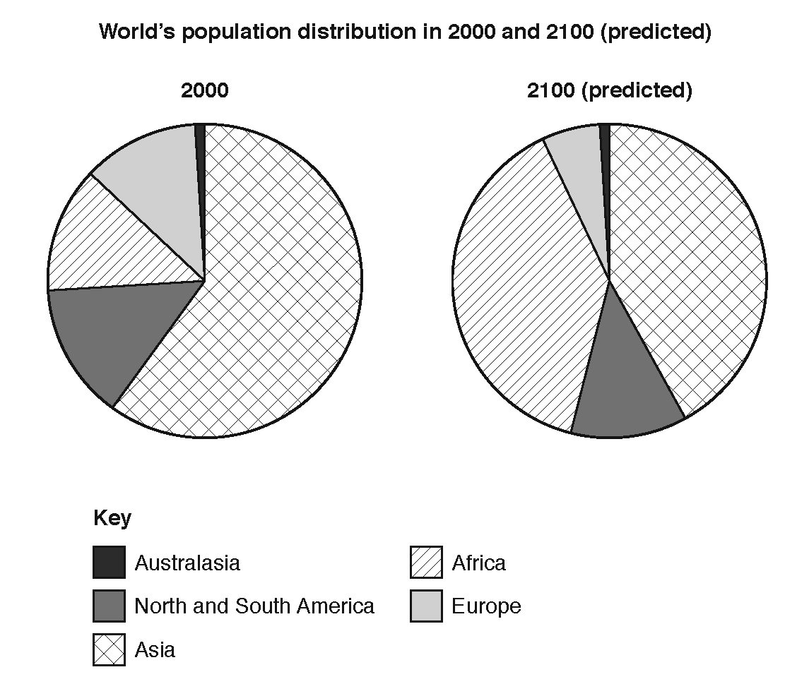
Ways of representing data
What ways do we know of representing data?
Notes:
Again, pose this question to the class to reveal what prior knowledge they have.

Slide 7
Are 3D pie charts a good way of representing data?
The costs involved in creating a food product
Notes:
Ask the class to write down the following expenditures and rank them from 1 – 6 from lowest percentage to highest percentage based on this pie chart.

Slide 8
Are 3D pie charts a good way of representing data?
10%
20%
15%
10%
The costs involved in creating a food product
20%
25%
Notes:
When the learners are finished, reveal the percentages.
Hence, discuss whether this is a good/bad way of representing data.

Slide 9
Drawing a pie chart
A short reminder on how to draw a pie chart…
Colour cars bought from a car dealer yesterday
What is the total amount of cars bought?
How can I covert these numbers into degrees?
Blue | 58
Black | 85
Red | 37
Notes:
Ask the class if they have any ideas where to begin

Slide 10
Drawing a pie chart
What is the total number of cars bought?
180
How can I covert these numbers into degrees?
Multiply by 360
Blue | Black | Red
$\frac{\text{58}}{\text{180}}$ x 360 = 116° | $\frac{\text{85}}{\text{180}}$ x 360 = 170° | $\frac{\text{37}}{\text{180}}$ x 360 = 74°

Slide 11
Drawing a pie chart
Blue | Black | Red
$\frac{\text{58}}{\text{180}}$ x 360 = 116° | $\frac{\text{85}}{\text{180}}$ x 360 = 170° | $\frac{\text{37}}{\text{180}}$ x 360 = 74°
Notes:
Ask the class if they have any ideas where to begin with drawing and how to use a protractor

Slide 12
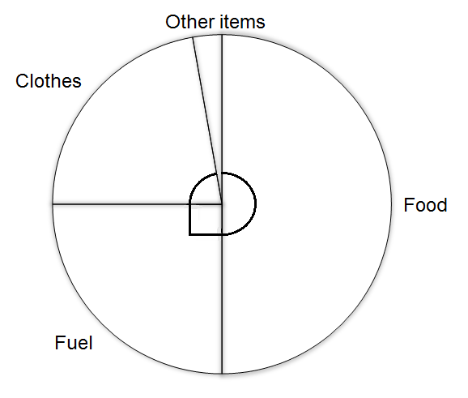
Reminder: Reading a pie chart
I went shopping at the weekend and the pie chart shows how I spent my money.
I spent $100 in total. How much did I spend on fuel? How many degrees were allocated to ‘other items’? How could I write this as a percentage? Can you think of a better way to draw this pie chart?
80°
180°
Notes:
Ask the class if they have any ideas where to begin.
Please feel free to change the currency.
Answers:
Fuel cost $25
Other items 10°
Other items as a percentage is 10/360 x 100 = 2.7% (not 10%)

Slide 13
Example: Reading a Pie Chart
Notes:
What makes this representation better?

Slide 14
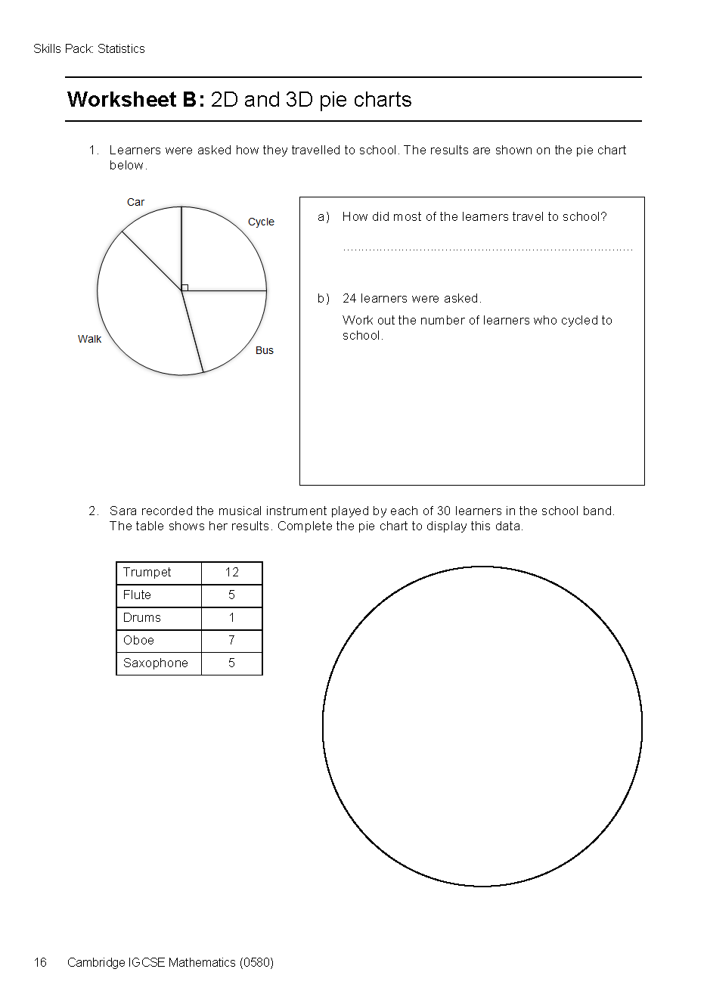
Your turn
Complete Worksheet B and discuss your answers in pairs when you are ready.

Slide 15
Homework
Design TWO Questionnaires on the same topic. The topic should be something people can agree or disagree on.
The first questionnaire should encourage people completing it to agree with your view on the topic (it should be biased).
The second questionnaire should be fair and not encourage people to agree or disagree with a particular view (it should be fair).
Things to consider
What should my topic be?
How can I ask the right kind of questions for the different questionnaires?
What sort of demographic (group of people) should I write the questions for?
Notes:
The ‘Things to consider’ section may not be required by each class but should be helpful to groups that don’t know where to begin

