Slide 1
Teaching Pack – Understanding bearings
Lesson 2: Bearings, compass points and angle facts
Cambridge IGCSE™
Mathematics 0580
Version 1

Slide 2
Lesson objectives
To be able to identify the basic points on a 16-point compass along with their bearings.

Slide 3
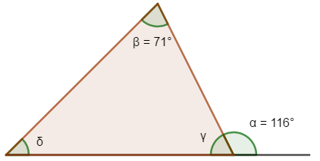
Try this!
Find the missing angles. Make sure you explain each step using the information on the diagram and the angle facts you met in the last lesson and any other angle facts you might know.
α + γ = 180° (angles on a straight line)
116° + γ = 180°
δ + γ + β = 180° (angles in a triangle)
γ = 180° – 116°
δ + 71° + 64° = 180°
γ = 64°
Missing angles
δ = 180° – 135°
δ = 45°
Notes:
Worksheet 2a: Missing angles is available for students to use with this slide

Slide 4
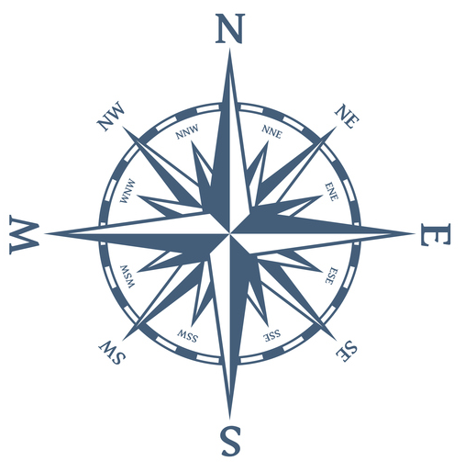
How do we write bearings?
A bearing tells you the direction of travel. It is an angle measured clockwise from North and represents the 360 degrees of a circle.
Bearings can have any value from 0° to 360°.
That means that North can be written as 000° or 360°.
If the bearing is less than a 100 degrees, you will need to add a zero to the front, for example, 054°.
If the bearing is less than 10 degrees you will need to add two zeros to the front, for example, 007°.

Slide 5
16 Point compass
The marked points of a compass are primarily divided into four points: north, south, east, and west.
These cardinal directions are further subdivided by the addition of the four intercardinal (or ordinal) directions—northeast (NE), southeast (SE), southwest (SW), and northwest (NW). These indicate the eight principal winds.
In meteorology further intermediate points between cardinal and ordinal points, such as north-northeast (NNE) are added to give the 16 points of a wind compass.

Slide 6
16 Point compass
Notes:
Go through the points on the 16 point compass listed in the diagram explaining the logic behind how they are named. Ask students how the bearing for NNE has been calculated (90˚ ÷ 4, 45 ÷ 2) and
ENE (3 x 22.5 or 90 – 22.5 or 45 + 22.5). Encourage students to share different way of calculating these examples. Students then complete Worksheet 2b: 16 point compass.
Assessment Opportunity Pelmanism game of 16 point compass points. In this simple game, players lay cards face down and take turns flipping over two cards at a time looking for a match between the name of the direction on the 16 point compass and its three figure bearing. If they find a match, they go again. If the cards are not a match, the player turns them back over and the next player goes. Most often, the game is played with two to four people at a time. As there are a limited number of cards in this version of the game suggest it is played in pairs. The cards are enclosed as part of the resource pack. Print, cut up and laminate if possible.

Slide 7
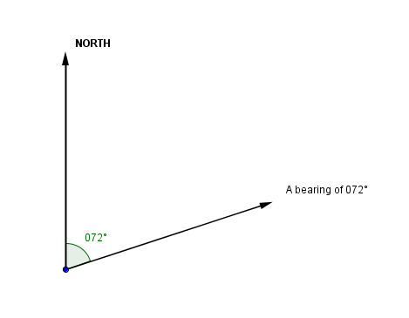
How to draw a bearing
To draw a bearing from a point, draw the North line at that point first, straight up the page. Then measure the bearing from that line in a clockwise direction and mark the new direction. Then connect the new direction with a line to illustrate the bearing (angle of turn)

Slide 8
Parallel lines and bearings
Two north lines are always parallel to each other. You can use this fact and some of the angle facts you looked at in lesson 1 to help you work out bearings.

Slide 9
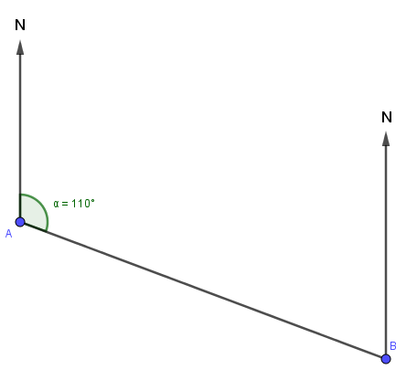
Try this!
The bearing of point B from point A is 110°.
What is the bearing of point A from point B?
HINT Start by drawing a diagram. “A problem well drawn is a problem well solved.”
Angle FBA is equal to 110°. (opposite angles are equal)
Angle CBF is equal to 180°. (angles on a straight line)
Bearing are always measured clockwise from North. So the bearing from B to A is equal to angle CBF + angle FBA:
180° + 110° = 290°

Slide 10
Parallel lines and bearings
Can you suggest a rule that you think might always work for finding the bearing back to your starting point?
What about 180° plus the original bearing?
Do you think this rule will always work?

Slide 11
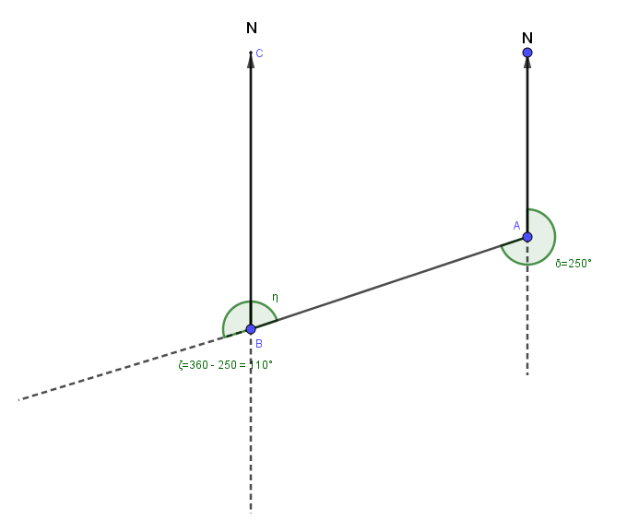
Try this!
What about this example?
Angle α = 360 – 250 = 110°
(angles in a circle)
Angle ζ = 360 – 250 = 110°
(Corresponding angles or angles in a circle)
Angle CBA = 180° - Angle ζ
Angle CBA = 180° – (360° – 250°)
Angle CBA = 180° – 360° + 250°
Angle CBA = -180° + 250°
α
ζ

Slide 12
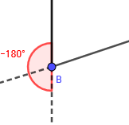
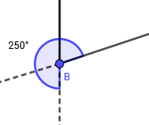
Parallel lines and bearings
What is the rule this time?
What about -180° plus the original bearing?
Look at the diagram can you see why the rule makes sense.

Slide 13
Parallel lines and bearings
So we have two rules we can use:
If the original bearing is less that 180° the rule for finding the reverse bearing is 180° plus the original bearing.
If the original bearing is greater than 180° the rule for finding the reverse bearing is -180° plus the original bearing.

Slide 14
Parallel lines and bearings
What if the original bearing is 180°. Do our rules still make sense?
In this case they both make sense. Remember if the original bearing is 180° then we are travelling due South. So to get back to where we started from we need to travel to North.
Using the first rule 180° + 180° = 360°
Using the second rule -180° + 180° = 000°
Remember what we said at the start of this lesson that North can be written as 000° or 360°.

Slide 15
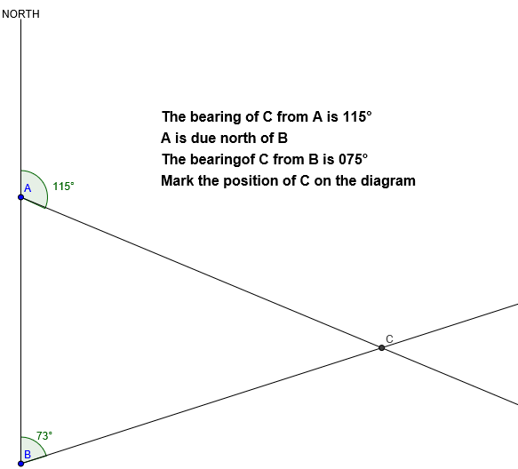
Example
The bearing of C from A is 115°
A is due north of B
The bearing of C from B is 075°
Mark the position of C on the diagram
So what do you need to do first?
Yes draw a diagram. Remember our catchphrase. "A problem well drawn is a problem well solved"
Notes:
Allow learners time to work on the problem. Then use the Geogebra file Lesson 2 Example Slide 16 to demonstrate how you would approach this problem.

Slide 16
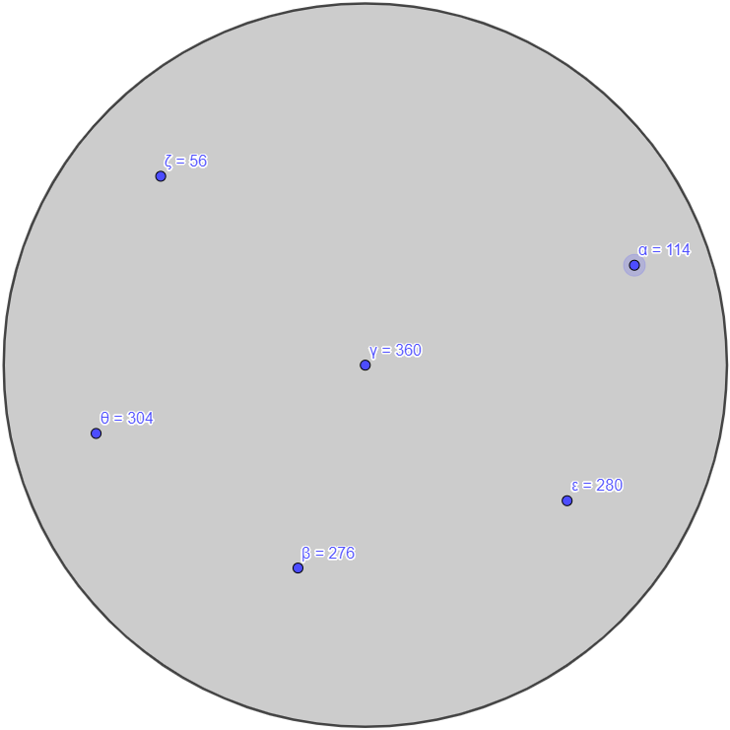
Air Traffic Control
This circle shows the screen of an air traffic controller. Each dot shows the location of an aircraft.
The values in blue are the bearings along which each plane is travelling. We can assume the planes are travelling at a similar speed.
Remember if we were sharing these bearings with anyone else we would write or say them as a
3-figure bearing. So for example 56 would be 056°
Do you think any of these planes’ paths will meet the cross over path?
Talk about this with your neighbour.

Slide 17
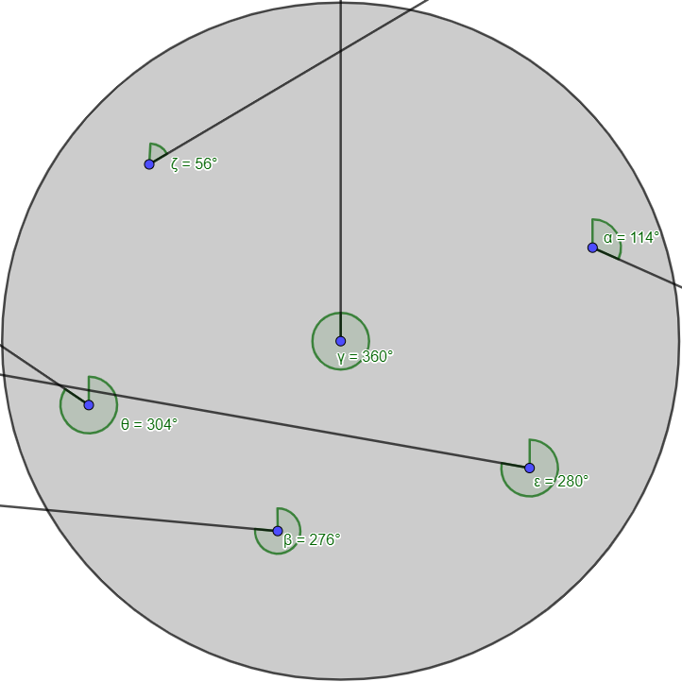
Air Traffic Control
On this version of the screen you can see that the projections for ε and θ cross. However as the length of the lines are quite different and we are assuming that the planes are travelling at similar speeds we can also see that the planes will not meet the crossover point at the same time so will not crash.
The projections from ζ and γ also cross and whilst the lines are not the same length there may be an argument in this case for taking some avoidance action just in case

Slide 18
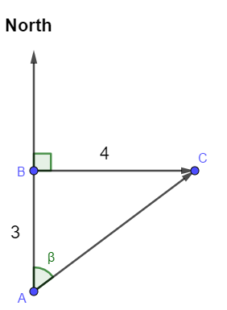
Try this!
A small passenger plane flies 3km due north then 4km due east. What is the three figure bearing of its current position from its starting position?
What are you going to do first to help you see how to solve this problem?
Draw a diagram!
Which of your other mathematical skills are you going to need to solve this problem?
You will then need to use trigonometry to find β which will tell you the bearing from A to C.
Tan β = $\frac{Opposite }{Adjacent }$ = ($\frac{4}{3}$)
β = Tan ⁻¹ ($\frac{4}{3}$) = 53°(to the nearest degree). So the three figure bearing from A to C is 053°.
Notes:
This plenary will prepare students for the problem solving in the next lesson.

