Slide 1
Teaching Pack – Accuracy and bounds
Lesson 2 - Accuracy and bounds to 3 decimal places
Cambridge IGCSE™
Mathematics 0580
Version 1.0
Copyright © UCLES March 2018

Slide 2
Quiz
1
130 has been rounded to the nearest 10.
Give the lower and upper bounds.
Lower bound = 125
Upper bound = 135
Notes:
This quiz is designed to be used with mini whiteboards (with the answers being held up by learners). As an alternative, learners could write down their answers in their books.
The timing is currently set to 30 seconds for each question, but this can be adjusted to suit your learners.

Slide 3
Quiz
2
400 has been rounded to the nearest 10.
Give the lower and upper bounds.
Lower bound = 395
Upper bound = 405

Slide 4
Quiz
3
700 has been rounded to the nearest 100.
Give the lower and upper bounds.
Lower bound = 650
Upper bound = 750

Slide 5
Quiz
4
4000 has been rounded to the nearest 1000.
Give the lower and upper bounds.
Lower bound = 3500
Upper bound = 4500

Slide 6
Quiz
5
2000 has been rounded to the nearest 100.
Give the lower and upper bounds.
Lower bound = 1950
Upper bound = 2050

Slide 7
Quiz
6
590 has been rounded to the nearest 10.
Give the lower and upper bounds.
Lower bound = 585
Upper bound = 595

Slide 8
Quiz
7
2700 has been rounded to the nearest 100.
Give the lower and upper bounds.
Lower bound = 2650
Upper bound = 2750

Slide 9
Quiz
8
32 000 has been rounded to the nearest 1000.
Give the lower and upper bounds.
Lower bound = 31 500
Upper bound = 32 500

Slide 10
Quiz
9
600 has been rounded to the nearest 100.
Give the lower and upper bounds.
Lower bound = 550
Upper bound = 650

Slide 11
Quiz
10
500 has been rounded to the nearest 10.
Give the lower and upper bounds.
Lower bound = 495
Upper bound = 505

Slide 12
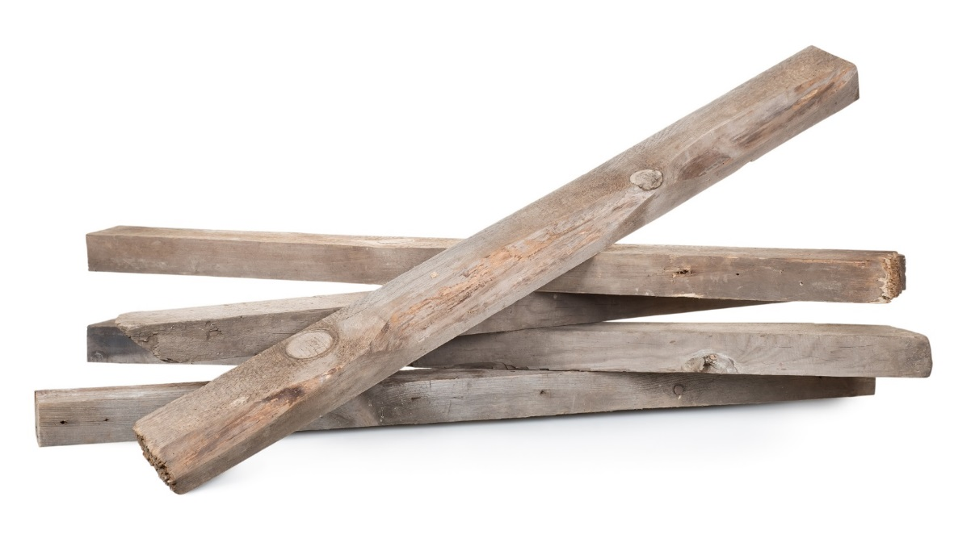
Numbers given to the nearest whole number
Marta measures the length and width of a piece of wood.
She records her measurements to the nearest centimetre.
What is the lower bound for the length?
What is the upper bound for the length?
Complete the statement about the width, w cm, of the piece of wood.
Length = 23 cm
Width = 14 cm
$⩽$ w <
Notes:
Use this slide to introduce bounds with numbers given to the nearest whole number.
Inequality notation is introduced to describe bounds. You could adapt this by asking learners to state the lower and upper bounds for either length or width without using inequality notation.
The next slide provides a number line which you can use to support your explanation of the bounds for the mass. More confident learners may not need a number line.
There is a second example on slide 15.
Differentiation option: focus on numbers rounded to the nearest whole number for one lesson. In the next lesson, look at numbers rounded to a given number of decimal places.
Answers:
Lower bound for length 22.5cm
Upper bound for length 23.5cm
13.5 ≤ w <14.5

Slide 13
23 cm to the nearest centimetre
22
22.5
23
23.5
24
Notes:
Use this slide, if required, to support explanation of the upper and lower bounds.

Slide 14
14 cm to the nearest centimetre
13
13.5
14
14.5
15
Notes:
Use this slide, if required, to support explanation of the upper and lower bounds.

Slide 15
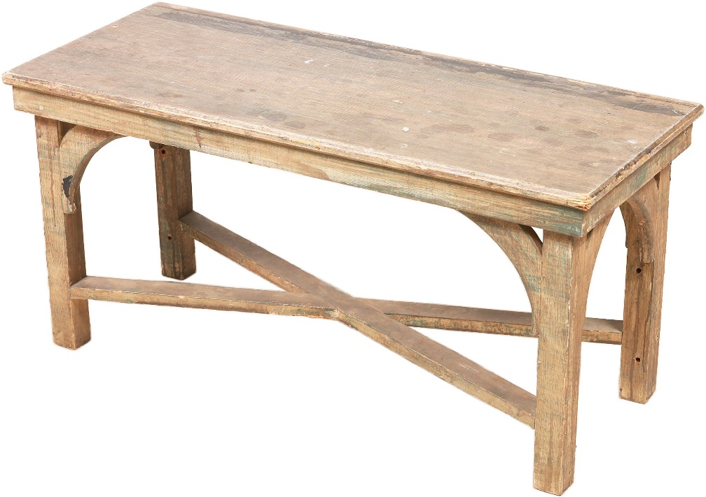
Numbers given to the nearest whole number
Amadi measures the mass of a table.
He records his measurement to the nearest kilogram.
What is the lower bound for the mass?
What is the upper bound for the mass?
Complete the statement about the mass, m kg, of the table.
Mass = 17 kg
$⩽$ m <
Notes:
You could adapt this by not asking for the statement to be completed.
The next slide provides a number line which you can use to support your explanation of the bounds for the mass. More confident learners may not need a number line.
Differentiation option: focus on numbers rounded to the nearest whole number for one lesson. In the next lesson, look at numbers rounded to a given number of decimal places.
Answers:
Lower bound for mass 16.5 kg
Upper bound for mass 17.5 kg
16.5 ≤ m <17.5

Slide 16
17 kg to the nearest kilogram
16
16.5
17
17.5
18
Notes:
Use this slide, if required, to support explanation of the upper and lower bounds.

Slide 17
Bounds where numbers are rounded to 1 decimal place
Carlos has measured the travel distances from Cambridge to a number of different places.
The distances are given in kilometres and have been rounded to 1 decimal place.
Place | Distance | Lower bound | Upper bound
Bedford | 49.1
Huntingdon | 31.7
Peterborough | 65.6
Notes:
Ask learners for the information they need to complete the table.
Extension – ask learners to write down statements for the distances using inequalities.

Slide 18
49.1 km to 1 decimal place
49.0
49.05
49.1
49.15
49.2
Notes:
Use this slide, if required, to support explanation of the upper and lower bounds.

Slide 19
31.7 km to 1 decimal place
31.6
31.65
31.7
31.75
31.8
Notes:
Use this slide, if required, to support explanation of the upper and lower bounds.

Slide 20
65.6 km to 1 decimal place
65.5
65.55
65.6
65.65
65.7
Notes:
Use this slide, if required, to support explanation of the upper and lower bounds.

Slide 21
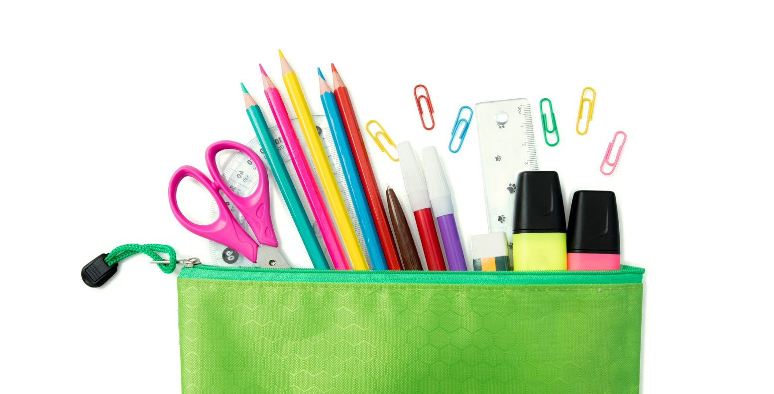
Rounded to the nearest millimetre
Rutna is measuring items in her pencil case.
She recorded each length in centimetres rounded to the nearest millimetre.
Notes:
Discuss with learners what an accuracy of ‘to the nearest millimetre’ means when we have lengths in centimetres. This is equivalent to giving answers to 1 decimal place

Slide 22
14 cm to the nearest centimetre
13
13.5
14
14.5
15
Notes:
Use this slide, if required, to support explanation of the upper and lower bounds.

Slide 23
Activity
Roll a die.
Use the numbers you have rolled to fill the gaps.
Assume that this number is rounded to the nearest whole number.
Give the lower bound and the upper bound for the number you have generated.
Notes:
Ideally learners would use 10-sided dice but this would still work with a normal 6-sided die.
Differentiation:
Support – roll a die once and then find the bounds
Extension – ask students to complete the inequality statement

