Slide 1
Lesson slides
Topic E2.11
Lesson 2: Sketching Quadratics
Cambridge IGCSE™
Mathematics 0580
Version 1

Slide 2
Starter – Factorising and completing the Square
Non-Calculator
Factorise and solve.
Complete the Square.
$$y=(x+6)(x+1)$$
$$x=−6 or x=−1$$
$$y=x^{2}+6x+7$$
$$y={(x+3)}^{2} − 2$$
$$y=(x−5)(x−3)$$
$$x=5 or x=3$$
$$y=x^{2}−8x+15$$
$$y={(x−4)}^{2} −1$$
$$y=(x−16)(x+4)$$
$$x=16 or x=−4$$
$$y=x^{2}−12x−64$$
$$y={(x−6)}^{2} −100$$

Slide 3
Quadratic graphs
We can create a sketch of a quadratic without using a table of values.
All quadratics have a parabola shape.
The turning point is where the graph changes direction.
This is a maximum point.
This is a minimum point.

Slide 4
Quadratic graphs
The equation of this graph is
$y=x^{2} −7x+12$.
Is there a way of getting the intercept or roots without using a table of values?
Try solving $x^{2} −7x+12=0$
$\left(x−3\right)\left(x−4\right)=0$
$x=3 x=4$
$y$ intercept
Roots

Slide 5
Quadratic graphs
The equation of this graph is
$y=x^{2} −2x−15$.
Roots
$y$ intercept is $−15$.
Solve $x^{2} −2x−15=0$ to find the roots.
$$(x−5)(x+3)=0$$
$$x=5 or x=−3$$
$y$ intercept

Slide 6
Quadratic graphs
Notice that the minimum point of this graph is $(1,−16)$.
We can find this point by completing the square.
$$x^{2} −2x−15$$
$${(x−1)}^{2}−1−15$$
Minimum point
$$(1,−16)$$
$${(x−1)}^{2} − 16$$
$$y=−16$$
$$x=1$$

Slide 7
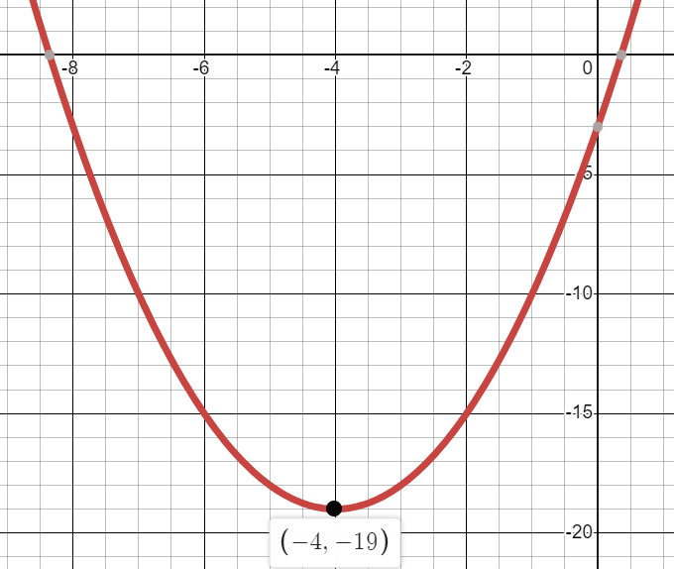
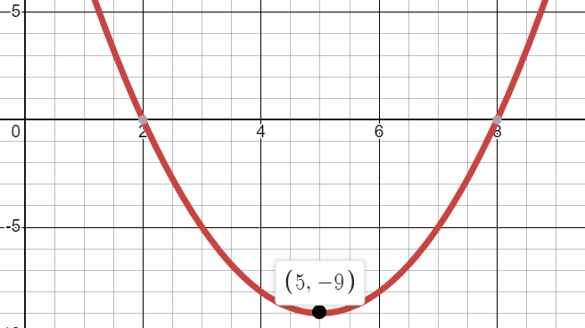
Your Turn
Sketch the graph of the following, including finding the minimum point.
$$y=x^{2}+8x −3$$
$$y=x^{2}−10x+27$$

Slide 8
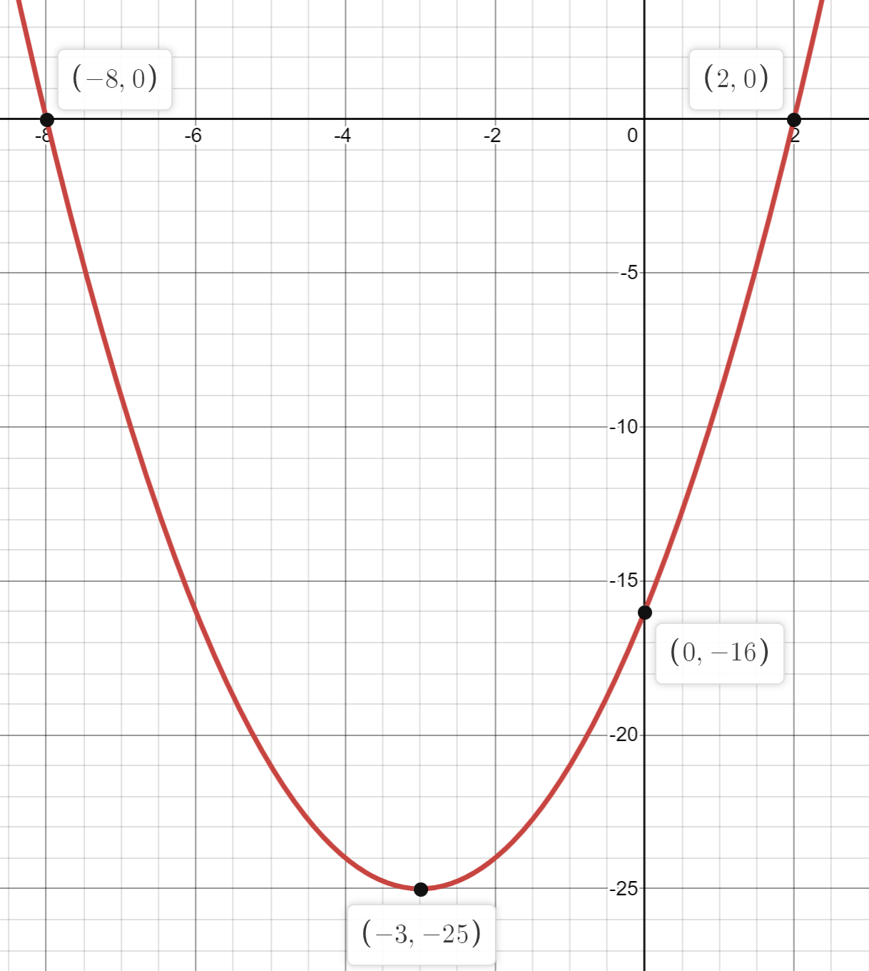
Your Turn
Sketch the graph of $y=x^{2}−x−6$ by plotting the roots and the intercept.
Sketch the graph of $y=x^{2}+6x−16$ by plotting roots, intercept
and turning point.

Slide 9
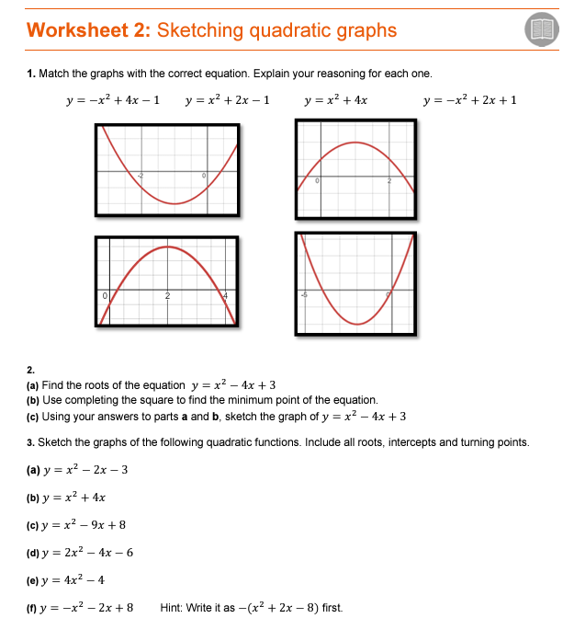
Now work through worksheet 2

