Slide 1
Skills Pack – Circle theorems
Lesson 2: Angle in a semicircle
Cambridge IGCSETM
Mathematics 0580
Version 0.1

Slide 2
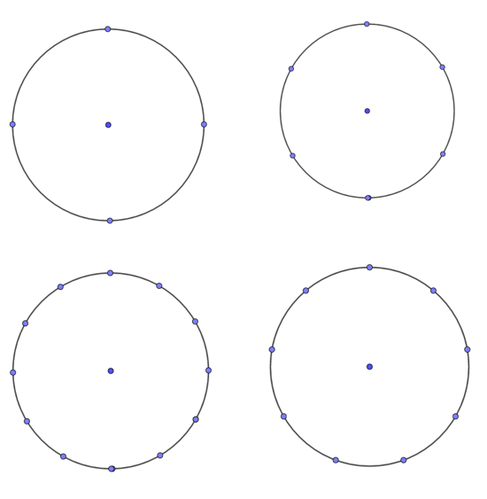
Try this!
Can you make a right-angled triangle on the peg-board diagrams by joining up three points round the edge?

Slide 3
Inscribed shape
What is an inscribed shape?
An inscribed shape is one that is enclosed by another .
Triangle inscribed in a rectangle
Rectangle inscribed in a circle

Slide 4
Angle in a semicircle (Thales' Theorem)
The angle at the circumference in a triangle inscribed in a semicircle is always a right angle: Thales' Theorem
The end points of the base of the triangle are either end of a circle's diameter, the apex point can be anywhere on the circumference.
P
A
B
Angle APB = 90°
P
A
A
B
P
B

Slide 5
Thales' Theorem - proof
P
y
x
A
x
y
B
B
O
x + y + y + x =180°
x + y = 90°
Angle APB = x + y = 90°
Notes:
We can split the triangle in two by drawing a line from the centre of the circle to the point on the circumference that tringle touches.
The lines OB, OP and OA are radius of the circle and are the same length. Therefore two triangles are isosceles and has a pair of equal angles.
All of the angles together must add up to 180 degrees.

Slide 6
Try this!
Find the value of x.
A
Angle CAB = 90°
Angles in a triangle add up to 180°.
x = 180° – 90° – 60°
60º
x
x = 30°
C
O
B

Slide 7
Try this!
A
Find the value of x.
Angle CAB = 90°
Angles in a triangle add up to 180°.
x = 180° – 90° – 40°
40º
x
x = 50°
C
B
O

Slide 8
Activity
Explain to your classmate sitting next to you what Thales’ theorem is and see if you can remember how to prove it!

