Slide 1
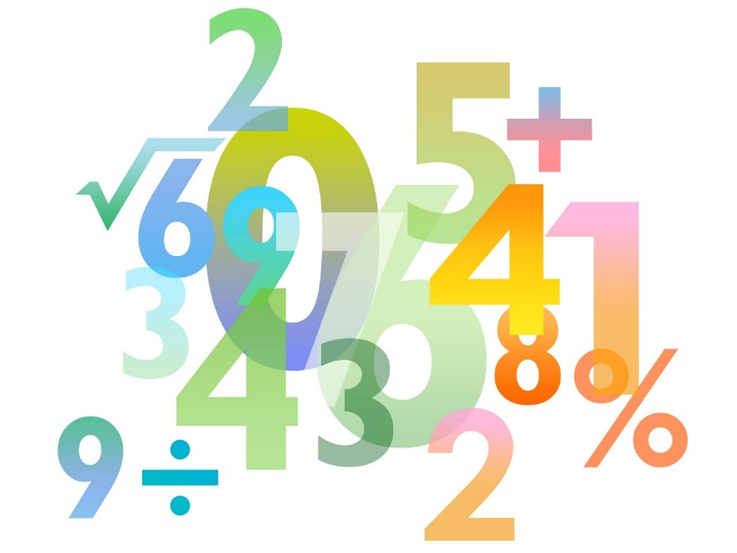
Teaching Pack – Differentiation
Lesson 3 – Classifying turning points
Cambridge IGCSE™
Mathematics 0580
Version 1.0

Slide 2
Lesson objectives
Understand what turning or stationary points are.
Use differentiation to find and classify turning points.

Slide 3
Try this!
Look at the graph below. It is the graph of y = 6x - x².
a) Write down the coordinates of P and Q (where the graph crosses the axes).
0 = 6x – x²
0 = x(6 – x)
x = 0 or x = 6
b) Use differentiation to find the gradient for this graph.
c) Find the gradient of the curve when x = 5.
When x = 5
c) Find the gradient of the curve when x = 3.
P
Q
When x = 3
(0,0)
(6,0)

Slide 4
Video: Introduction to Calculus
Notes:
Make sure that you are logged in to Resource Plus before you attempt to play this video

Slide 5
Vertex of a parabola
The vertex of a parabola is an example of a turning point. There are two types of turning points that you might see on a graph, in both cases the gradient of the graph at the turning point is equal to zero, meaning that we can use differentiation to locate them.
Places where the graph has a ‘local maximum’.
Places where the graph has a ‘local minimum’.

Slide 6
Try this!
Consider the equation y = x² – 8x + 7. What does the graph of this equation look like?
Sketch it!
y = (x – 7) (x – 1)
y = (x – 4)² – 9
What is the gradient of the graph when x = 4?
What significance does this have to the graph?
Graph crosses:
y axis at 7
x axis at 1 and 7
Turning point at (4,-9)

Slide 7
Try this!
Consider the equation y = 10 + 4x – x². What does the graph of this equation look like?
Sketch it!
Doesn’t really factorise
y = - (x – 2)² + 14
Where is the ‘vertex’ of the graph?
The vertex of the graph is at (2,14).

Slide 8
Try this!
Consider the graph y = 2x² – 4x + 3.
Find and classify the types of turning points, hence sketch the graph.
x | 0.9 | 1 | 1.1
 | -0.4 | 0 | 0.4
So a local minimum at (1,1).

Slide 9
Try this!
Consider the graph y = 2x³ – 24x.
Find and classify the types of turning points, hence sketch the graph.
x = 2 or – 2
x | -2.1 | -2 | -1.9
 | 2.46 | 0 | -2.34
x | 1.9 | 2 | 2.1
 | -2.34 | 0 | 2.46
So a local maximum at (-2,32 )
So a local minimum at (2,-32 )

Slide 10
Try this!
Consider the graph y = 3x² – x³.
What are the coordinate values of the turning points of the graphs? Use this to sketch the graph.
x = 0 or x = 2
x | -0.1 | 0 | 0.1
 | -0.63 | 0 | 0.57
x | 1.9 | 2 | 2.1
 | 0.57 | 0 | -0.63
So a local minimum at (0,0 )
So a local maximum at (2,4 )

Slide 11
Finding and classifying turning points
Is it possible for the gradient of a curve to be zero at a point and for the point not to be a turning point?
Find and classify the ‘turning point’ on the curve y = x³
$$\frac{\text{d}\text{y}}{\text{d}\text{x}}\text{=3}{\text{x}}^{\text{2}}$$
$\text{3}{\text{x}}^{\text{2}}$ = 0
x = 0 y = 0³ = 0
x | -0.1 | 0 | 0.1
$$\frac{\text{dy}}{\text{dx}}$$ | 0.03 | 0 | 0.03
We call this a point of inflection

Slide 12
Finding and classifying turning points
The points where the gradient of the curve equals zero are called ‘stationary points’.
Stationary points can be classified as:
‘local maximums’
- also called a ‘turning point’
‘local minimums’
- also called a ‘turning point’
‘points of inflection’
Notes:
Maximums = maxima, Minimums = minima

