Slide 1
Lesson slides
Topic E2.11: Sketching curves
Lesson 4: Sketching reciprocal and exponential graphs
Cambridge IGCSE™
Mathematics 0580
Version 1

Slide 2
What is an exponential graph?
This is a function where the power itself is the variable, rather than the base number.
For example, $y = 2x$is an exponential function.

Slide 3
What is an exponential graph?
There are two types of exponential graph.
Exponential
Decay
Exponential
Growth
All of these graphs have a $y$ intercept of 1, as anything to the power of zero is 1.
$$1$$
$$1$$
$y= a^{x}$ where $a>1$
$y=b^{−x}$ where $0<b<1$
$y= a^{−x}$ where $a>1$
$y=b^{x}$ where $0<b<1$

Slide 4
What is an exponential graph?
If you look at the negative $x$ values, you’ll see that the graph gets closer and closer to the $x$ axis.
If we drew the graph further, it would continue to get closer to the $x$ axis, but would never reach it.
The name for this feature of a graph is an asymptote.
(in this case, a horizontal one)
So for all of these exponential graphs, the $x$ axis, or $y=0$, describes the asymptote of the graph.
$$1$$

Slide 5
Examples
Sketch the graph of
$$y=4x$$
$$1$$
$$y=0.5x$$
$$1$$

Slide 6
Your turn
Sketch the graph of
$$y=10x$$
$$1$$
$$y=9^{−x}$$
$$1$$

Slide 7
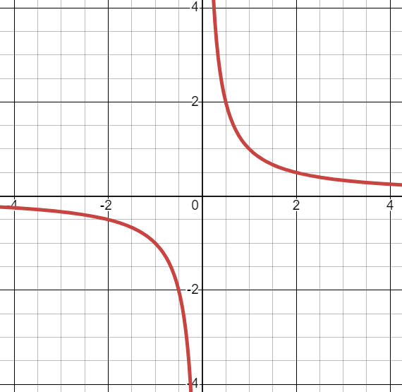
Reciprocal graphs
How would the graph of $y= \frac{1}{x}$look?
What happens for large values of $x$?
$y$ gets very small
What happens for small values of $x$?
Using $x=0.001$as an example:
$y=\frac{1}{0.001} =1000$ Very large

Slide 8
Reciprocal graphs
$$y=\frac{1}{x}$$
Key features:
The graph is symmetrical.
The graph has two asymptotes, the $x$ axis and the $y$ axis.

Slide 9
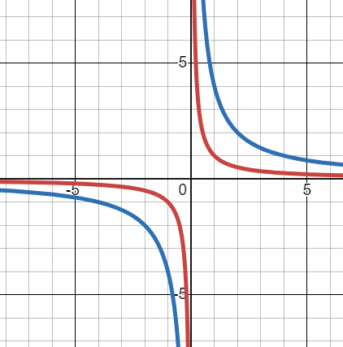
Reciprocal graphs
How would the graph of $y= \frac{4}{x}$ look?
Compare it to the previous graph.
It has the same shape, it’s just a little further from the axes.

Slide 10
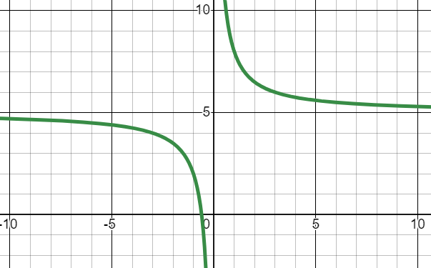
Reciprocal graphs of the form $y=\frac{1}{x}+b$
What happens if you add a value to the end of the equation?
$$y=\frac{1}{x}+5$$
It has the same shape as $y=\frac{1}{x}$.
The horizontal asymptote is now at 5.
This is because we added 5 to the equation.

Slide 11
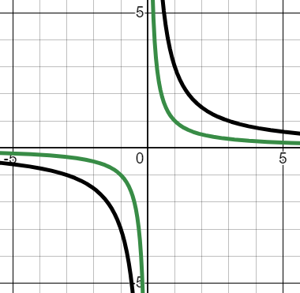
Your turn
On the same graph, sketch
$$y=\frac{1}{x}$$
$$y=\frac{3}{x}$$

Slide 12
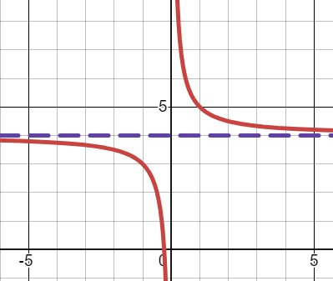
Your turn
Sketch $y=\frac{1}{x}+4.$

Slide 13
Now work through worksheet 4

