Slide 1
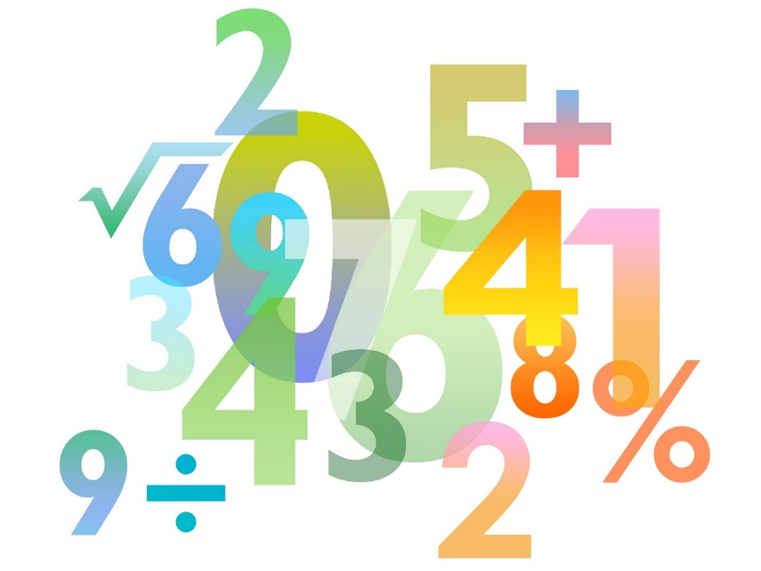
Teaching Pack – Differentiation
Lesson 4 – Exam practise and
Second derivatives
Cambridge IGCSE™
Mathematics 0580
Version 1.0

Slide 2
Lesson objectives
apply differentiation to turning points in the context of an examination question
discriminate between maxima and minima by any method in the context of an examination question
use the second derivative to classify turning points.

Slide 3
Try this!
If y = 3x³ + 4x – 3. Find .
If y = x³ – 5x² – 2x . Find .
If y = 6x² – 3x . Find the gradient of the curve when x = 1.
Function for Gradient of the curve is
When x = 1, gradient is therefore 9.

Slide 4
Try this!
If y = 3x² + 12x. What is the value of x when the gradient is 0.
If y = x³ + 5x² + 6x . For what values of x is the gradient 3?
So or

Slide 5
Try this!
Circle the position of the local maximum on the graph below.

Slide 6
Try this!
Circle the position of the point of inflection.

Slide 7
Try this!
A curve has equation y = x³ – 6x² + 16 .
a) Find the coordinates of the two turning points.
So x = 0 or x = 4
When x = 0 y = 0³ – 6 x0² + 16
= 16
When x = 4 y = 4³ – 6 x4² + 16
= -16
So stationery points at (0,16) and (4,-16)
b) Determine whether each of the turning points is either a maximum or a minimum. Give reasons for your answers.
x | -0.1 | 0 | 0.1
 | 1.23 | 0 | -1.17
x | 3.9 | 4 | 4.1
 | -1.17 | 0 | 1.23
A local maximum at (0,16)
A local minimum at (4,-16)

Slide 8
Video: Example Calculus Question
Notes:
Make sure that you are logged in to Resource Plus before you attempt to play this video

Slide 9
Try this!
A curve has equation y = x³ +3x² + 1.
a) Find the coordinates of the two turning points.
So x = 0 or x = -2
When x = 0 y = 0³ + 3 x 0² + 1
= 1
When x = -2 y = (-2)³ + 3 x (-2)² + 1
= 5
So stationery points at (0,1) and (-2,5)
b) Determine whether each of the turning points is either a maximum or a minimum. Give reasons for your answers.
x | -0.1 | 0 | 0.1
 | -0.57 | 0 | 0.63
x | -2.1 | -2 | -1.9
 | 0.63 | 0 | -0.57
A local minimum at (0,1)
A local maximum at (-2,5)

Slide 10
Try this!
A curve has equation y = 4x³ – x⁴.
a) Find the coordinates of the two turning points.
So x = 0 or x = 3
When x = 0 y = 4 x 0³ – 0⁴
= 1
When x = 3 y = 4 x (3)³ – (3)⁴
= 27
So stationery points at (0,0) and (3,27)
b) Determine whether each of the turning points is either a maximum, a minimum or a point of inflection. Give reasons for your answers.
x | -0.1 | 0 | 0.1
 | 0.124 | 0 | 0.116
x | 2.9 | 3 | 3.1
 | 3.364 | 0 | -3.844
A point of inflection at (0,0)
A local maximum at (3,27)

Slide 11
Write a 5 point summary outlining the key facts and messages from this unit.

