Slide 1
Lesson slides Topic 1.2: Functions Lesson 3: Graph Transformations – Combining Transformations
Version 1

Slide 2
Starter – Quick Recap
Write down as many of the graph transformations as you can remember from the previous 2 lessons.

Slide 3
Recap of the function transformations
$$+$$
Translation $\left(\begin{matrix}0 \\ a\end{matrix}\right)$
$$f\left(x\right)+a$$
$$−$$
$$f\left(x+a\right)$$
Translation $\left(\begin{matrix}−a \\ 0\end{matrix}\right)$
$$+$$
$$−$$
$$af\left(x\right)$$
Stretch, scale factor $a$ , in the $y$ direction
$$×a$$
$$f\left(ax\right)$$
Stretch, scale factor $\frac{1}{a}$in the $x$ direction.
$$×\frac{1}{a}$$
$$−f\left(x\right)$$
Reflection in the $x$ axis
$$f\left(−x\right)$$
Reflection in the $y$ axis

Slide 4
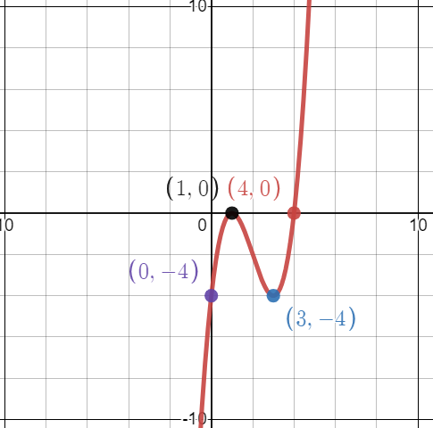
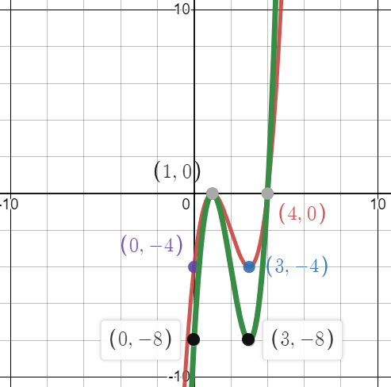
Combinations of transformations
Consider the following graph. We don’t know the equation, but we are given some of the key coordinates.
The graph is $y=f(x)$
How could we sketch $y=2f(x)$?
This means a vertical stretch, scale factor 2. Apply this transformation to each individual coordinate.
(0,-4) → (0,-8)
(1,0) → (1,0)
(3, -4) → (3, -8)
(4,0) → (4,0)

Slide 5
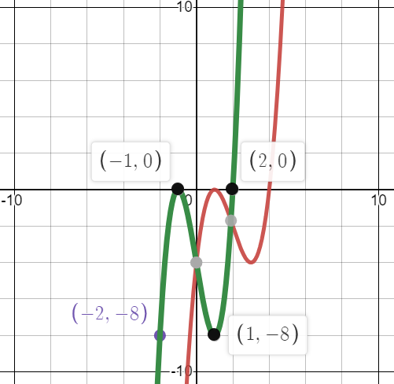
Combinations of transformations
How could we sketch $y=2f\left(x+2\right)$?
There are 2 transformations here:
Translation $\left(\begin{matrix}−2 \\ 0\end{matrix}\right)$
Stretch s.f. 2 in the $y$direction
Because one effects the $x$ direction, and the other effects the $y$ direction, it doesn’t matter which one you apply first. If we do translation first:
(0,-4) → (-2,-4) → (-2, -8)
(1,0) → (-1,0) → (-1,0)
(3, -4) → (1, -4) → (1,-8)
(4,0) → (2,0) → (2,0)

Slide 6
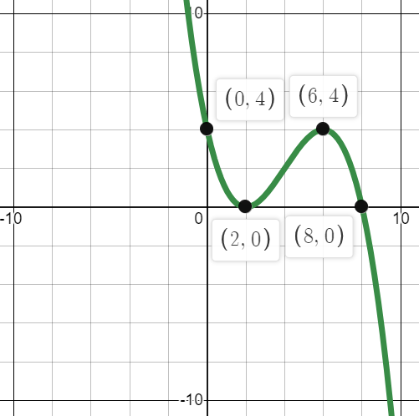
Combinations of transformations
How could we sketch $y=−f\left(\frac{1}{2}x\right)$?
There are 2 transformations here:
Reflection in the $x$axis
Stretch s.f. 2 in the $x$direction
Again, one effects the $x$ direction, and the other effects the $y$ direction, it doesn’t matter which one you apply first.

Slide 7
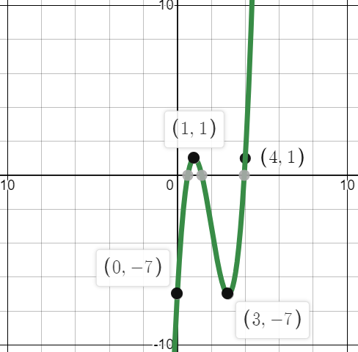
Combinations of transformations
How could we sketch $y=2f\left(x\right)+1$?
There are 2 transformations here:
Stretch s.f. 2 in the $y$direction
Translation $\left(\begin{matrix}0 \\ 1\end{matrix}\right)$
This features 2 transformations in the $y$ direction.
You must apply the transformations in the correct order. For this, follow the same principles as BIDMAS. You apply the stretch (multiply) before you translate (add).

Slide 8
Worksheet C: Combining Transformations
Now work through all questions on Worksheet C.
Squared paper would be useful for sketching your graphs.

