Slide 1
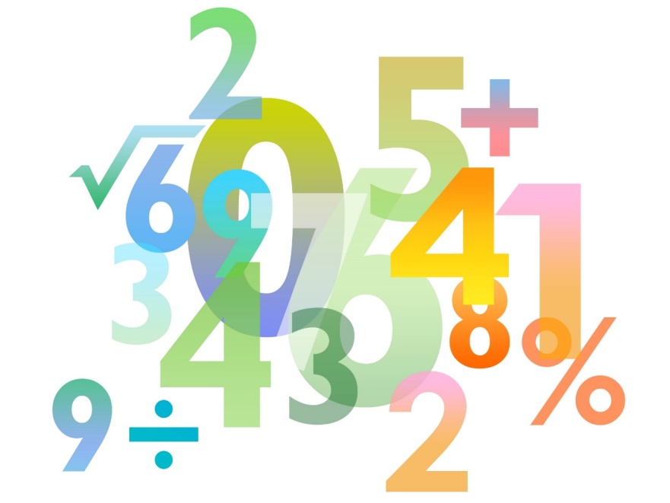
Skills Pack – Circle theorems
Lesson 3: Angle at the centre of a circle
Cambridge IGCSETM
Mathematics 0580
Version 0.1

Slide 2
What angle facts do you know?

Slide 3
Did you recall all these facts?
The angles in a triangle add up to 180°.
Corresponding angles are equal.
Angles on a straight line add up to 180°.
β
Angles around a point add up to 360°.
β
Angles in an equilateral triangle are all 60°.
Opposite angles are equal.
Alternate angles are the same.
δ
δ
α
α
An isosceles triangle has two equal sides and angles.
The angles in a quadrilateral add up to 360°.
Notes:
What angle facts do you know? Did you recall all these facts?

Slide 4
Angle at the centre of a circle (Inscribed Angle theorem)
In a circle the angle at the centre is twice the angle at the circumference.
A
Angle COB = 2 x angle CAB
O
C
B

Slide 5
Angle at the centre of a circle - proof
Extend AO to D
AO = BO = CO (radii of same circle)
Triangle AOB is isosceles (base angles equal)
Triangle AOC is isosceles (base angles equal)
Angle AOB = 180° - 2α (angle sum in a triangle)
Angle AOC = 180° - 2β (angle sum in a triangle)
Angle COB = 360° – (AOB + AOC) (angles at point)
Angle COB = 360° – (180° - 2α + 180 - 2β)
Angle COB = 2α + 2β = 2(α+ β)
= 2 x Angle CAB
A
β
α
O
β
α
C
B
D

Slide 6
Try this!
Explain why the circle theorem you learnt in lesson 2 is a special case of the theorem you have proved in this lesson.
Lesson 2
Lesson 3
A
P
A
B
O
B
O
C
B
Angle APB = 90°
Angle COB = 2 x angle CAB

Slide 7
Angle in a semicircle
Think for a minute about how we can use the theorem we learnt today to help us prove the angle in a semicircle is a right angle.
The theorem we learnt today tells us that the angle at the centre is twice the angle at the circumference when the angles have the same chord.
The angle at the centre is on a straight-line (the diameter). Therefore the angle at the centre is 180°.
In turn this means that the angle in a semicircle must be 90° as it will be half the angle at the centre.
P
A
B
O
180
°

Slide 8
Try this!
Find the value of x.
A
The angle at the centre is twice the angle at circumference.
Angle COB = 76°
38º
x = 360° – 76°
x
x = 284°
O
C
B

Slide 9
Try this!
Find the value of x.
A
Angle CAB = 180° – 140°
140º
Angle CAB = 40°
The angle at the centre is twice the angle at circumference.
x = 80°
O
x
C
B

